Slide 1
BTEC Creative Media Production
Component 2a and 2b
Knowledge Organisers

Slide 2
Component 2 Overview
Component 2a/2b
Pre-production:
Mood boards
House style
Thumbnails
Sketches
Flat Plans
Production:
Writing and editing copy
Taking photographs
Image manipulation techniques
Creating graphics: Logos
Creating graphics: Hand drawn
Post-production:
Typography
Use of colour
Paragraph and character styles
Text wrap/columns/creating a visual hierarchy
Using white space
In this component you will get a chance to apply the theory you learnt in component 1 to create media products. You will first undertake a number of workshops to learn key production skills. Then you apply those skills by reworking an existing media product.
2
Notes:
https://www.justinmind.com/blog/9-mood-board-examples-thatll-inspire-you-to-create-your-own/

Slide 3
Component 2a
Level 2 Pass
Level 2 Merit
Level 2 Distinction
Grade descriptors:
Demonstrate comprehensive development of media production skills and techniques through creative experimental practical work.
Demonstrate appropriate development of media production skills and techniques through relevant experimental practical work.
Demonstrate effective development of media production skills and techniques through focused experimental practical work.
What the grade descriptors actually mean:
All aspects of pre-production, production and post production skills and techniques are evidenced.
You take risks when experimenting and showing a creative flair with your ideas meaning they are unique and possibly unusual.
Annotation is detailed showing real insight into how skills have been developed with reference to how what you have done might generate meaning and engage audiences.
Focussed in terms of developing skills and techniques for a specific outcome (poster for instance).
Effective means your practical work actually looks good!
Experimental means that you will practice with a range of skills and techniques. For examples, evidence of different image editing/manipulation.
Annotation explains your development journey with reasons.
Relevant in terms of:
Evidence of pre-production -
Evidence of production –
Evidence of post-production –
Some annotation to describe what you have done.
3

Slide 4
Component 2b
Grade descriptors:
Level 2 Merit
Level 2 Distinction
Level 2 Pass
Demonstrate relevant application of pre-production, production and post-production skills and techniques when reworking aspects of an existing media product, leading to appropriate outcomes.
Demonstrate effective application of pre-production, production and post-production skills and techniques when reworking aspects of an existing media product, leading to effective outcomes.
Demonstrate imaginative application of pre-production, production and post-production skills and techniques when reworking aspects of an existing media product, leading to creative outcomes.
What the grade descriptors actually mean:
Your reworked product will be unique and have the ‘wow’ factor.
Your reworked product will generate meaning using a variety of ways (mode of address, representation, subversion of genre etc).
Your reworked product will engage the teen audience (feelings).
Your reworked product will fully conform to codes and conventions and use a variety of advanced software features well.
Annotation is detailed showing real insight into design decisions and how it generates meaning (thoughts) and engages the audience (feelings).
For a pass your reworked product will have sensible copy and images etc, but for a merit your reworked product will actually engage the audience and catch their eye making them want to read on.
The reworked product will largely conform to the codes and conventions of the product/genre.
Your annotation gives reasons for your choices in relation to how it connects with the audience.
Produce planning to rework a product (Thumbnails, sketches etc)
Produce assets for the reworked product (Photographs, logos etc)
Combine and refine assets into a finished reworked product (magazine front cover, inside page)
You finished product would appeal to a teen audience and fit for purpose using sensible copy and assets.
Some annotation to describe what you have done.
5

Slide 5
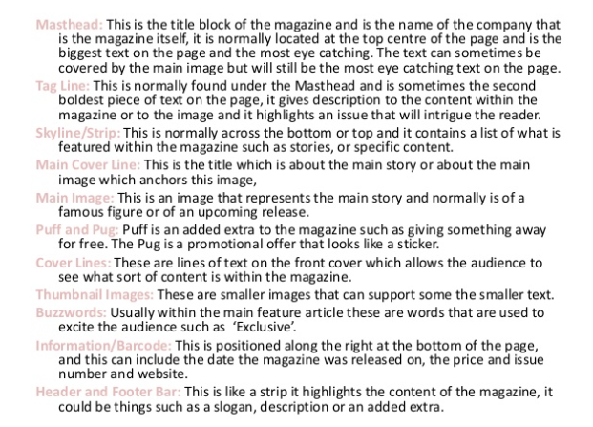
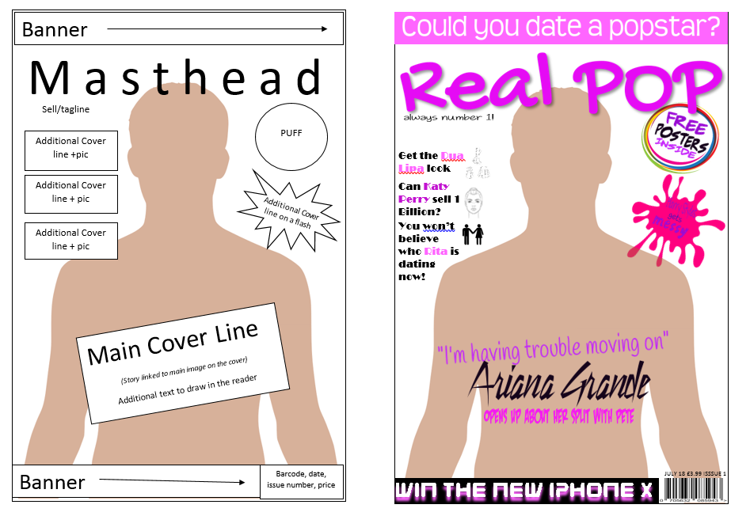
Front cover terminology
7
You will be asked to draw sketches of your ideas for both assessments in component 2 and the component 3 exam. Students achieving the higher grades will use the correct terminology in their writing. For you to do this you must memorise the terms below:

Slide 6
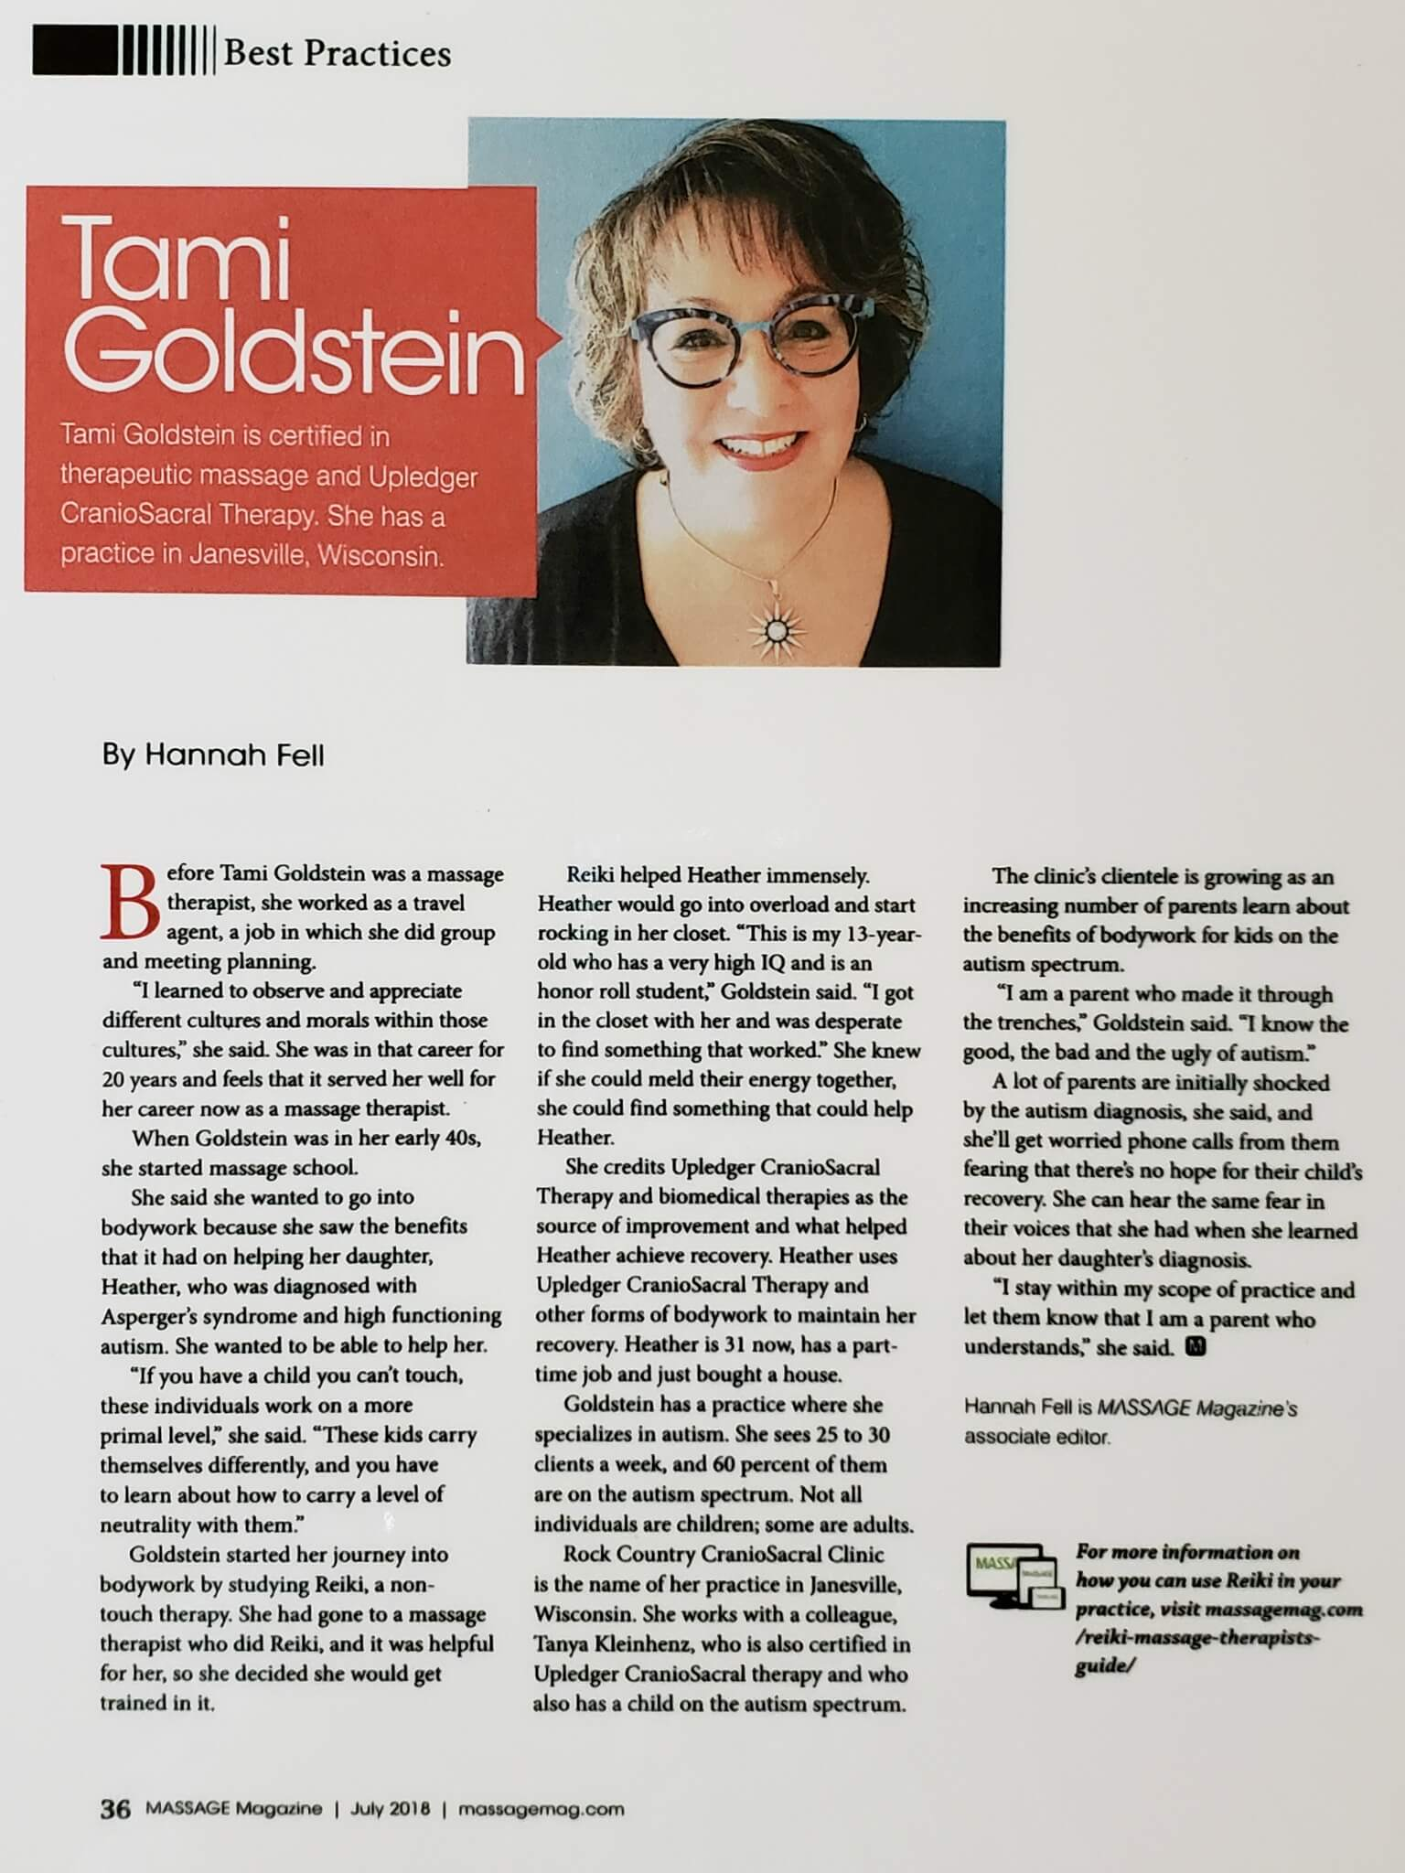
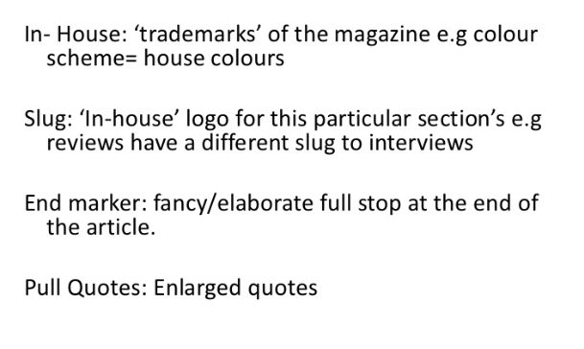
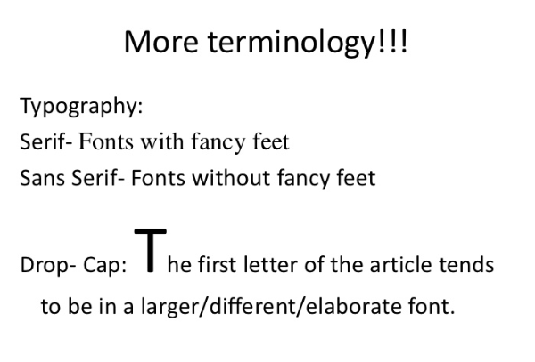
Inside page terminology
You will be asked to draw sketches of your ideas for both assessments in component 2 and the component 3 exam. Students achieving the higher grades will use the correct terminology in their writing. For you to do this you must memorise the terms below:
Running Head
Headline written in sans serif to give a contemporary look
One image dominates the page.
Kicker – text wrapped tight with the headline.
Byline
Drop Capital
Columns
Gutters
8
Page number, magazine title, date

Slide 7
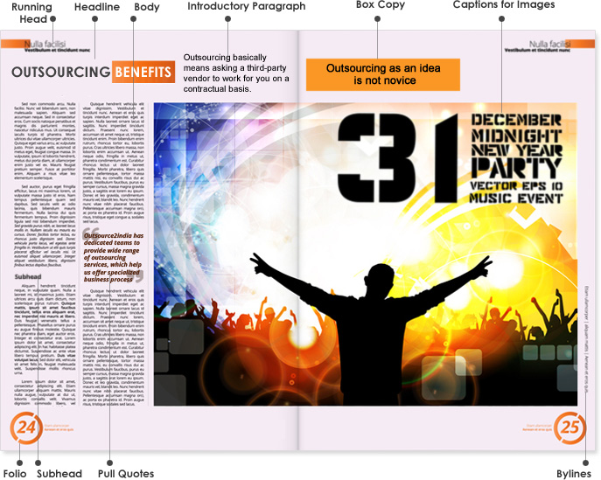
Inside Page Further Key Terminology
You will be asked to draw sketches of your ideas for both assessments in component 2 and the component 3 exam. Students achieving the higher grades will use the correct terminology in their writing. For you to do this you must memorise the terms below:
9

Slide 8
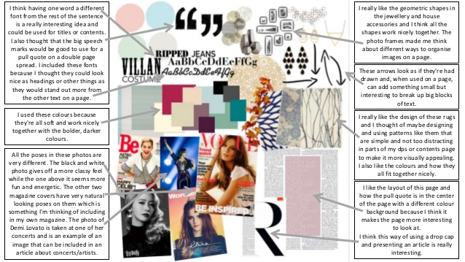
Moodboards
A mood board is a way for people to communicate ideas in a visual way. Moodboards can express an idea much faster than words. Using a mood board is a great way to show your vision. Memorise the key elements of a mood board below:
Mood boards contain:
Text ideas
Text styles
Sample colours
Sample images
Compositions of pages you like
Objects
10
Notes:
https://www.justinmind.com/blog/9-mood-board-examples-thatll-inspire-you-to-create-your-own/

Slide 9
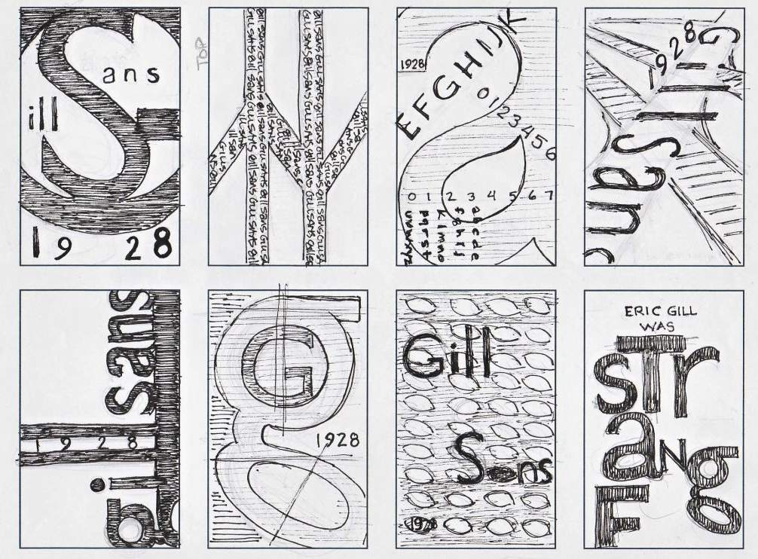
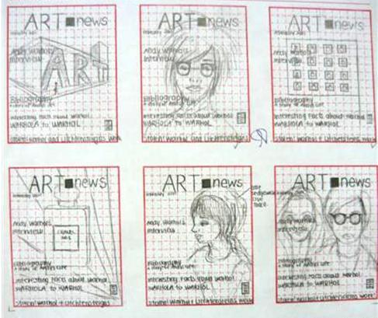
Thumbnails
Thumbnail sketches are drawing quick, abbreviated drawings. Usually, they are done very rapidly and with no corrections - you can use any medium, though pen or pencil is the most common. Thumbnails sketches are usually very small, often only an inch or two high. You will be asked to do them in component 2 and 3. Memorise the WAGOLL’s below:
11
Poster thumbnails
Magazine front cover thumbnails

Slide 10
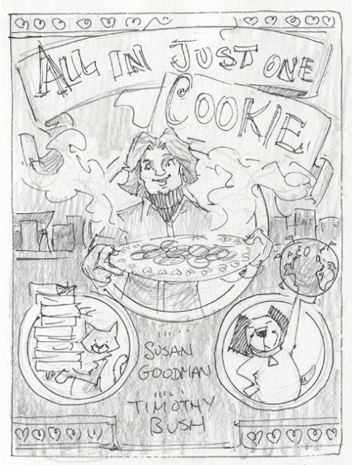
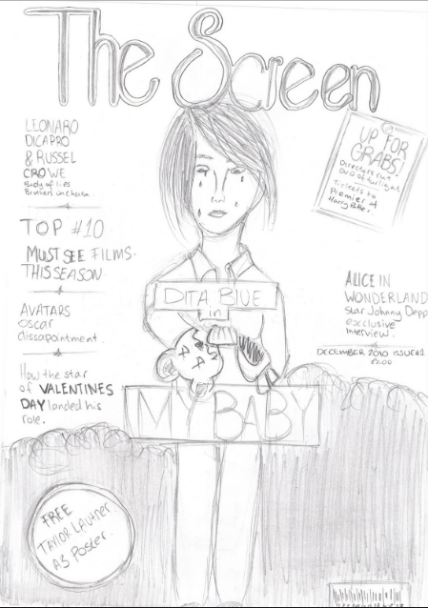
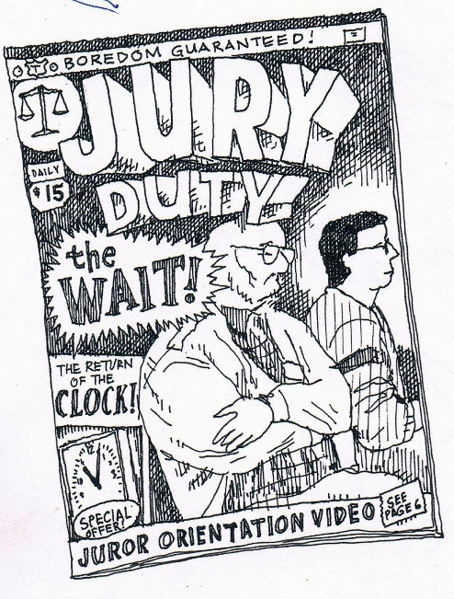
Sketch
A sketch is a large detailed drawing of the final idea. It is often accompanied with annotated notes regarding key design ideas such as colour and font choice, and how these meet the brief or engage the audience. You will be asked to do them in component 2 and 3. Memorise the WAGOLL’s below:
12
Book cover sketch
Magazine cover sketch
Comic book cover sketch

Slide 11
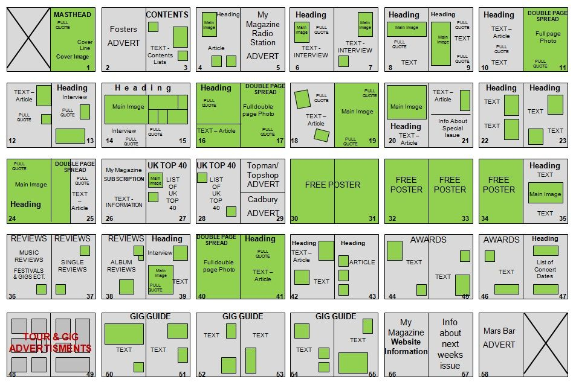
Flat Plan
The flatplan is a page plan of a publication that shows how the articles and adverts are laid out
You will be asked to do them in component 2. Memorise how to create a flat plan below:
A flatplan shows where all articles and adverts are laid out, and in what order. It allows complete control of the publication production process avoiding confusion.
Without a flatplan, the production director and advertisement director struggle to control which pages go where. This makes signing off a publication very difficult and time-consuming.
Flatplans started life drawn out on pieces of paper stuck to the wall of the production team. As pages moved around, and advertisements were booked (and cancelled) the pages were annotated and amended.
Nowadays, paper flatplans are being replaced by digital flatplans.
13

Slide 12

Writing and Editing Copy
14
Step 1 – Write the copy
The great distinction between content writing and copywriting lies in the purpose of writing it. Copywriting means writing for the sake of promotional advertising or marketing. The purpose of content writing is to entertain and entice the online audiences so they stay longer on websites and engage with the brand.
Step 2 - Copy editing
The tasks involved in copy editing include checking written material for grammar, spelling, style, and punctuation issues before it’s prepared for proofreading. A copy editor may also do a rewrite, if necessary, to fix any problems with transitions, wordiness, jargon, and to ensure the style of the piece fits with the publication. This work is known as revision.
Step 3 - Proofreading
When the material is nearly a finished product, meaning it has been edited, laid out, and designed, the proofreader searches for typographical errors. The proofreader works with a facsimile of a finished product, or a proof (hence the term proofreading). Proofreaders don’t suggest major changes to the text; rather, they look for minor text and formatting errors and confirm the material is ready for publication.
Memorise the 3 steps in writing and editing copy.

Slide 13
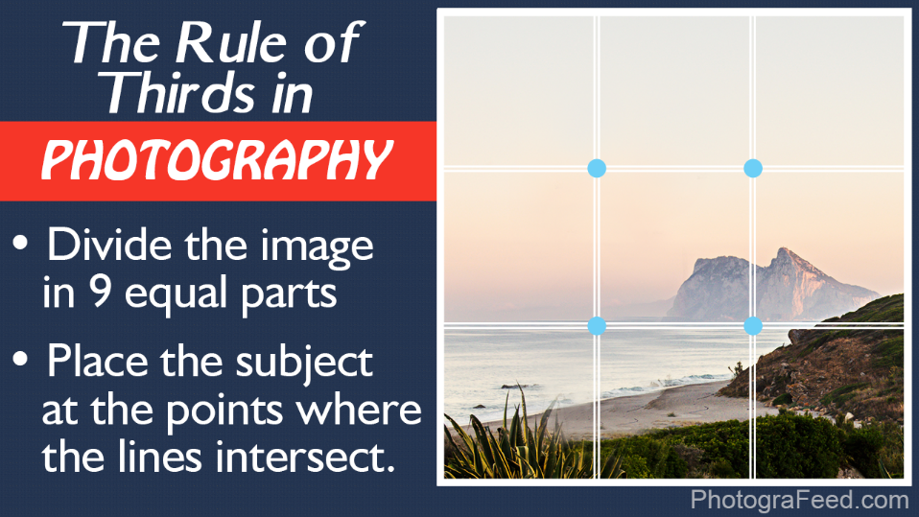
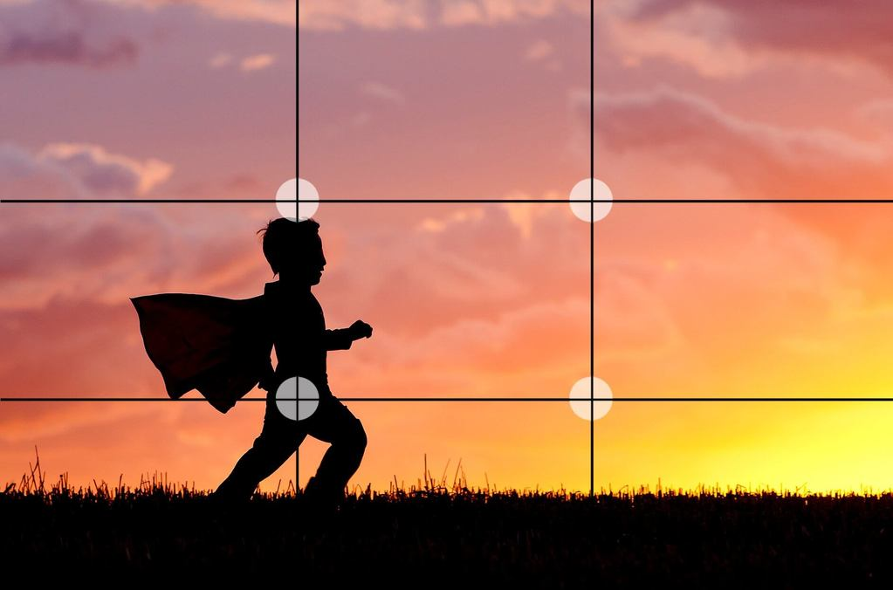
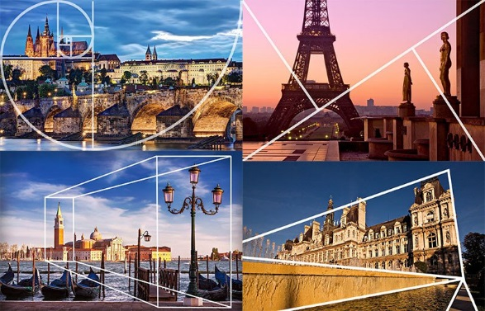
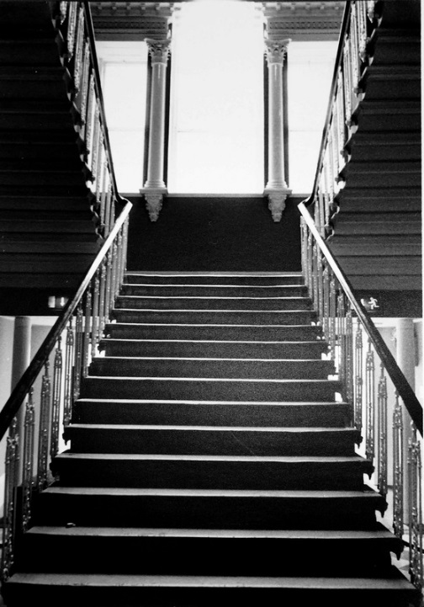


Photography Skills – Composition Techniques
Memorise the different image compositions.
Then practice them with a camera or your phone.
15
Central Composition
Symmetrical Composition
Golden Ratio Composition

Slide 14
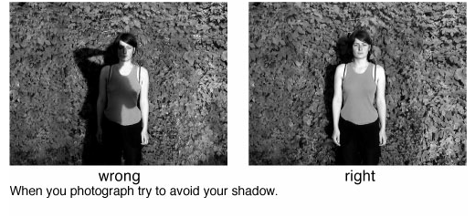
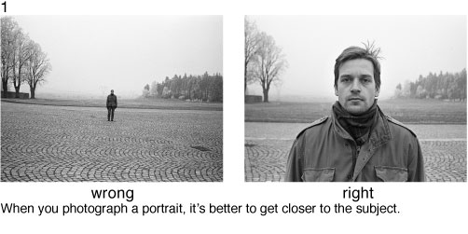
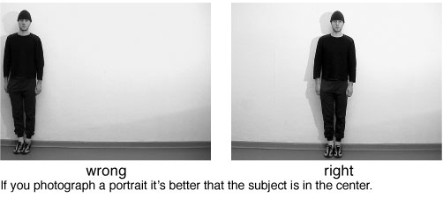
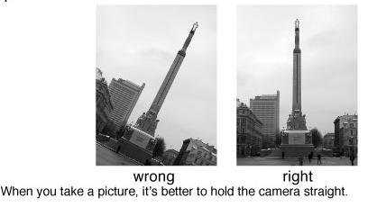
Photography Skills – Common Mistakes
Memorise the different mistakes that can be made so you don’t make them.
Then practice them with a camera or your phone.
16

Slide 15
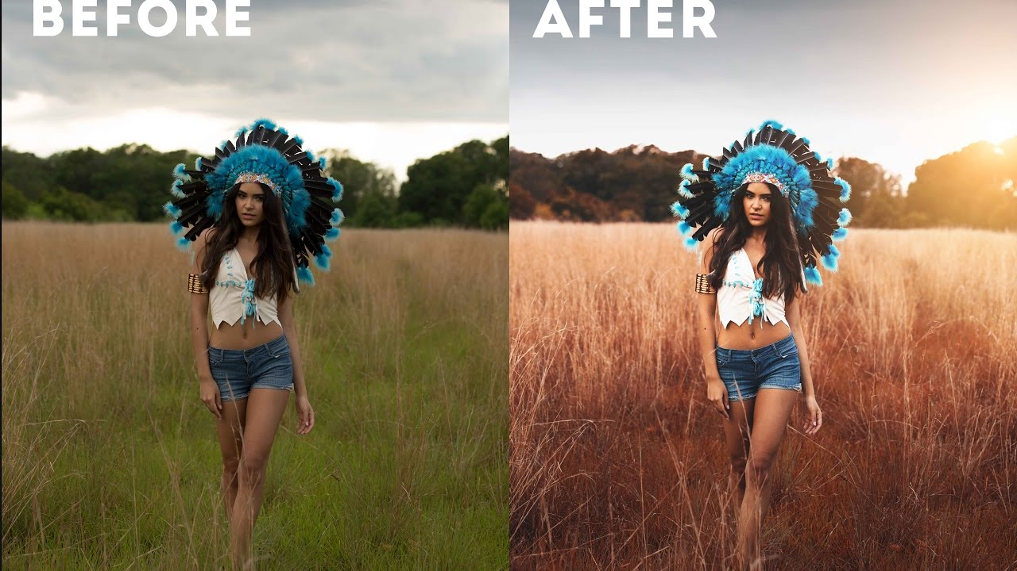
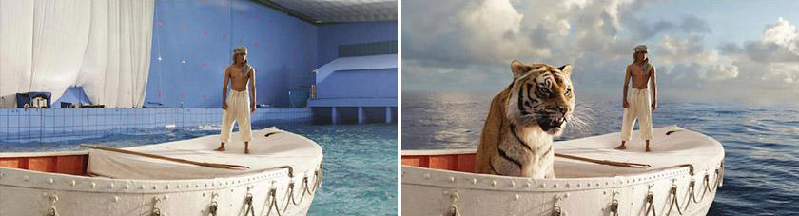
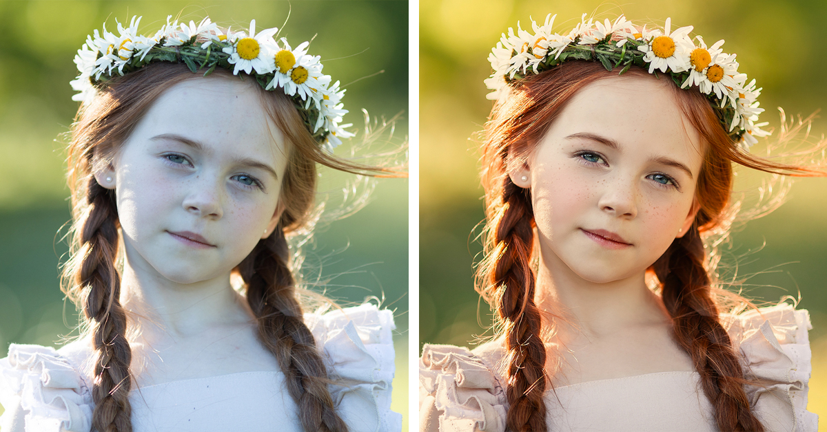
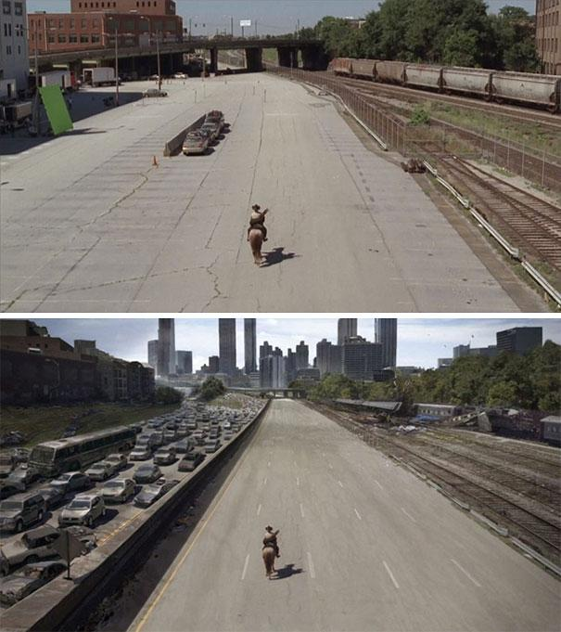
Image Manipulation Techniques
Most images used in publications have been edited in some way. You will need to practice editing images for component 2 and component 3.
You can practice at home using simple apps for your phone, even you phone gallery will have simple to old that you could use to edit an image. Spend some time practicing these techniques below:
17

Slide 16
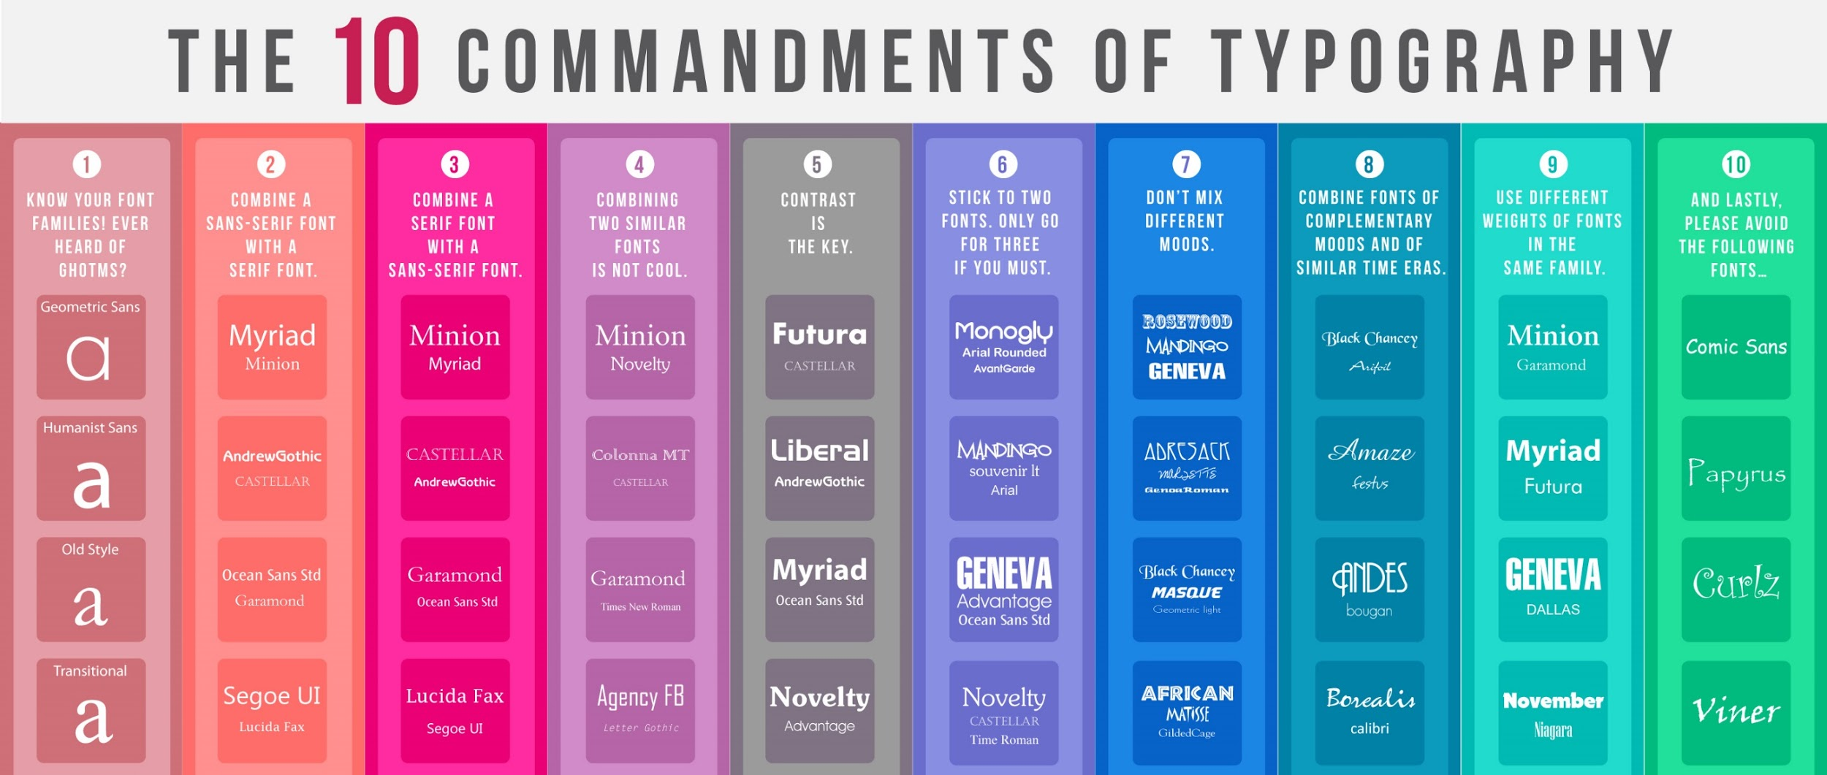
Typography
Typography is the art and technique of arranging type to make written language legible, readable, and appealing when displayed.
There are some rules around making sure your typography is effective. Memorise the ten rules below and ensure you follow them in your work.
18

Slide 17
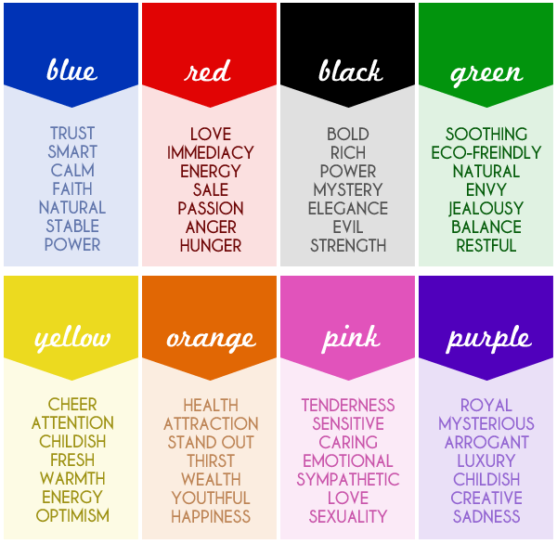

Use of Colour
Colour can be used to generate meaning. Some of the most popular meanings for colours are below. To make sure you refer to these in your assessments you must memorise them.
19

Slide 18
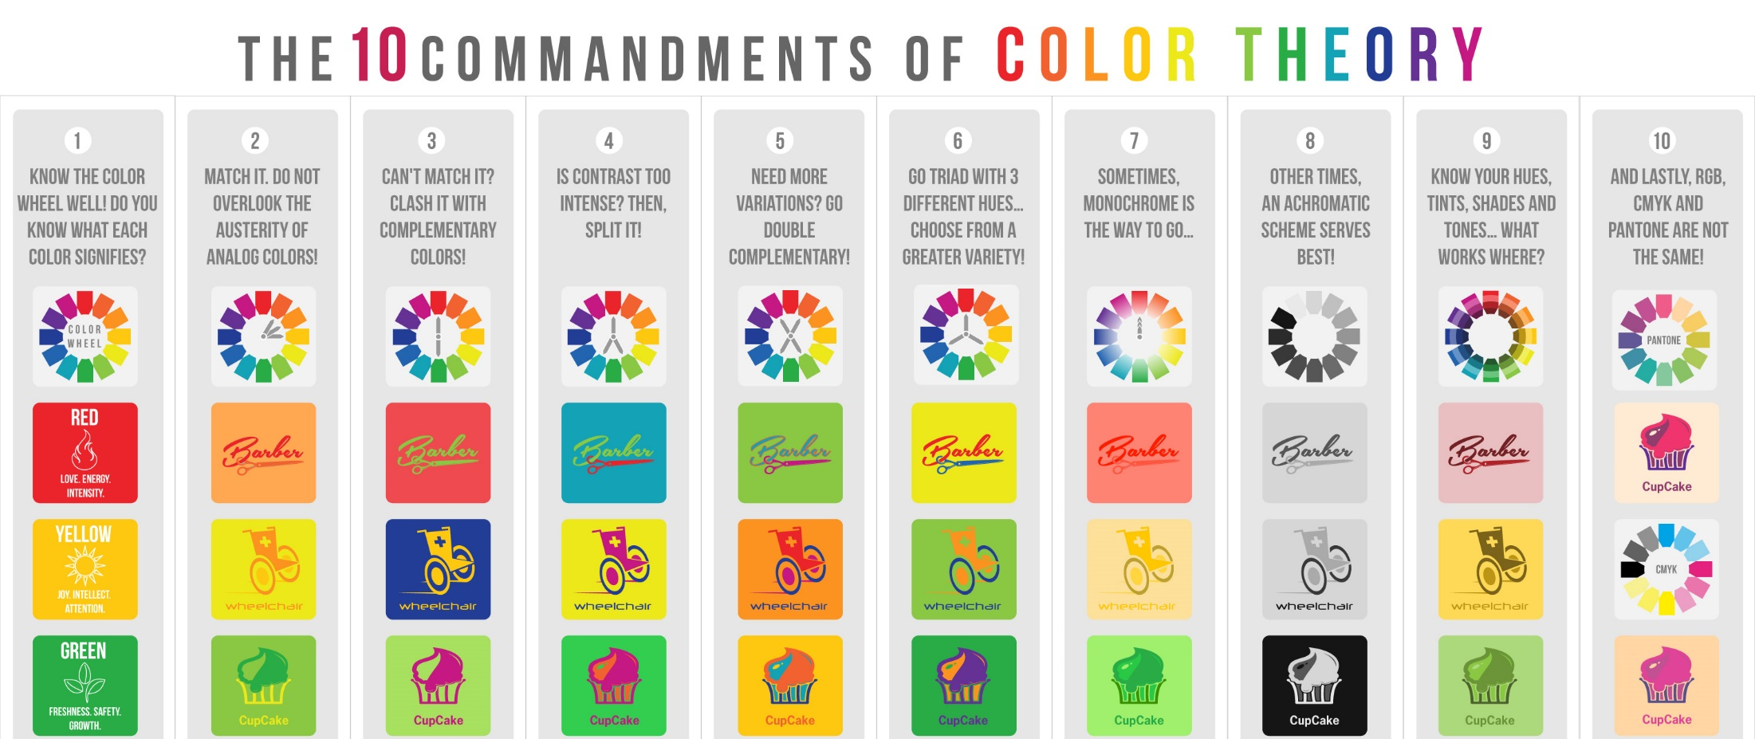
Colour Theory
Using colour effectively is a skill. There are a number of rules that most designers adhere to. In order to use these rules affectively in your work you must memorise them.
20

Slide 19
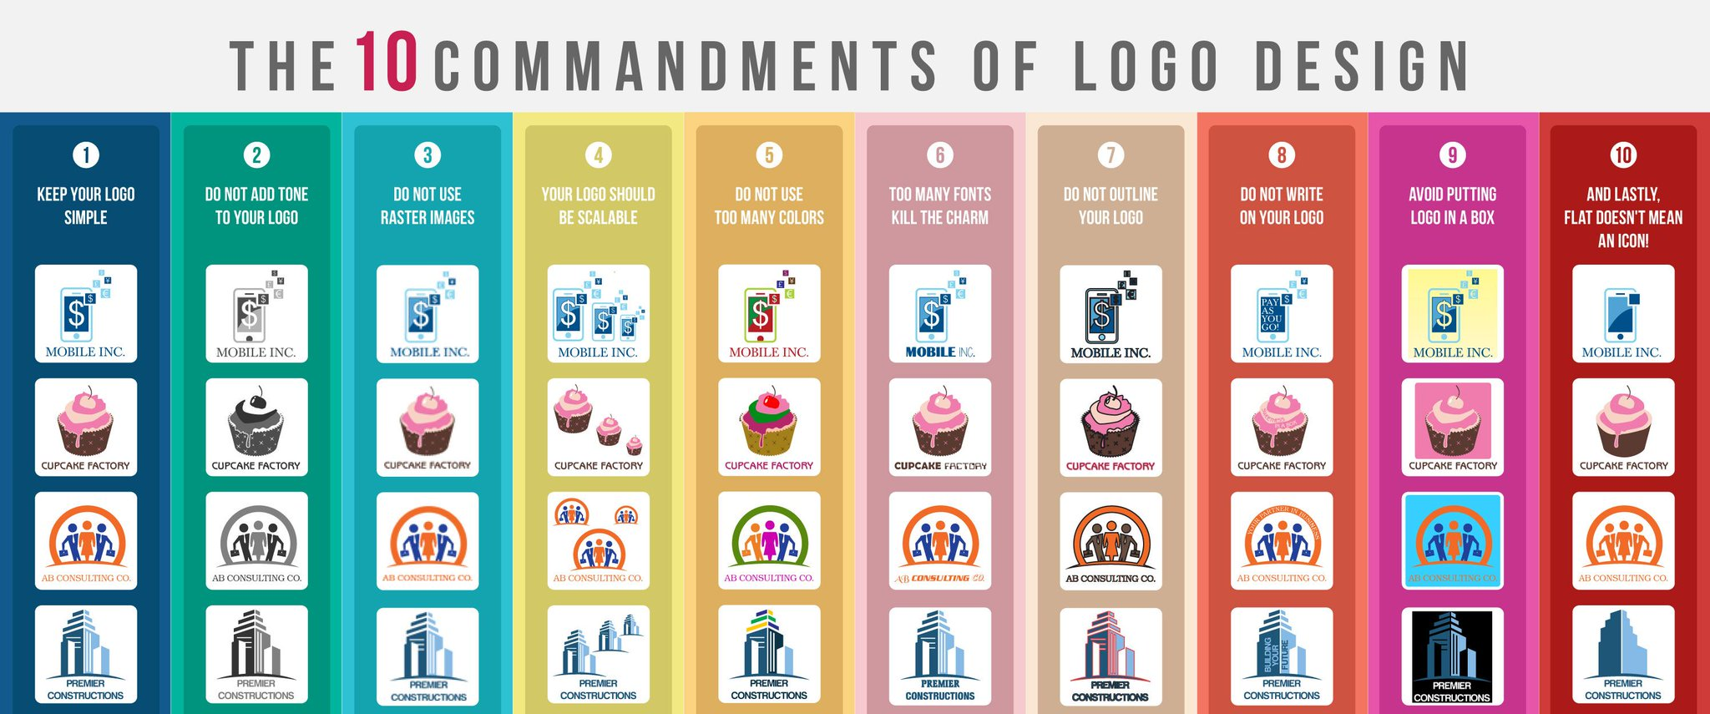
Logo Design
Creating an effective logo that gives a strong brand image is a skill. There are a number of rules that most designers adhere to. In order to use these rules affectively in your work you must memorise them.
21

Slide 20
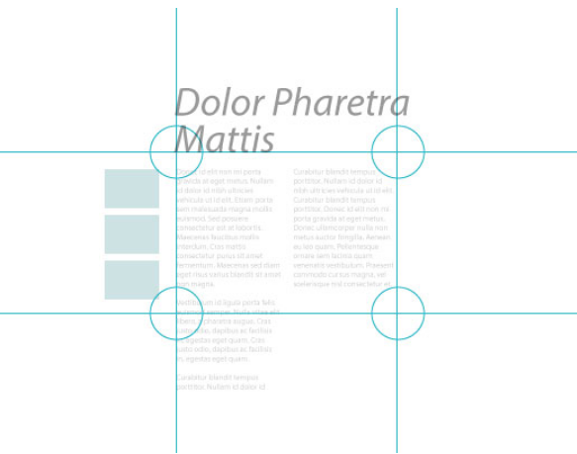
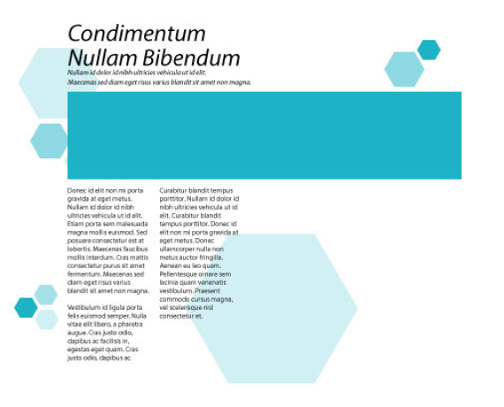
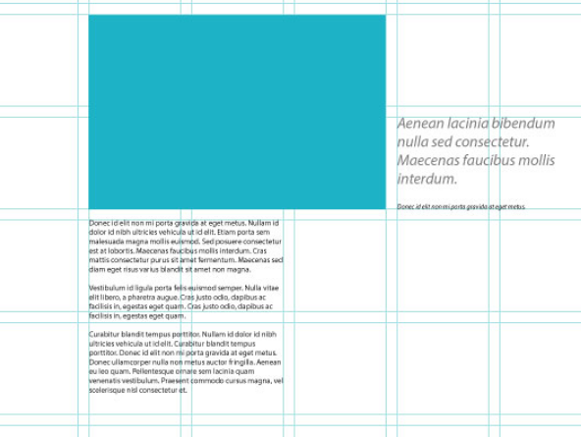
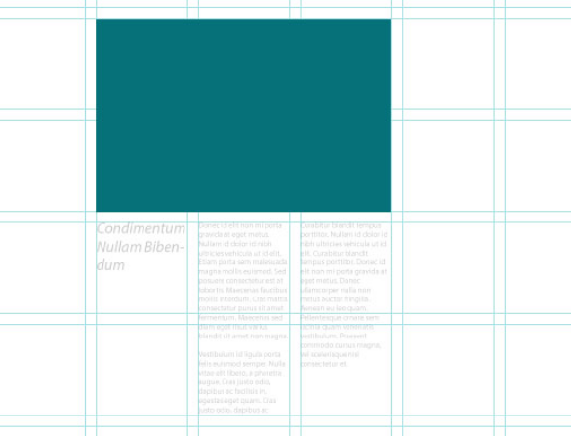
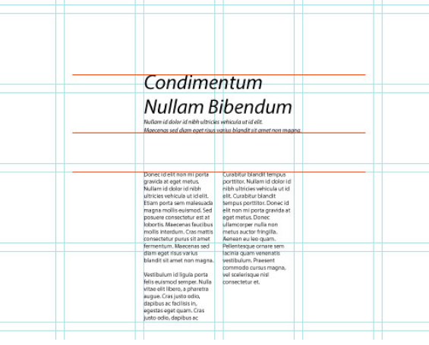
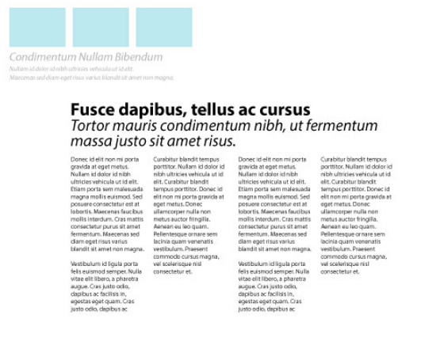
Page Layout
Page layout refers to where each item is positioned on the page. There are some common industry standards that most publishers adhere to. In order to ensure you follow these rules in your work you must memorise them bollow.
Use a grid – this will make sure everything is perfectly lined up.
The rule of thirds – placing the most important design elements on the points of the ‘third’ looks visually right.
Repeat design elements – these can be shapes of position of text and images.
Choose a singe focal point – this can be an image or a part of an image. Then place the other items around them.
Use of white space – don’t fill all the space up. Some space in between is good visually.
22
Use hierarchy – this means have something impart big, then make the least important things small.
Notes:
https://www.creativebloq.com/netmag/create-balanced-page-layouts-7-pro-tips-121310009

Slide 21

Magazine Front Cover Golden Tips
Most magazine front covers follow the same conventions. You must ensure that your work follows these conventions. Memorise the top tips below:
Do your research! What are the codes and conventions of a front cover for the genre you have chosen? Copy them.
Magazine name at the top and wide enough for the full width of the page.
Work with a grid to make sure everything lines up perfectly.
Decide on a focus point and build everything else around it.
Mix and match Serif and Sans Serif font styles for coverlines.
Emphasize powerful words
Choose a colour scheme for the fonts
Use direct mode of address
Avoid busy backgrounds
Dare to be bold! Be creative!
23
Notes:
https://design.tutsplus.com/articles/10-tips-for-designing-high-impact-magazines--cms-25956

Slide 22
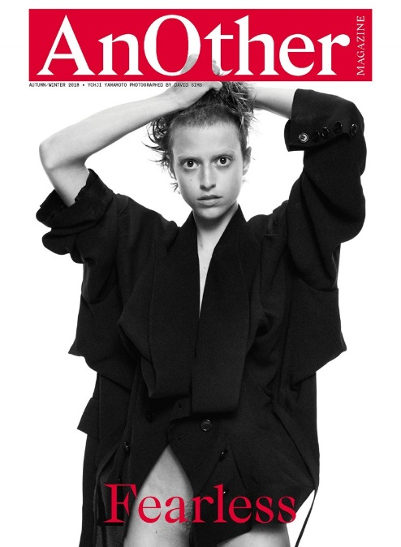
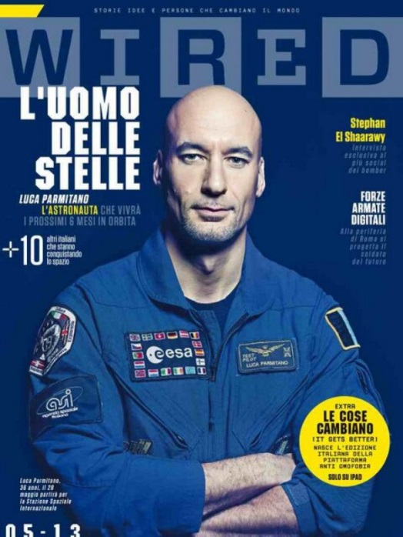

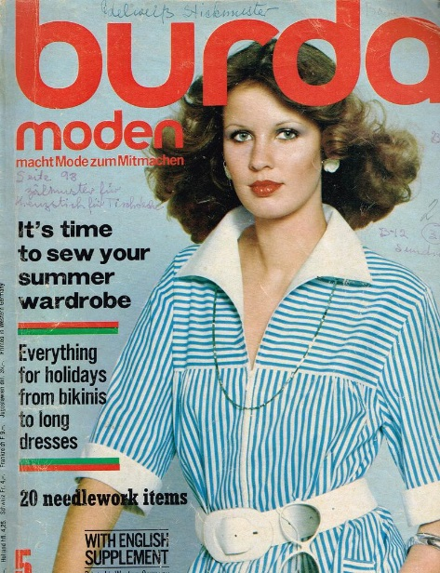
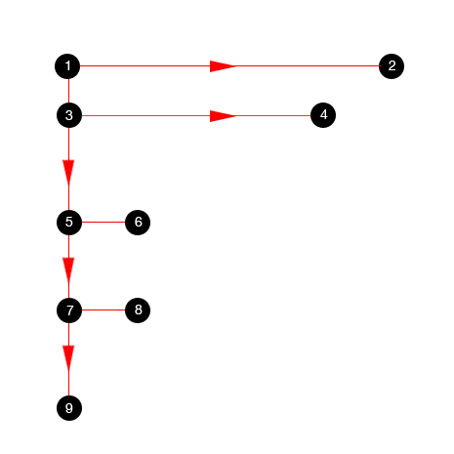
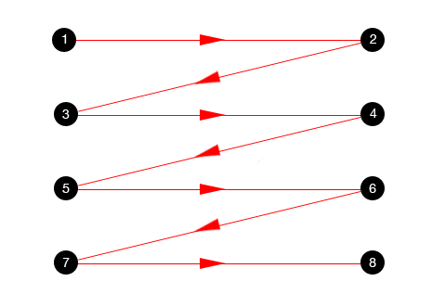
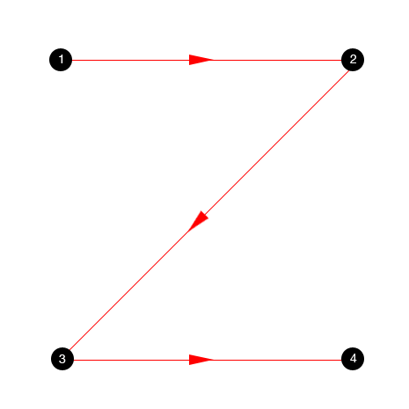
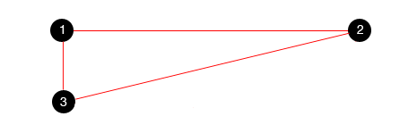
Magazine Front Cover Layouts
Several layout patterns are often recommended to take advantage of how people scan or read through a design. The human eye scans through a page in particular pattern. Depending on what part of the layout you want to draw attention to first, you must use one of the layouts below. Memorise them.
24
F Pattern
Golden triangle
Zig Zag pattern
Z pattern
Notes:
https://www.canva.com/learn/multi-page-layout/
https://vanseodesign.com/web-design/3-design-layouts/

Slide 23
Codes and Conventions
What do you expect to see/hear?
5
What are codes?
Codes are systems of signs, which create meaning. Codes can be divided into two categories – technical and symbolic. Technical codes are all the ways in which equipment is used to tell the story in a media text, for example the camera work in a film. Symbolic codes show what is beneath the surface of what we see. For example, a character's actions show you how the character is feeling.
What are conventions?
Conventions are the generally accepted ways of doing something. There are general conventions in any medium, such as the use of interviewee quotes in a print article, but conventions are also genre specific.
How codes and conventions apply in media studies
Codes and conventions are used together in any study of genre. It is a convention of the horror genre that side and back lighting is used to create mystery and suspense – an integral part of any horror movie.

