Slide 1
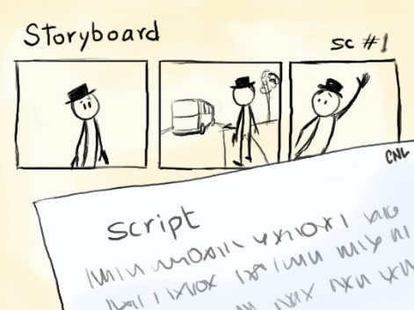
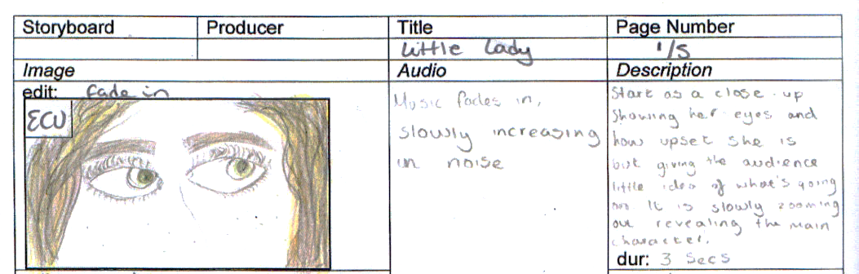
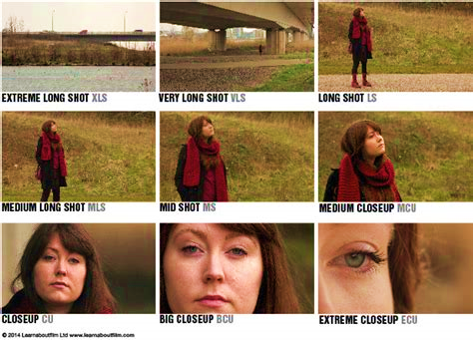
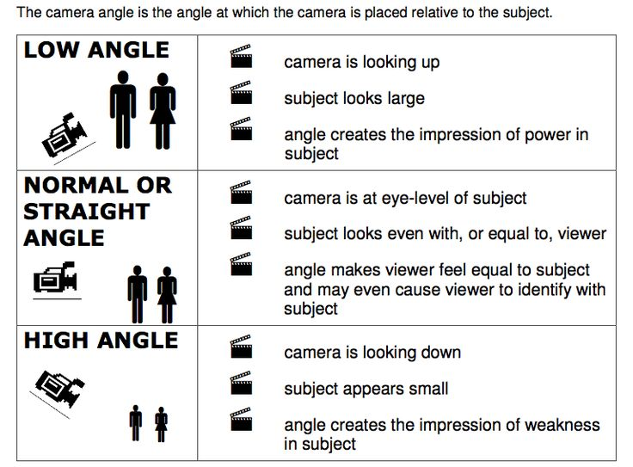
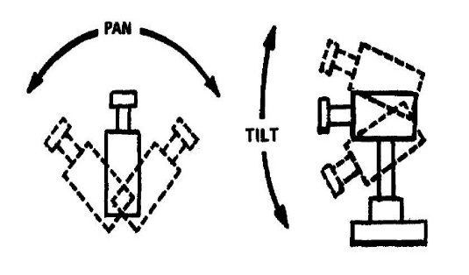
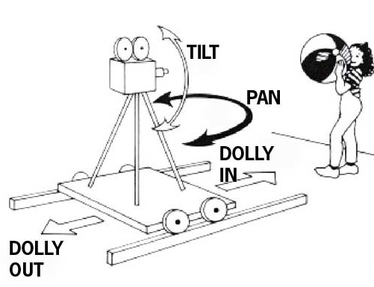
Component 2: DEVELOPING DIGITAL MEDIA PRE-PRODUCTION SKILLS
PRE-PRODUCTION
This is the planning stage for your film. It is everything which happens before filming begins.
STORYBOARDING
A storyboard is essential and should show shot type & duration, audio, dialogue, camera movement, text and any SFX.
.
SHOT ANGLES

Slide 2
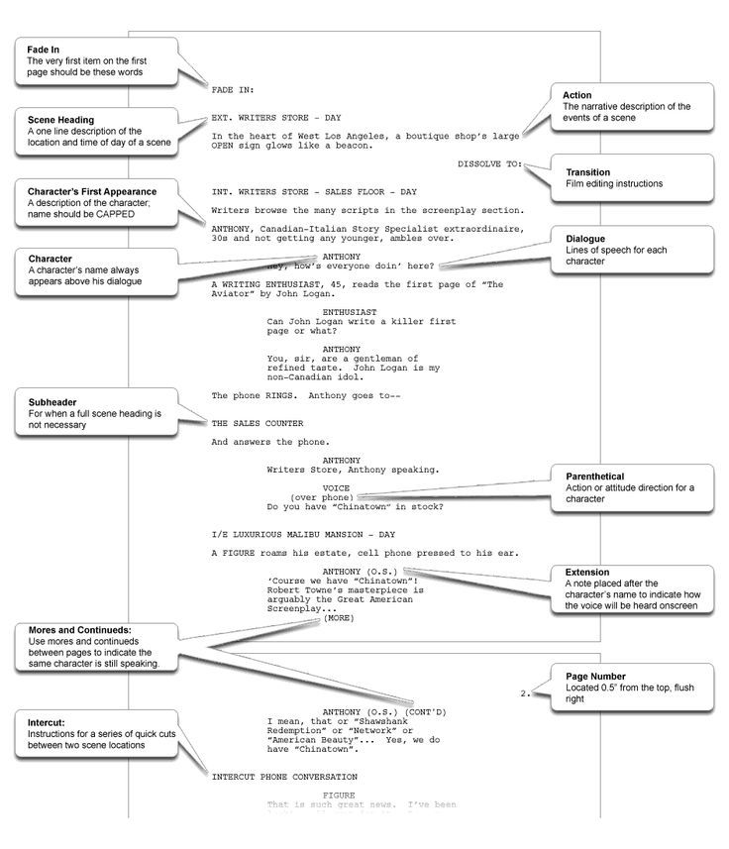
Writing a SCREENPLAY
Film TREATMENT
A treatment is a document outlining your idea and to sell your idea to a producer. It should include:
A working Title
Target Audience
Synopsis (who, where and when)
Research you have undertaken
More detailed breakdown of the plot into three ‘acts’ - Act 1 sets up the narrative by introducing the characters and situation - Act 2 the middle, progresses the situation, usually creating some kind of conflict for the characters - Act 3 the conclusion, how the conflict and narrative are resolved.
For each location you must undertake a RISK ASSESSMENT. This makes sure that the person responsible when on location has considered the safety of everyone involved in the filming from the contributor, the crew to the general public. Think through the filming day and consider what the potential hazards are, what injury could result from this hazard and how the risk can be reduced or avoided

Slide 3
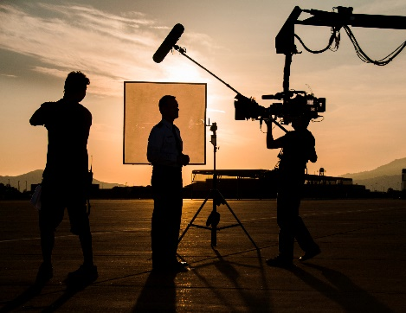
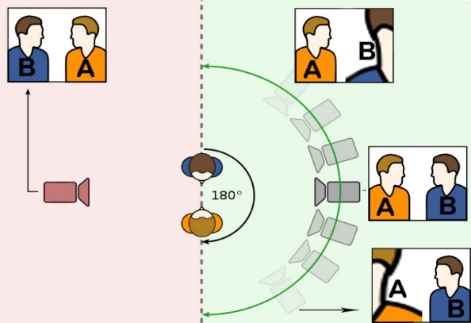
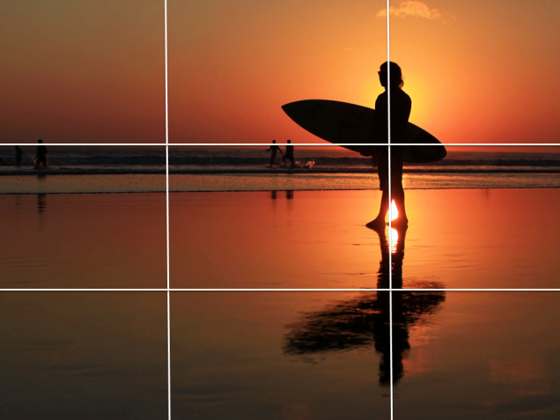
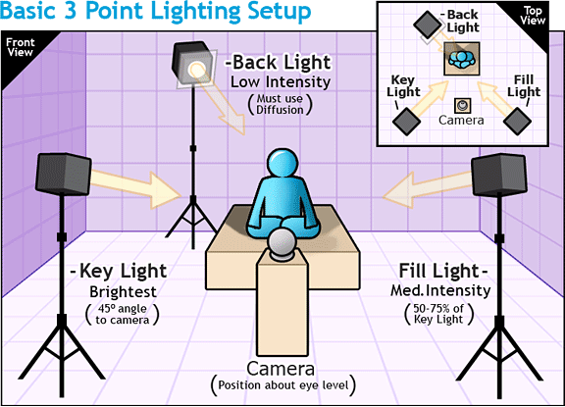
Component 2: DEVELOPING DIGITAL MEDIA PRODUCTION SKILLS
PRODUCTION
This is the stage where you will shoot your footage and record your audio for your moving image product.
180 DEGREE RULE
You need to remain on one side of the “Axis of Action” when filming – otherwise it will create the effect that actors have swapped places or moving objects have changed direction.
RULE OF THIRDS
You will create well composed footage if you use the “rule of thirds” – placing things on the lines or on the intersection of the lines will create well balanced shots.
.
LIGHTING
In the studio, one direct light can cause shadows. Use a multiple light set up and soft boxes to reduce this, unless harsh lighting is deliberate. When on location, never film in front of a window/the sun
TOP TIPS:
Film the scene from multiple perspectives
Use a tripod for stability

Slide 4
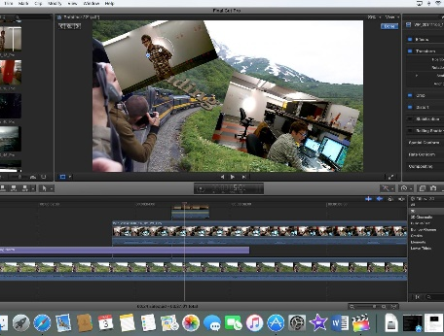
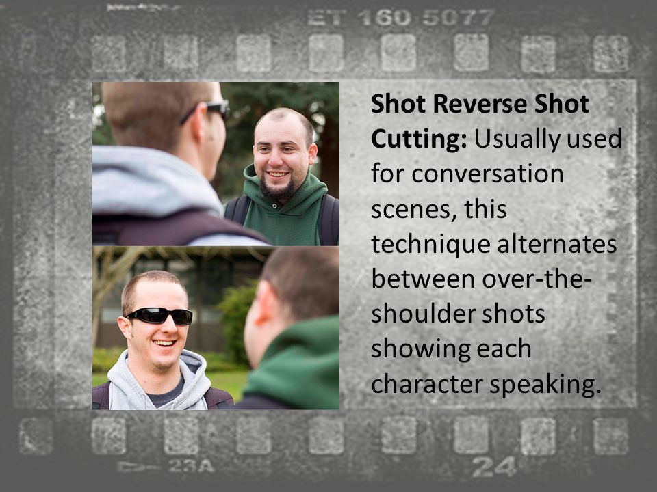
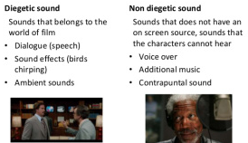
Component 2: DEVELOPING DIGITAL MEDIA PRODUCTION SKILLS
EDITING CONVERSATIONS
POST-PRODUCTION
This is the stage where you will edit your footage and add special effects, audio and titles.
EDITING TRANSITIONS
There are many different transitions available – but if you use anything other than a straight CUT, make sure you have a good reason for doing so. The common transitions are:
Cut: the most common transition Fade (usually to black): can be used to denote the end of a scene. A fade to black followed by a fade in shows the passage of time Cross-dissolve: a gradual fade from one shot to another to show a change in time/space Wipe: pushes off the screen – rarely used There are many others in Final Cut – explore them but use with care!
SOUND
In the edit you can add NON-DIEGETIC sound, and you can remove / edit DIEGETIC sound. There are many sites with copyright free sound effects and music online if you need to add these.
TOP TIP:
Film “cutaways” to help disguise
continuity errors in the edit

