Slide 1
Component 1b
BTEC Creative Media Production
Knowledge Organisers
1

Slide 2
Component 1b
Grade descriptors:
Level 2 Distinction
Level 2 Pass
Level 2 Merit
Describe how genre, narrative and representation and how production techniques are used to engage audiences, with reference to relevant examples of media products.
Analyse the relationship between genre,
narrative, representation and how production techniques are used to effectively create meaning and engage selected audiences, with reference to considered examples of media products.
Discuss the relationship between genre, narrative, representation and how production techniques are used to create meaning and engage audiences, with reference to appropriate examples of media products.
What the grade descriptors actually mean:
How does the specific elements of genre, narrative, representation and production techniques generate meaning (think) and engage the audience (feel)?
Give lots of examples.
Provide lots of reasons.
Compare the techniques. How are they similar? How are they different?
Choose products that are all linked in some way (E.g. all targeting the same gender, age, from the same franchise etc)
Cover ALL aspects of the genre, narrative, representation and production techniques in an ordered manner.
Interpret what the intended meaning of the techniques are using many examples and giving many reasons, and how this will change depending on who the audience is.
Constantly refer to how your products are linked giving reasons why different audiences responds to them in different ways.
Describe the genre (horror etc).
Describe the narrative (structure, storytelling devices, themes etc).
Describe the representation (stereotypes etc)
Descrieb the production techniques (lighting, camera angles etc).
At least two product from one sector.
Examples of sentence starters to achieve the grade descriptors:
A xxxx audience would take the meaning xxxx from this technique. However, a xxxxx would have this meaning….
Both product X and Y use the technique xxxx to engage the xxxx audience.
believe product X is better that product Y at targeting this audience because…
The least/most effective xxxx technique is…. Because….
The genre of the product is…because I can see the media producers have used the following iconography xxx in the product.
The POV xxxx was used in the product when….
(Identify and describe lots of genre, narrative, representation and production elements from your products)
The POV xxxx makes the audience think…because…
This will make the audience feel…because…
Both POV xxx and XXX are similar in how they engage the audience by….because…
However they are different in how they generate meaning when….because….
2

Slide 3
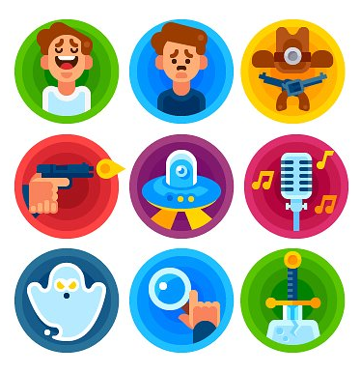
Component 1: Learning Aim B: GENRE, NARRATIVE, REPESENTATION & AUDIENCE INTERPRETATION
3
GENRE IS…
the word is used to describe a particular style which has certain characteristics or ‘Ingredients’, which we call genre CONVENTIONS
Conventions | Genre conventions are all the parts of the genre such as character similarities and repeated plots that allow us to distinguish between genres. Genres have elements that the audience expects as they have been used many times in previous films.
Actors | Certain types of characters stereotypically only act in the same genre of film for example Jenifer Aniston is usually only found in Romcoms, Jason Statham as a star would usually indicate an action film
Narrative | A films ‘story, or plot’ , for example boy meets girl would indicate romance, Heroes or Heroines vs Villains indicates Action
Setting or Location | A films setting can help us to tell a films genre, for example ‘western’ films are usually set in the America outback, a Scifi film will usually be set in space
Mise-en-scene | A French term meaning “put into the scene”, this includes costumes, hair, make-up, and props and can help us identify the genre.
Iconography | Icons that help us to identify the genre, for example icons of the Western genre includes ten gallon hats, spurs and horses, the action genre would include guns.
Technical Codes | Technical codes are aspects like camerawork, sound and lighting and these can indicate genre. For example the technical code of lighting is used in all genres but in horror, side and back lighting is used to create mystery and suspense.
SUB and HYBRID genres
Within most genres we can find sub genres, for example within Comedy we can find RomCom
A hybrid genre is a genre which blends themes and elements from two or more different genres, for example The Office is a documentary/comedy
GENRE: Repetition & Difference
Genres are instances of repetition and difference (Steve Neal). Mere repetition alone would not attract the audience
Products must conform to (repeat) enough of the genre’s conventions to be considered a part of that genre
Products must also subvert these conventions (difference) to be considered a unique product
This leads to genres changing over time – genres are therefore not static.

Slide 4
NARRATIVE: Todorov’s Theory
1. A state of equilibrium (all is as it should be)
2. A disruption of that order by an event
3. A recognition that the disorder has occurred
4. An attempt to repair the damage of the disruption
5. A return or restoration of a NEW equilibrium
Types of NARRATIVE Structure
linear, where the story is told in order and a new equilibrium arrived on at the end
non-linear, where events are told out of sequence
circular, where the story ends where it began – ie there has been no change to the equilibrium
interactive, where the audience can influence the narrative
open narratives, where there is no resolution by the end
closed narratives, where the story is resolved
single-strand, where the narrative follows just one storyline
multi-strand, where there are different interwoven stories
Audience RESPONSE
Preferred Reading – the audience respond to the product the way media producers want/expect them to without questioning – these are passive audiences
Negotiated Reading – the audience knows what the producer wants us to think, knows why that might be an untruthful representation, but forms an opinion which is a combination of both – these are active audiences
Oppositional Reading – the audience completely reject the product’s message
Propp’s CHARACTER Types
Hero – undertakes a journey or a quest
Villain – attempts to thwart or kill the hero
Donor – gives the hero advice or a useful object
Helper – a friend who helps the hero in their quest
Princess – motivation and reward for the quest
Dispatcher –sends the hero on their quest
False Hero – one who turns on the hero and is punished
Everything we see in the media is constructed – the people, places, issues and events we see are a re-presentation of reality. When analysing a media text you should consider:
What is being represented? To whom?
Is the representation positive or negative?
How might different audiences ‘read’ this representation?
4

Slide 5


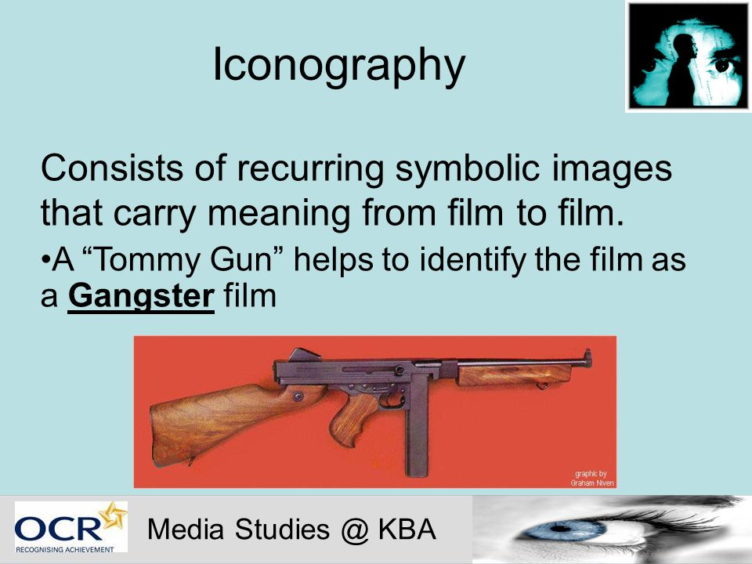









Genre
Main Film Genres: Listed below are some of the most common and identifiable film genre categories, with descriptions of each type or category.
5
Genre Iconography – What do you expect to see/hear?
What are codes?
Codes are systems of signs, which create meaning. Codes can be divided into two categories – technical and symbolic. Technical codes are all the ways in which equipment is used to tell the story in a media text, for example the camera work in a film. Symbolic codes show what is beneath the surface of what we see. For example, a character's actions show you how the character is feeling.
What are conventions?
Conventions are the generally accepted ways of doing something. There are general conventions in any medium, such as the use of interviewee quotes in a print article, but conventions are also genre specific.
How codes and conventions apply in media studies
Codes and conventions are used together in any study of genre. It is a convention of the horror genre that side and back lighting is used to create mystery and suspense – an integral part of any horror movie.

Slide 6
Storytelling Devices
6
Anagnorisis: See Discovery.
Narrator: Absent telling what is happening.
Nested Stories: Stories within stories.
Parable: Teaching story.
Peripeteia: See Reversal.
Plot Coupon: Item that is a plot substitute.
Plot Dump: See Exposition.
Point of View: First person, second and narrator.
Proairetic Code: Sequential events.
Prolepsis: See Flashforward.
Prologue: See Exposition.
Quibble: Wriggling out of an agreement.
Racconto: See Flashback.
Realization: The 'aha' moment.
Red Herring: Something that distracts from the final truth.
Reversal: Sudden change, for example of fortunes.
Science and Magic: Gets you out of a sticky situation.
Split: Breaking into separate story fragments.
Twist Ending: Unexpected end to the story.
Anagnorisis: See Discovery.
Analepsis: See Flashback.
Aside: Speaking to the audience.
Back Story: The context that gives the story sense.
Character Shield: Makes the character invulnerable.
Chekhov's Gun: Initially insignificant then important.
Cliffhanger: Ending with incomplete excitement.
Death trap: Machine that kills the hero slooowly.
Denouement: Completing the story, exposing the plot.
Deus Ex Machina: God in the machine. Magical action.
Diegesis: See Narrator.
Discovery: Revelation that changes story.
Dream Sequence: Separated fragment that explains.
Eucatastrophe: See Twist ending.
Exposition: Explaining other parts of story.
Fable: Teaching story with animal characters.
Flashback: Narration of earlier events.
Story devices and techniques are 'tricks of the trade' that authors use to make their story work effectively. Here is an alphabetic list of all devices in this collection.
Flashforward: Narration of future events.
Flashing Arrow: Indicator of important item.
Fold: Changing direction mid-stream.
Foreshadowing: Hints about what is to come.
Hermeneutic Code: Engaging unanswered question.
Info Dump: See Exposition.
In Medias Res: Starting the story in the middle.
Interrupted Routine: Adding confusion to the familiar.
MacGuffin: Initially important but then not.
Mimesis: See Narrator.
Monologue: Extended speech by character.
Narrative Hook: Opening excitement that captures attention.
Narrator: Absent telling what is happening.
Notes:
http://changingminds.org/disciplines/storytelling/devices/devices_all.ht

Slide 7
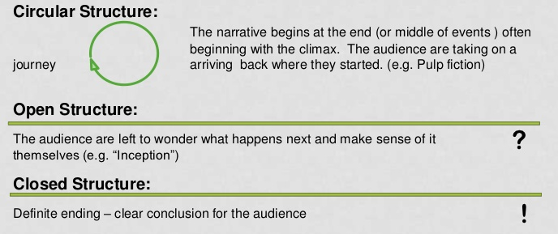
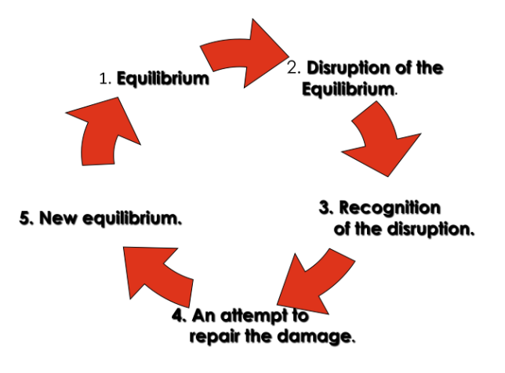
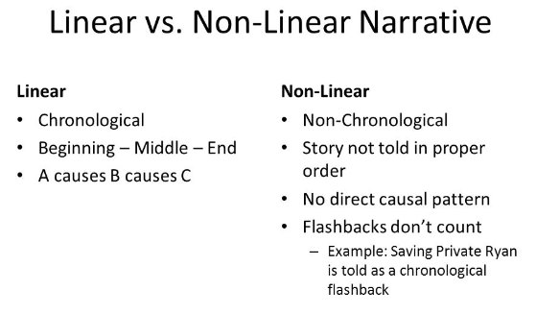
Narrative Structures
Todorov's Narrative Theory: Todorov produced a theory which he believed to be able to be applied to any film. He believed that all films followed the same narrative pattern. They all went through stages called the equilibrium, disequilibrium, acknowledgement, solving and again equilibrium﻿.
Interactive Structure don’t follow a set path. The ending or even the whole product is decided by the audience. E.g playing a computer game.
Single Strand Structure only follows one storyline. E.g. The film Toy Story.
Multi Strand Narrative multiple threads/storylines that often cross over and combine. E.g. Coronation Street.
7
Notes:
https://www.slideshare.net/Alan_Hook/interactive-narrative-jason-rohrer-and-the-authorial-role

Slide 8
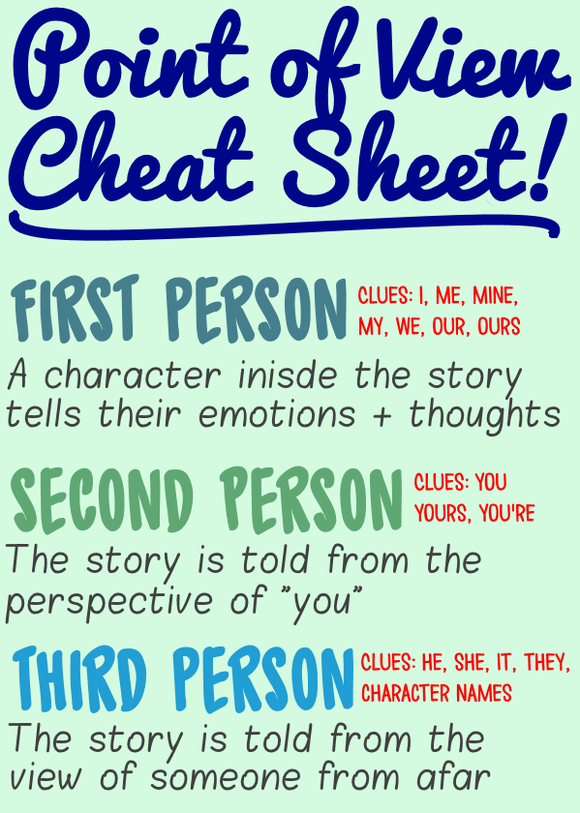

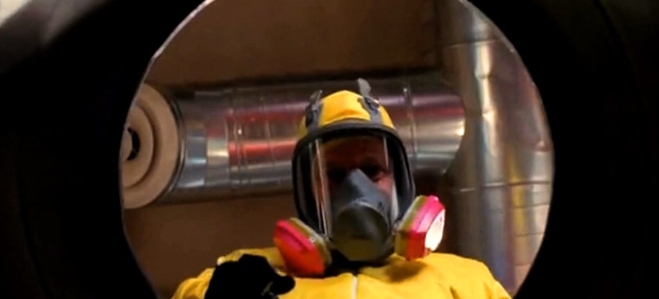

Point of View
Examples of Point of View. Point of view refers to who is telling or narrating a story. A story can be told in three different ways: first person, second person, and third person. Writers use point of view to express the personal emotions of either themselves or their characters. POV can be expressed in moving images through camera angles.
Literal First person point of view
Main POV shot:
Literal 1st person POV
Quasi 1st person POV
Can often be combined with:
Eyeball shot POV
Reaction shot POV
Telescope shot POV
Camera shot POV
Gunsight shot POV
Robot shot POV
Reading shot POV
Obstructed keyhole shot POV
Upside down shot POV
Moving POV
Binocular POV
Snap zoom
Inanimate object point of view
Hidden monster point of view
Engages the audience in the following ways:
Empathy
Movement
Humour
8
Notes:
https://www.premiumbeat.com/blog/power-point-view-pov-shots/

Slide 9
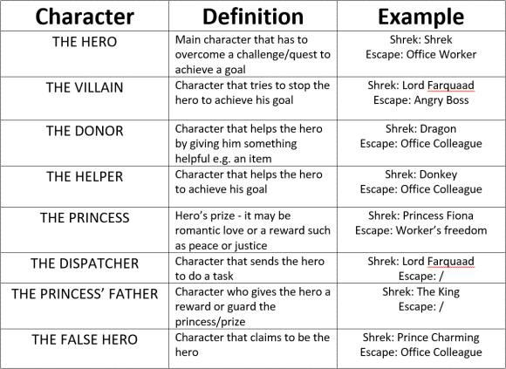
Characterisation - PROPP
Vladimir Propp was a folklorist researcher interested in the relationship between characters and rrative
Propp argued that stories are character driven and that plots develop from the decisions and actions of characters and how they function in a story.
He claimed characters could be classified into certain roles that progress a story.
9
Notes:
https://www.bbc.co.uk/bitesize/guides/zgydhv4/revision/1

Slide 10
Themes
10
Movies
Movies generally have one or two themes, but not many more. Themes are the human connection between the film and the audience. A story about an affair has the theme of ‘betrayal’ for example. The themes in movies are often said outright instead of hinted at. Some of the popular themes from movies today include:
Family
Fate
Fear
Feminism
Freedom
Friendship
Future
Loyalty
Man vs nature
Man vs man
Man vs self
Man vs machine
Mankind
Maturity
Medicine
Mercy
Morality
Nationalism
Nature
Necessity
Optimism
Neglect
Normality
Opportunity
Optimism
Overcoming
Death
Dedication
Democracy
Desire to escape
Despair
Disillusionment
Abuse of power
Arrogance
Art
Autonomy
Beating the odds
Beauty
Beliefs
Betrayal
Bible
Bravery
Celebration
Tolerance
Travel
Trust
Truth
Universe
Unselfishness
Valor
Vices
Violence
Virtue
War
Waste
Wealth
Wisdom
Willpower
Winning/losing
Xenophobia
Youth
God
Good vs Evil
Government
Greed
Growing Up
Happiness
Hate
Heritage
Hero
Heroism
Hope
Humor
Human Nature
Identity
Ideology
Ignorance
Illusion of power
Individuality
Inner peace
Effects from the past
Empowerment
Everlasting love
Facing reality
Failure
Resistance
Reunion
Revolution
Revenge
Sanity
Secrecy
Segregation
Self-awareness
Self-discipline
Simplicity
Society
Social Construct
Solitude
Soul
Suicide
Survival
Technology
Temptation
Passion
Patience
Patriotism
Peace
Perfection
Peer pressure
Perseverance
Power/corruption
Prejudice
Pride
Progress
Purpose
Quests
Race
Reality
Redemption
Regret
Religion
Innocence
Isolation
Jealousy
Justice
Kindness
Knowledge
Law
Leadership
Liberty
Life
Logic
Losing hope
Loss of innocence
Lost love
Love and sacrifice
Chance
Change
Chaos and order
Children
Circle of life
Coming of age
Common sense
Conservation
Conspiracy
Creation
Crime
Courage
Darkness and lightness

Slide 11
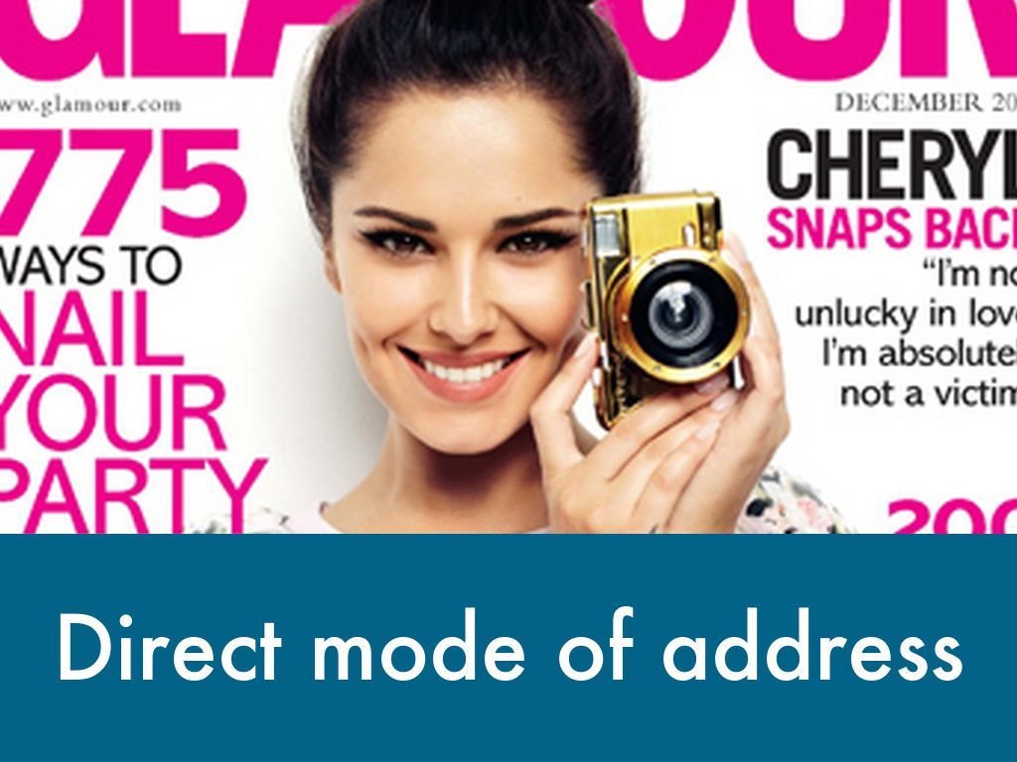
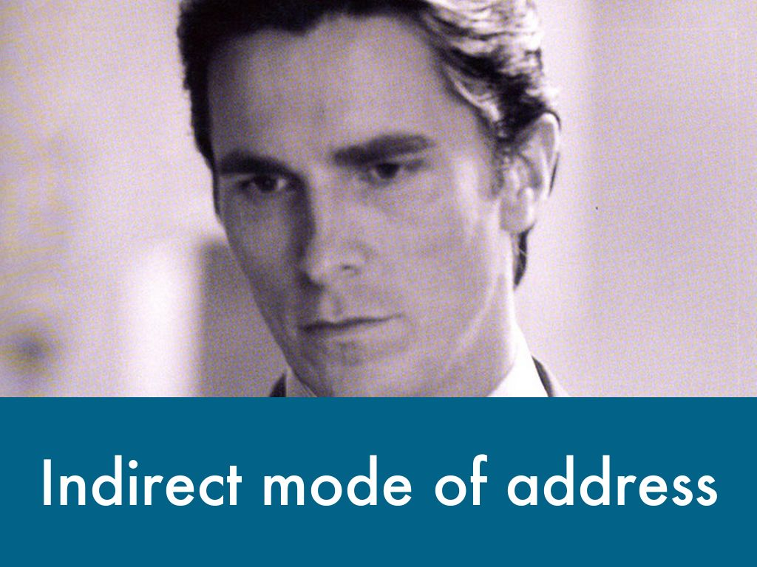
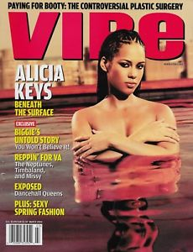
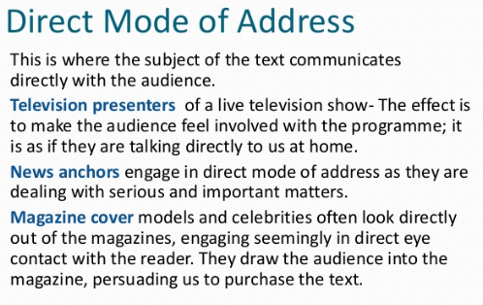
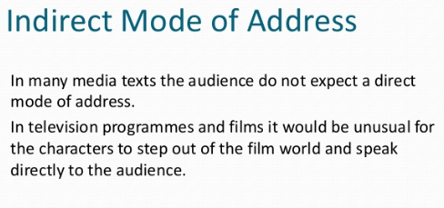
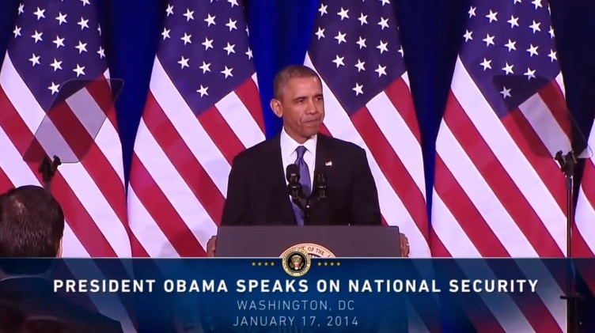
Mode of Address
Informal Mode of Address
Use of slang language, personal pronouns
11
Formal Mode of Address
Complex vocabulary, sophisticated style

Slide 12

Representation
In print based media texts representation is constructed using:
Layout and Design
Language and Mode of Address
Camera shots and angles in any photographs
Visual codes
In this poster for the film Brooklyn, there are representations of gender, place and the past.
The style of font used (design) along with the costumes worn by the three characters (visual codes), and the colours used reflect the 1950s when the film is set. Taken together, the colours and images are soft and warm, and represent the past in a nostalgic way; this is a romantic, idealised representation of the past (mode of address).
Gender is represented by the positioning of the three characters (layout): the main character Eilis (Saoirse Ronan) is in the middle of the poster and shown from a low angle (camera shots), and she looks directly ahead of her, over the heads of anyone looking at the poster.
These elements combine to represent her as a strong, confident female who is at the centre of this story.
The layout also emphasises that the story has two sides which is represented by the two men pictured and the images behind them.
The left hand side of the poster features a picture of Jim (Domnhall Gleeson): he is pictured against the rugged Irish coast and is looking down and to the left (visual codes). In this way, he represents Eilis's past in Ireland.
The right hand side features Tony (Emory Cohen), Eilis’ love interest in America, and he is looking up and to the right. He is pictured against the towering Brooklyn Bridge - this represents Eilis' life in Amercia and maybe her future as well.
The tag line at the top of the poster - ‘Two countries, two loves, one heart’ - anchors (anchorage) the images and gives the audience an idea of what the film is representing: romantic love.
Anchorage
12

Slide 13
Stereotype Classifications
The definition of a stereotype is any commonly known public belief about a certain social group or a type of individual. Stereotypes are often confused with prejudices, because, like prejudices, a stereotype is based on a prior assumption. Stereotypes are often created about people of specific cultures or races.
Almost every culture or race has a stereotype. Stereotypes are not just cantered on different races and backgrounds, however. Gender stereotypes also exist. For example, if you say that men are better than women, you're stereotyping all men and all women. If you say that all women like to cook, you are stereotyping women.
Why Is it Bad to Stereotype?
Stereotyping is not only hurtful, it is also wrong. Even if the stereotype is correct in some cases, constantly putting someone down based on your preconceived perceptions will not encourage them to succeed.
Stereotyping can lead to bullying form a young age. Stereotyping is encouraging bullying behaviour that children carry into adulthood. Stereotyping can also lead people to live lives driven by hate, and can cause the victims of those stereotypes to be driven by fear. For example, many gays and lesbians are afraid to admit their sexuality in fear of being judged. It is a lose-lose situation, both for those who are doing the stereotype and those who are victims.
Types of stereotypes:
Racial profiling
Gender profiling
Cultures
Groups of individuals (e.g. disabled)
Sexual stereotypes
13

Slide 14
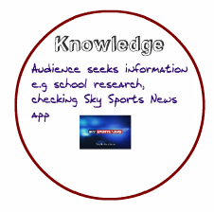
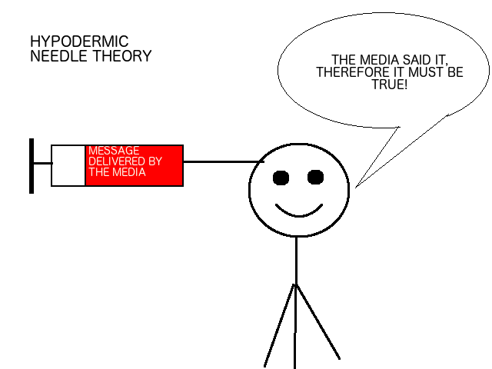
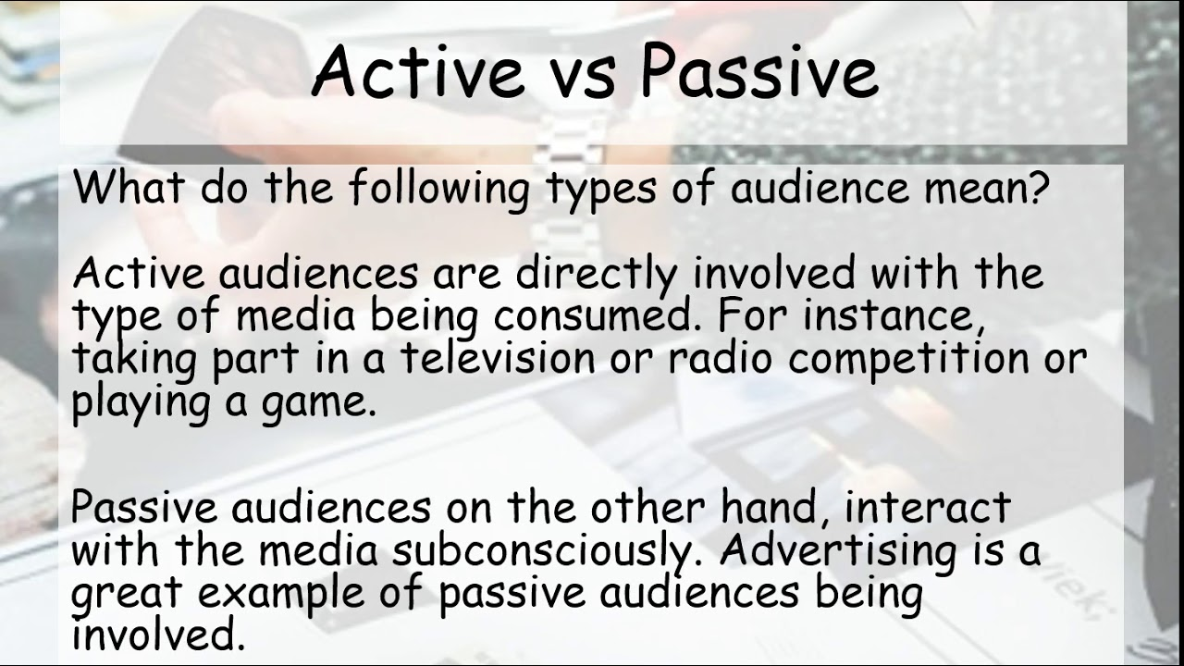

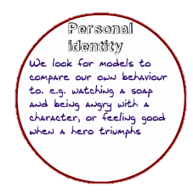



Passive and Active Audiences
Hypodermic
Needle
Theory
Message delivered
by the media
14
Uses and
Gratification
Theory

Slide 15

Preferred Reading
Reception theory explains that media texts are encoded and decoded. The producer encodes messages and into their media product which are then decoded by the audience. However, different audience members will decode the media in different ways and possibly not in the way the producer originally intended.
Stuart Hall states that audience members adopt one of the following three positions when they decode the text:
Dominant, or Preferred Reading - how the producer wants the audience to view the media text. Audience members will take this position if the messages are clear and if the audience member is the same age and culture; if it has an easy to follow narrative and if it deals with themes that are relevant to the audience.
Oppositional Reading - when the audience rejects the preferred reading, and creates their own meaning for the text. This can happen if the media contains controversial themes that the audience member disagrees with. It can also happen when the media has a complex narrative structure perhaps not dealing with themes in modern society. Oppositional reading can also occur if the audience member has different beliefs or is of a different age or a different culture.
Negotiated Reading - a compromise between the dominant and oppositional readings, where the audience accepts parts of the producer's views, but has their own views on parts as well. This can occur if there is a combination of some of the above e.g. audience member likes the media, is of the same age as you and understands some of the messages, but the narrative is complex and this inhibits full understanding.
15
Notes:
https://revisionworld.com/a2-level-level-revision/media-studies-level-revision/reception-theory
https://www.communicationtheory.org/reception-theory/

Slide 16
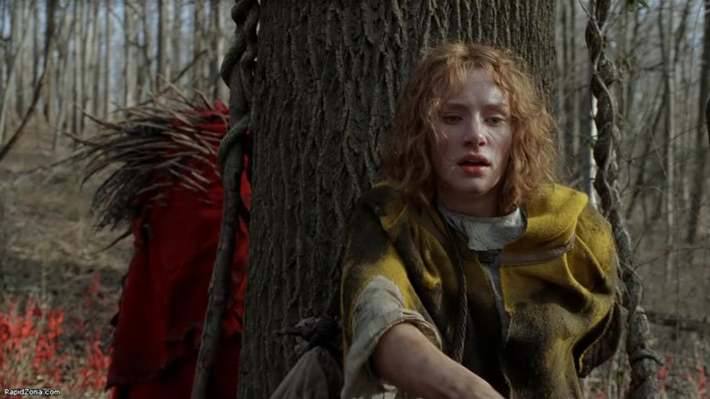
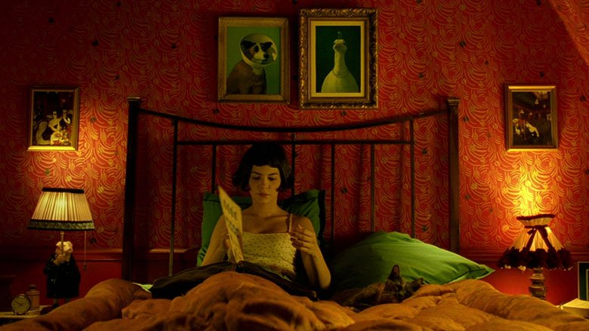
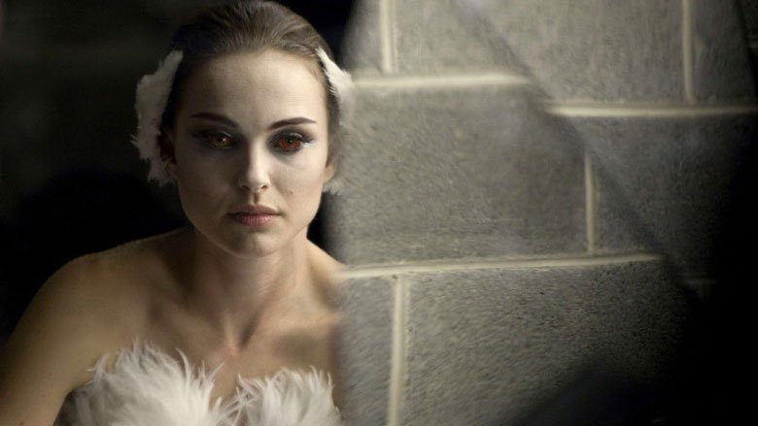
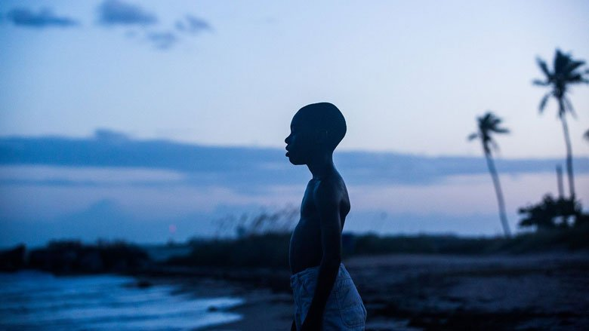
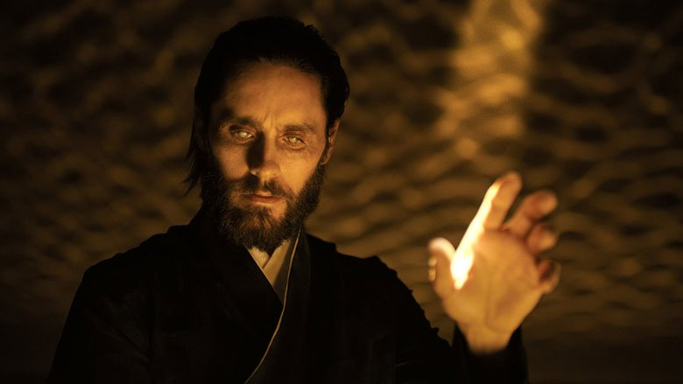
Mise en Scene
“Everything in the frame can carry meaning.”
Mise en scène – literally “placing on stage” in French. To explain it simply, mise en scène refers to what we see onscreen in a film. It’s the film’s visuals; meaning, all of the elements that appear on camera and their arrangement. Mise en Scene generates huge meaning for the audience. Often filling in gaps in knowledge.
Characters
Decor
Costumes/Makeup
When we talk about “depth of space”, we’re talking about the depth of the image onscreen. Depth is determined by the distances between objects, people, and scenery, influenced by their placement along with camera location and lens choice.
Depth of space
16
Setting
Lighting
Notes:
https://www.lightsfilmschool.com/blog/mise-en-scene-in-film-afk

Slide 17
Setting
Setting is an important literary device that is often taken for granted or easily misunderstood. Creating clear depictions of time and place in a story creates mood and moves the story along. Without setting, the plot line would be confusing and boring. A key element of a strong setting is using descriptive details, pulling on the reader’s senses.
Backdrop setting – Time and place are not important to the story as the story could be set anywhere in any time period. Therefore the setting is vague. We may not know exactly where the characters are but it doesn’t matter.
Integral setting – Time and place are important to the story. Therefore the setting is explicit with buildings, locations, weather (sunshine/cloud) etc Elements of the setting generates meaning for the audience.
Where is it? | In a middleclass neighborhood; I'm not sure yet where it is.
When is it? | Wintertime in the evening, during an era when it was still common to see driving horses—maybe the late 1800s.
What is the weather like? | Cold, and the night falls early.
What are the social conditions? | In this neighborhood it seems people mostly stay inside in the evening; the narrator is aware of "rough tribes from the cottages" nearby—probably members of a lower social class.
What is the landscape or environment like? | Dark and quiet, with a sense of heaviness that contrasts with the narrator's shouting and playing.
What special details make the setting vivid? | Sensory details: the violet color of the sky, the dim lanterns, the stinging cold, the ashpits' odors, the music of the horse's harness.
17

Slide 18

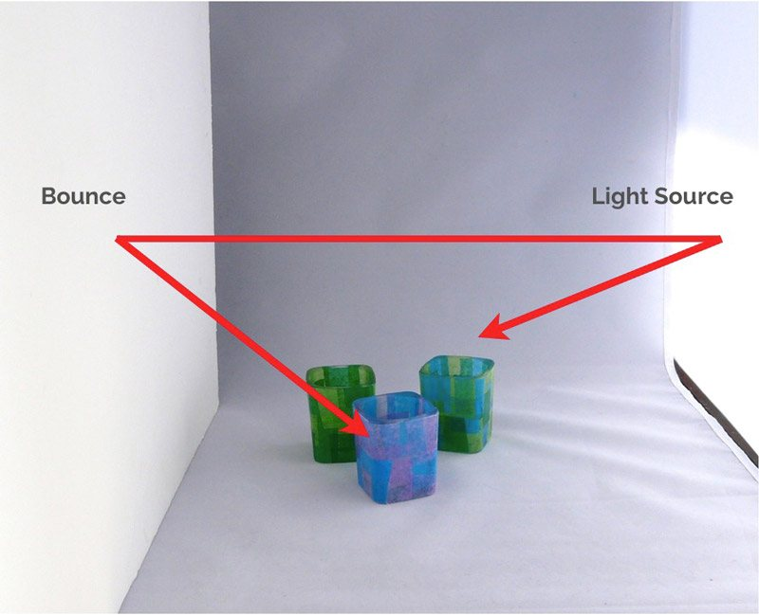


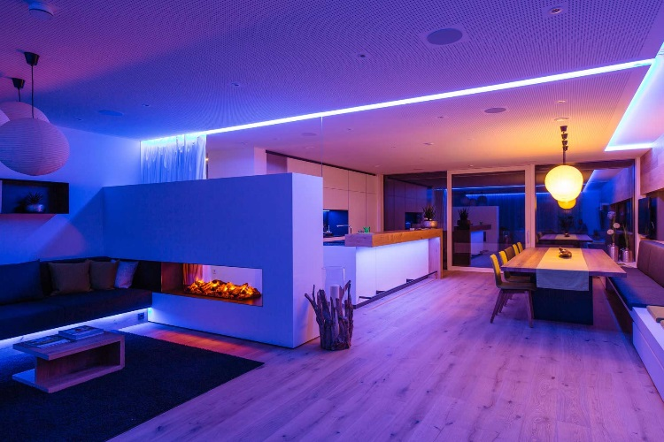
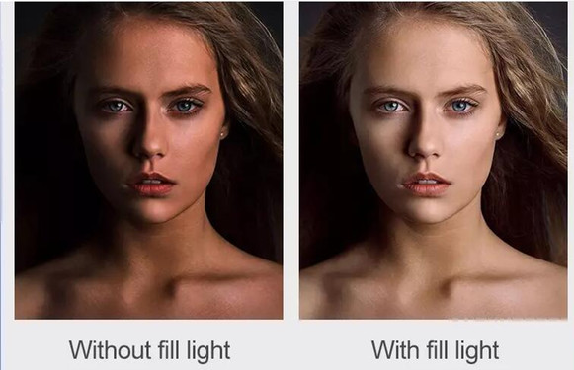
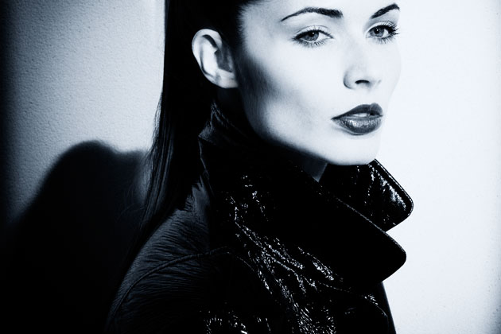

Lighting
Bounce Lighting
Key Lighting/
side lighting
Back Lighting
Motivated Lighting
Ambient Light
18
Controlling shadows with fill lighting
Hard Lighting
Soft Lighting
Notes:
https://www.adorama.com/alc/basic-cinematography-lighting-techniques

Slide 19
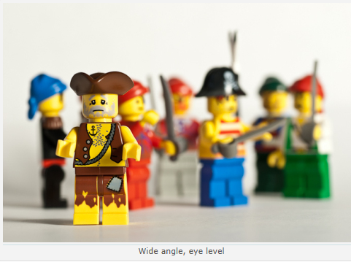
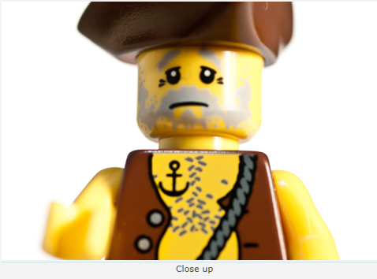
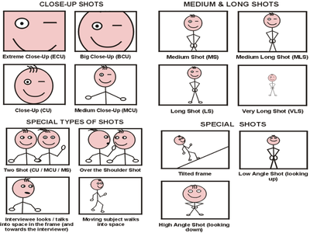
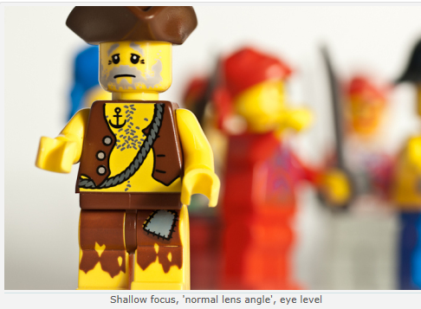
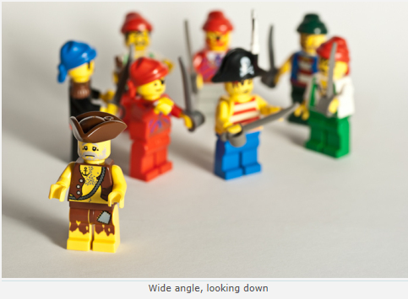
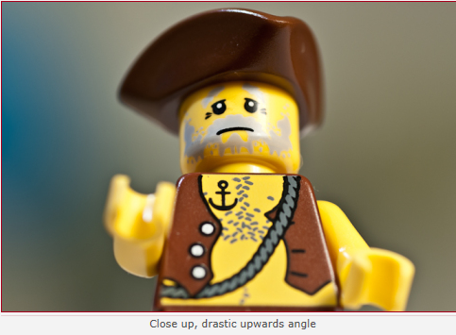
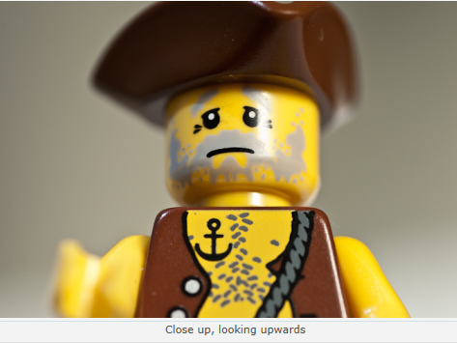
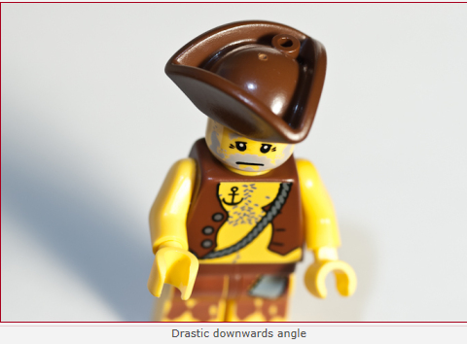
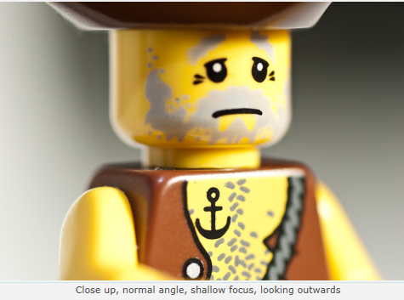
Camera Angles
19
Camera angles generate huge meanings for the audience. For example, a low angle shot (looking up) generates the meaning that the character has power. Whereas, a high angle shot (looking down generates the meaning of fragility and dominance.
Wide angle eye level
Close up
Shallow Focus, ‘normal lens angle’, eye level
Wide angle, looking down
Close up, drastic upwards angle
Close up, looking upwards
Drastic downwards angle
Close up, normal angle, shallow focus, looking outwards
Notes:
https://quizlet.com/gb/217971345/gcse-media-studies-camera-techniques-flash-cards/

Slide 20
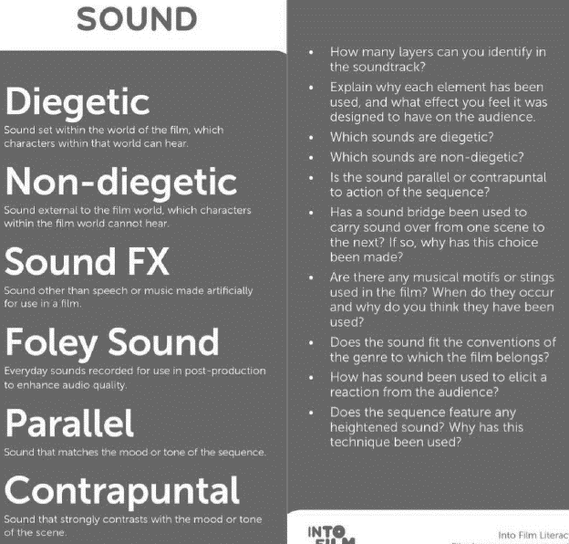
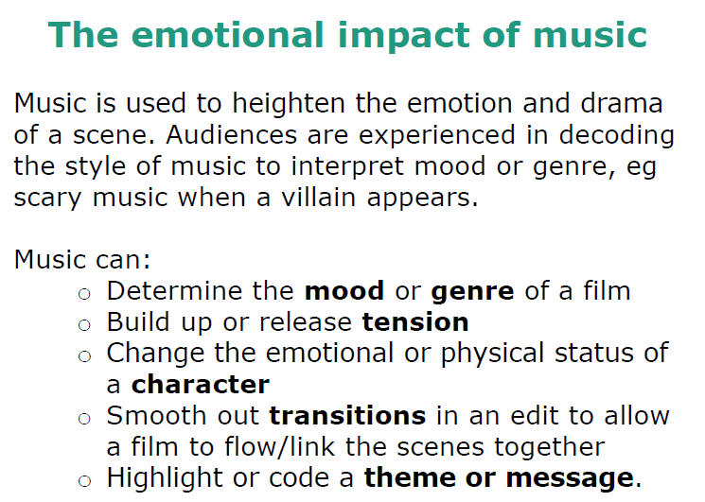
Use of Sound
Diegetic sounds set within the world of the film, which characters within the film can hear.
Non-diegetic sounds are often used to add drama to moments that would be silent without it. Sounds external to the film world, which characters can’t hear.
Sound FX other than speech or music made artificially for use in a film.
Foley Sound everday recorded sound for use in post-production to enhance audio quality.
Parallel sound that matches the mood or tone of the sequence.
Contrapuntal sound that strongly contrasts with the mood or tone of the scene.
20
Notes:
https://www.bfi.org.uk/sites/bfi.org.uk/files/downloads/bfi-language-sound-jennifer-johnston-into-film-2016-07.pdf

Slide 21
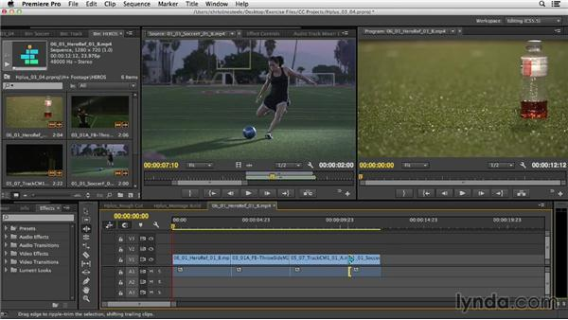
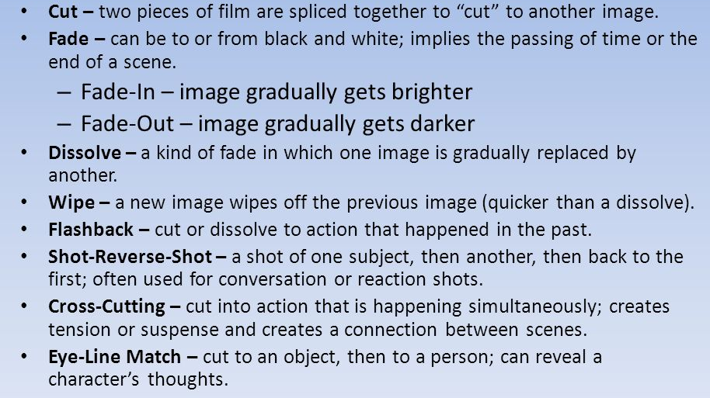
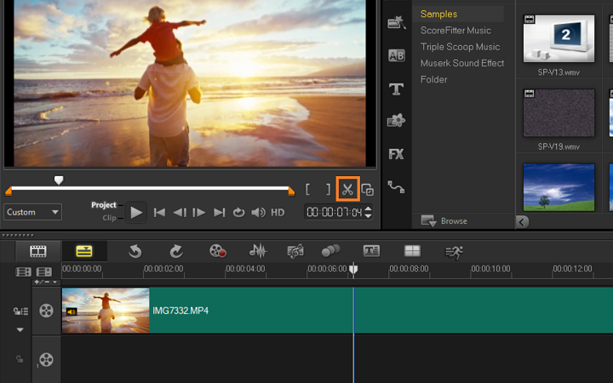
Editing Techniques
Continuity editing
Arranges the shots in a clear and understandable way. Seamless – the audience will not notice the editing. It is also known as ‘invisible editing’.
180-degree rule – where we establish which side of the action we are on with the opening shot, and stay on that side throughout.
Match on action – where we cut from one camera shot to another and the action continues smoothly across the two.
21

