Slide 1
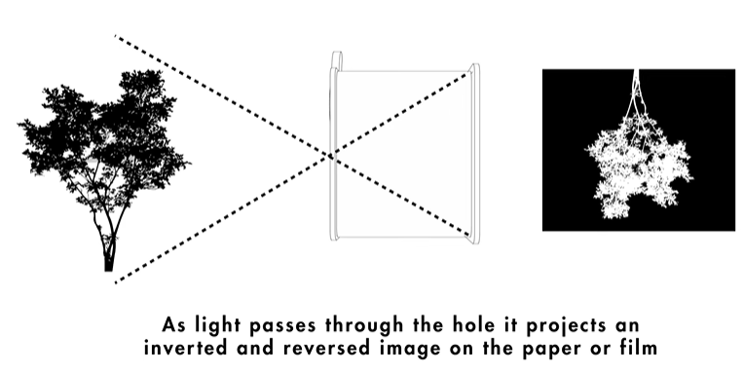
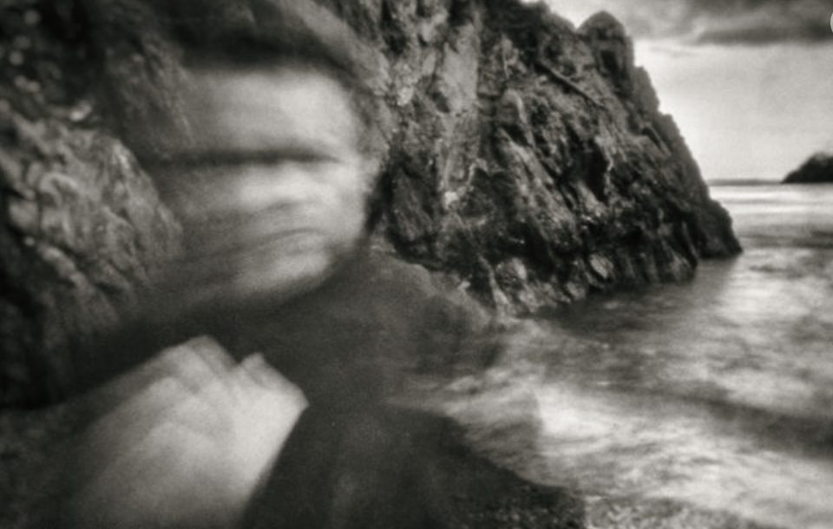
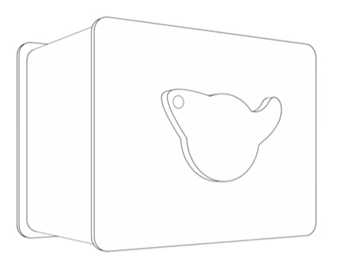
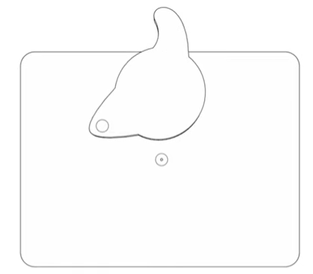
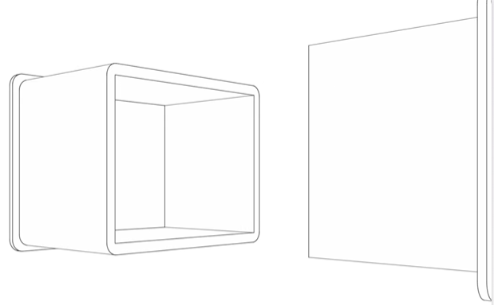
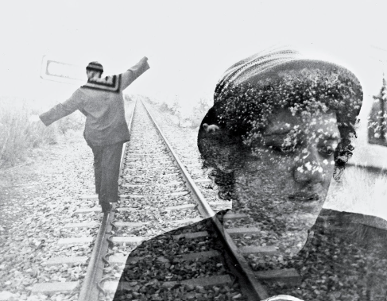
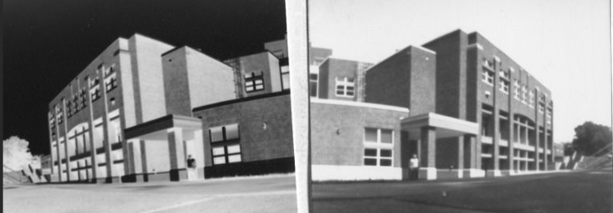
Pinhole Photography Knowledge Organiser
A pinhole camera is a simple camera without a lens but with a tiny aperture (the so-called pinhole) – it is effectively a light-proof box with a small hole in one side. Photographic paper is placed inside the pinhole camera on the opposite side to the aperture (pinhole). This is done in the darkroom with the red safe on.
Light from a scene passes through the aperture and projects an inverted image on the opposite side of the box, which is known as the camera obscura effect. The size of the images depends on the distance between the object and the pinhole.
Techniques
Due to long exposure times pinhole is a great way of capturing movement or trying multiple exposure (2 images layered).
Key vocabulary
Pinhole camera
Aperture
Exposure
Negative
Positive
Depth of field
Tone
Contrast
When using a pinhole camera
Always have the sun behind the pinhole camera
Keep the camera still (unless you intentionally want to capture movement/blur)
Remember that exposure times will vary depending on the weather and lighting – no 2 pinhole images will be the same
Capture high contrast and a variety of tones
A negative pinhole photograph
A positive pinhole photograph

Slide 2
Creating a positive pinhole image from your initial negative pinhole photograph in the darkroom
What you will need:
How to make a positive pinhole:
Your negative pinhole photograph (it must be dry)
Test strip photographic paper
Enlarger
Black card
Photographic chemicals (Developer, Stop, Fix) and tongs
Photographic paper the same size as your original pinhole
Clear glass sheet/plate glass
Before getting any photographic paper, you must first set up your enlarger and collect the black card and plate glass. Ensure the enlarger lamp is raised to a high position and the aperture is set correctly (this will vary on which enlarger you are using).
Create a test strip so you can work out the correct exposure time. To do this you need to switch off the enlarger. Get a piece of test strip photo paper. Place the test strip glossy (shiny) side up under the enlarger. Place your pinhole photograph face down on top of the test strip (so both glossy sides of the photo paper are in contact. Place a piece of plate
glass on top of your paper. Use the black card to create a test strip at 3 seconds intervals
(3, 6, 9, 12 seconds).
3. Develop your test strip.
4. Work out the correct exposure time.
5. Keep your enlarger switched off! Get a piece of paper the same size as your original pinhole photograph and place this paper glossy side up. Place your negative pinhole on top of the blank photo paper, your pinhole should be shiny side down so both the shiny sides of the paper are in contact. Place the glass plate on top of the paper.
6. Expose all the paper to the correct time as worked out from your test strip and develop.
Key vocabulary
Pinhole photograph
Exposure time
Negative
Positive
Tone
Contrast
Developer
Stop
Fix
Darkroom
A negative pinhole photograph
A positive pinhole photograph

