Slide 1
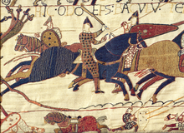
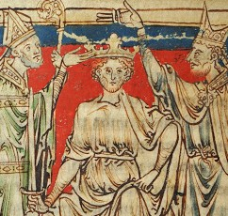
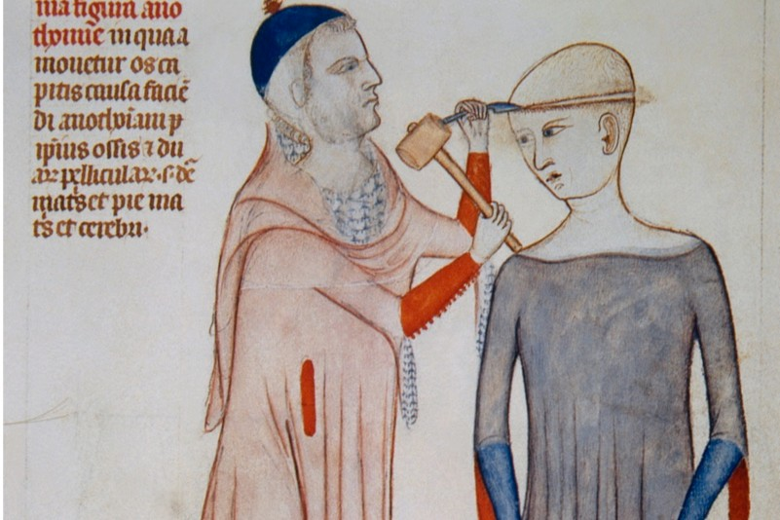
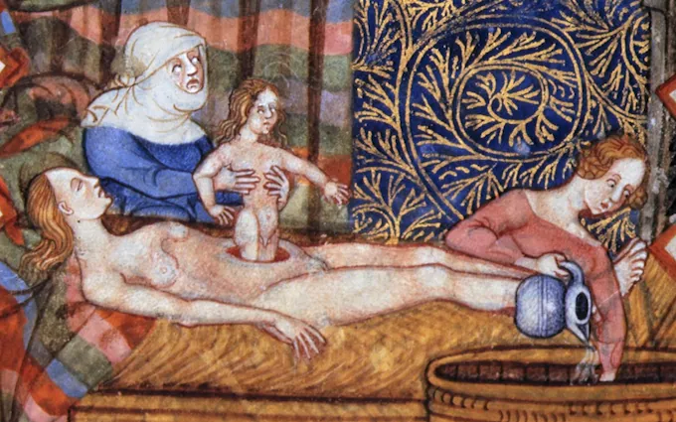
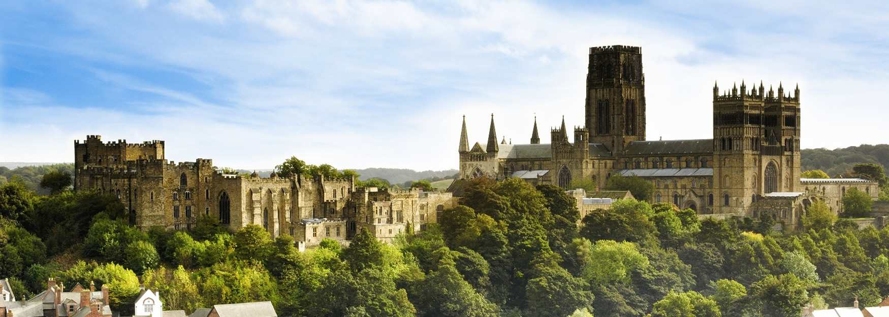
Paper 2 Therapy Pack
Norman England 1066-1100
Health and the People
Independent Learning Tasks
Complete the tasks in this booklet based on your target area
Once these tasks have been completed you will be ready to complete full past papers

Slide 2
Norman Conquest
A: Anglo Saxon life
The Saxons were the dominant group within England from around 500AD (when the Romans left) until 1066AD. From the 9th century England was ruled by one King; however, England was split into different kingdoms (Northumberland, Wessex, Mercia, East Anglia) which were ruled by Earls who (sometimes) challenged the power of the King. Most people were farmers in Saxon England, and slaves were common. The king was advised by the Witan - a council of high ranking people. All people were Christian, many villages had small wooden churches. The Church in England was led by a man called Stigand, the Archbishop of Canterbury (that is his job title). The King at the start of 1066, Edward the Confessor, had grown up in Normandy so had introduced some European style stone buildings to England like Westminster Abbey in London.
B: Kings before 1066 and claimants to the throne
After 1016 England had been ruled by a Viking called Cnut. After him his sons, Harefoot and Harthacnut ruled, until Harthacnut’s death in 1042. Edward the Confessor took over after this. In 1051 Edward appointed Harold Godwinson as ‘sub-regulus’ (meaning second King), this was his claim to the throne in 1066. William, Duke of Normandy claimed that Edward had name him as heir (next King) when Edward was in Normandy growing up. So, in 1066 (following Edward the Confessor’s death) there were several claimants to the English throne: The Saxon: Harold Godwinson, The 14 year old Saxon Edgar Atheling, the Viking: Harold Hardrada and the Duke of Normandy: William.
C: The Battles of Fulford Gate and Stamford Bridge
Following Edward’s death on January 5th, Harold Godwinson was crowned King of England on 6th January. In September 1066 Harald Hardrada arrived in the north of England, near York. He first defeated the Saxon Earls Edwin and Morcar at the Battle of Fulford on 20th September. Harold Godwinson marched his troops up to York in just four days and the Vikings were unprepared, Harold Hardrada was defeated and killed at Stamford Bridge on 25th September. However, Harold Godwinson heard news that William of Normandy had landed in the south of England at Pevensey Bay, and was raiding the surrounding villages. Harold Godwinson prepared to march his tired troops the 200 miles to London in order to defend his position as King of England.
D: The Battle of Hastings
Harold marched his troops to Hastings and arrived on 13th October, the day before the battle. Both armies were equally matched in numbers (around 7000) but the Normans had superior weaponry, including cavalry (horses) and archers. When the battle started, on 14th October, William aimed to use his cavalry and archers on the Saxon army; however, due to Harold’s position on top of the hill, they were unable to win. Eventually, possibly because of the Norman tactic of feigning (pretending) to retreat, Harold’s army advanced down the hill and the Norman army were able to defeat the Saxons. The Bayeux Tapestry (a picture story of the Norman Conquest – made by the Normans) shows Harold’s death after he was struck by an arrow in the eye.

Slide 3
Task 1: Norman Conquest
For each section, add at least 2 details to help you remember what happened
Anglo-Saxon Life
Norman Conquest
1066: The Battle of Hastings
Kings before 1066
1066: The Battle of Fulford & the Stamford Bridge
Claimants to the throne

Slide 4
Establishing William's early rule
A: Post-Hastings & William’s coronation
After Hastings, William attacked local towns like Romney to show his power. After trying (and failing) to crown Edgar Atheling, the Saxon Witan began to switch their allegiance to William as they realised they would lose their titles and land if they didn’t support William. By December most nobles had sworn an oath of loyalty to William and on Christmas Day, William was crowned King of England. At the end of 1066, William only really controls the South-East of England. Between 1067-1070 he sets about gaining control of the rest of England.
B: Early Saxon Rebellions
William aimed to ensure support by showing continuity, he allowed Lords who had sworn the oath to keep their lands and continued to write laws in English. However, there were a number of revolts against William in the early years of his rule. In 1067 a revolt was launched by Eadric the Wild, who allied himself with Welsh princes to attack the Normans before escaping. In 1068 the remaining members of the Godwin family refused to swear loyalty to William and shut the gates of Exeter to him. William laid siege to the city for 18 days before Exeter surrendered and William showed its citizens mercy and left them unpunished. Between 1070-1071, Hereward the Wake led a rebellion against the Normans and joined forces with local Danes and the Saxon Morcar. William defeated this rebellion, pardoned Hereward but imprisoned Morcar for life.
C: Northern Rebellion & the Harrying of the North
Edwin of Mercia, Morcar and Edgar Atheling launched a rebellion against the Normans in response to William appointing a Norman in charge of Northumbria. With the support of Sweiyn of Denmark, the Danes and Saxons took control of the city of York. William marched his army north and the rebels fled while William paid Sweiyn to leave England. William wanted to ensure the North would never rebel again so he launched the Harrying of the North. The people, livestock and farmland were attacked by the Normans, leaving 100,000 people to die of starvation, 60% of Yorkshire left as wasteland and many people resorting to cannibalism.
D: Anglo-Norman Earls Rebellion
The Earls’ revolt in 1075 involved Norman Lords themselves and was the last major rebellion against William’s rule. The son of Fitz Osbern (William’s second in command), Roger, Earl of Hereford, wanted extra land. Roger led a rebellion joined by Waltheof (a Saxon); however, the rebellion never really got going and Roger was captured. William decided to execute Waltheof. The final rebellion William had to deal with came from his half-brother Odo. Odo had ruled England on William behalf as regent and owned a large amount of land, however Odo began to take advantage of his position. He was found guilty of stealing from the Church in 1076 and was imprisoned by William in 1082 for trying to invade Italy and make himself Pope.

Slide 5
Task 2: William’s Early Rule
For each event, add 3 points of detail to help you remember what happened
William’s coronation
Later Rebellions
Cross-decade conflicts
Early Rebellions
Harrying of the North

Slide 6
Task 3: Key Terms of the Norman Conquest
After reading the first 2 sections of the content pack define these key terms
Key Term | Your definition
Witan
Stigand
Battle of Fulford
Battle of Stamford Bridge
Feigned Retreat
Battle of Hastings
Romney
William Fitz Osbern
Harrying of the North
Lanfranc

Slide 7
Controlling England
A: Castles
The Normans built castles to control England. The Saxons had created walled cities called burghs, but the Normans built motte and bailey wooden castles, which were eventually built in stone. Some castles controlled cities, like the White tower in London, some controlled rivers and road like Conisbrough Castle, and others controlled border lands near Wales. By 1087, 85 stone castles had been built. Castles were used to help scare the local population, and run local government eg collecting taxes. Without castles, it would have been impossible for the 8000 or so Normans, to control the 2 million Saxons.
B: The Feudal System
Under Saxon England, Earls had lots of power over one area. Under the Normans, society was organised based on land ownership. Land would be shared, in return the person receiving land gave something in return. This system of patronage helped establish strong links between the king, barons, knights and peasants. The King (William) owned 20% of the land, 25% went to the church, with the rest being shared out by 200 Norman barons. Many Saxons had their land confiscated, by 1086 the number of Saxons in control of land fell from 4000 to just 4. Norman earls who were given land by the King did not own it. Barons had to provide money and soldiers to the army, Barons would give some of their land to knights in return for their loyalty. There were also peasants who worked for the Knights for no pay, and could not leave the land without their Knight’s permission.
C: Land
William would often split land he gave out into small bits around England and Normandy, instead of giving an Earl one large area together. This made it harder to rebel than in Saxon times. At first he let Saxon Earls keep their land, he did this with Edwin and Morcar, but once he was more secure he gave all the land to Normans. By 1086 only 5% of land was controlled by Saxons. When William was away in Normand he let his vice-regents run the country; His two most trusted men were: his half-brothers, Odo of Bayeux and William FitzOsbern. Odo ruled in the south and FitzOsbern controlled land in the centre/west of England.

Slide 8
D: Norman Government
In Anglo-Saxon England government orders were given in writing called a ‘writ’. This was a short document that could be sent round the country. The Normans continued this system but made far more rules for the Saxons to follow. In Anglo-Saxon England the earls had a lot of power to decide what was done in their areas, but William wanted more centralisation (control by the government). The Chancery was created, a group of legal administrators who wrote royal documents. Under the Anglo Saxons, England had been split into 35 shires (ie Yorkshire). Each Shire had a capital where taxes and government would be organised. The Normans kept this system, the sheriffs (law keepers) became the baron’s deputies: sheriffs organised taxes and raised armies for the King. In short, William tried to centralise government, to bring more of it under his control, and standardise the laws and courts people were subjected to.
E: The Domesday Book
This was a survey (list) of all the land and resources in England and who it was owned by. The Domesday survey was started in 1086 as a way of William judging how much he could tax people, based on their wealth. It was also a legal proof of ownership over land, so Saxons couldn’t complain or get their land back. It was also was used to judge the amount of Knights that tenants were expected to give to William. Royal Commissioners were sent out to list the amount of wealth and land that tenants owned. The Domesday Book lists 250 landowners in England at the time of William’s reign as King, with William himself owning 17% of the land, the church 25%; the rest divided amongst the tenants.
F: Norman rule 1086-1100
Following William’s death in 1087 the succession was not clear as there were many claimants to the throne. Robert Curthouse was William’s eldest son but was thought of as not mature or sensible enough for the crown by William. So, William decided that after his death Robert should be Duke of Normandy but William Rufus (his second son) should become King of England. This caused a fight between the brothers. Bishop Odo led a rebellion of the English Lords against William Rufus in 1088. William Rufus persuaded the English Lords to back down by giving them new hunting rights and land. In 1100 William Rufus was killed by a stray arrow on a hunting trip; the English crown came to Henry (William the Conqueror’s third son) who became Henry I (1100-1135). His main issue was to deal with the investiture crisis in the Church.

Slide 9
Task 4: Controlling England
For each event, add 3 points of detail to help you remember what happened
Norman Rule 1086-1100
Castles
Controlling England
The Feudal System
The Domesday Book
Norman Government
Land

Slide 10
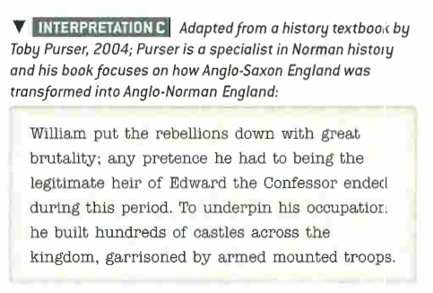
Exam Practice
Normans Q1 – 8 marks
How convincing is this interpretation about the way in which William dealt with rebellions? Use the interpretation and your own knowledge.
____________________________________________________________________________________________________________________________________________________________________________________________________________________________________________________________________________________________________________________________________________________________________________________________________________________________________________________________________________________________________________________________________________________________________________________________________________________________________________________________________________________________________________________________________________________________________________________________________________________________________________________________________________________________________________________________________________________________________________________________________________

Slide 11
Exam Practice
______________________________________________________________________________________________________________________________________________________________________________________________________________________________________________________________________________________________________________________________________________________________________________________________________________________________________________________________________________________________________________________________________________________________________________________________________________________________________________________________________________________________________________________________
____________________________________________________________________________________________________________________________________________________________________________________________________________________________________________________________________________________________________________________________________________________________________________________________________________________________________________________________________________________________________________________________________________________________________________________________________________________________________________________________________________________________________________________________________________________________________________________

Slide 12
Exam Practice
Normans Q2 – 8 marks
Explain what was important about the feudal system in Norman England. (8)
______________________________________________________________________________________________________________________________________________________________________________________________________________________________________________________________________________________________________________________________________________________________________________________________________________________________________________________________________________________________________________________________________________________________________________________________________________________________________________________________________________________________________________________________
____________________________________________________________________________________________________________________________________________________________________________________________________________________________________________________________________________________________________________________________________________________________________________________________________________________________________________________________________________________________________________________________________________________________________________________________________________________________________________________________________________________________________________________________________________________________________________________

Slide 13
Exam Practice
Normans Q3 – 8 marks
Write an account of how William changed the government of England after 1066. (8)
______________________________________________________________________________________________________________________________________________________________________________________________________________________________________________________________________________________________________________________________________________________________________________________________________________________________________________________________________________________________________________________________________________________________________________________________________________________________________________________________________________________________________________________________
____________________________________________________________________________________________________________________________________________________________________________________________________________________________________________________________________________________________________________________________________________________________________________________________________________________________________________________________________________________________________________________________________________________________________________________________________________________________________________________________________________________________________________________________________________________________________________________

Slide 14
Life under the Normans
A: Law and Justice
Under the Anglo-Saxons, laws could vary from place to place. The Normans simplified the system and made it the same across the country. The first system of law was trial by ordeal – suspects were ‘tested’ to see if they were guilty by seeing if they would float or sink in water. Another trial by ordeal required suspects to carry a hot rod of iron – if their hand had healed in three days there were declared innocent. Trial by battle was introduced by the Normans to settle serious disputes, where the accused would have to fight to the death to decide who was innocent and guilty. The Normans also introduced new law courts to judge suspects: the King’s court was the most important court, the Lord’s courts were run by local Lords to try their tenants, and church courts were set up to try members of the clergy.
The Normans were very harsh in their punishments; which included physical mutilation and hanging. The Normans created far more forests for the Normans to hunt in, such as New Forest in Hampshire. The Forest Law prevented the public from using this land; anybody caught doing so was blinded. The murdrum fine would also reintroduced, and in towns and cities constables were created to break up fights, and watchmen would enforce the curfew in cities and towns.
B: Norman villages
In most villages their lord would have changed from a Saxon to a Norman. In Brinsworth the old Saxon lord Godric was replaced by Roger of Bully. These new lords increased taxes and enforced the forest law in many places (with harsh punishments if peasants went onto Norman land). Many villages (75%) were destroyed during the Harrying of the North. Saxons in the south used to own slaves, but this declined in Norman times. However, daily life stayed the same, peasants drank weak ale, and farmed crops like rye for food. Peasants still had few rights, so for 80% of the population they still farmed the land just like they had in Saxon times.
C: Norman towns
The Normans created 21 new towns, close to their new castles. They also built many castles in towns that were already there like in York. Towns that were on the coast facing Europe did well, as they grew rich selling wool to places like Flanders. Towns in the North suffered, with York’s population lower by the end of William I’s reign due to the Harrying of the North. London had a population of 10,000 under Norman rule and Winchester 6000. Rich people in towns benefitted from more trade with Normandy. The main imports (goods from other countries) were fine cloth or wine from France. For people in towns, they often trained as apprentices in different trades. People in towns were called burgesses which gave them more freedom to work and move around, which was better than the experience of peasants in villages.

Slide 15
Norman Church and Monasticism
A: William & Lanfranc’s changes to the Church
All people in Saxon and Norman England were Christian. People who work in the church are called clergy, everyone else are the ‘Lay people’ or the laity. The Pope was the Head of the Church, and was based in Rome. In England there were (and still are) two heads of the church known as Archbishops: these were in Canterbury and York. Below the Archbishops were Bishops (who controlled areas of churches known as the diocese) and below Bishops were parish priests, who ran their own churches. The church owned 25% of the land in England. All people in England had to pay a tax to the church – this was known as the tithe – 1/10 of their income. Saxon churches were small and wooden, the Normans rebuilt many out of stone. By the end of William I’s rule the number of parish churches had doubled to 2000.
When he took over, William kept the Saxon Stigand as Archbishop of Canterbury until 1070. Only after the Harrying of the North, did William feel in control enough to replace Stigand with Lanfranc. Lanfranc and William then fixed issues in the Church like: Nepotism (jobs to friends/family), Pluralism (many jobs), Simony (selling jobs) and priests being married. Stigand did many of those things! Lanfranc created regular church meetings called Synods to keep an eye on the Church, and replaced Saxons with Normans. By William’s death there was only one Saxon Bishop left, a man called Wulfstan. William & Lanfranc moved 1/3 bishops into towns and cities so they were nearer the people. This all showed William’s desire to reform the Church in England.
B: William II & Henry I and the Church
William II did not get on with the church. His first fall out was with the Bishop of St Calais, William blocked him from being tried in a Church court. After Lanfranc died in 1089, William II didn’t replace him and kept the money from the job for himself. He eventually chooses Anselm to be Archbishop of Canterbury in 1093, but they fall out and Anselm is forced to leave England. When Henry I took over the throne in 1100, he also fell out with Anselm over who should pick Bishops in England. This was called the investiture controversy.
The Pope in Rome still had power in England. Pope Alexander II got on well with William the Conqueror, and gave him a papal banner for Hastings. William and his son both fell out with the next pope, Gregory VII who wanted to Church to have more power. William II and other leaders eventually managed to get Gregory sacked. The next Popes, Urban II and Paschal II got on with the kings better than Gregory had. King Henry I and Paschal made a deal to sort out the investiture controversy in 1107.

Slide 16
C: Monastic Life
England had monasteries before the Normans arrived, they also worshipped their own Saints, like Saint Cuthbert, but the Normans increased the number of religious buildings and made the rules stricter. The number of religious houses grew to 250 and the number of monks/nuns went from 1000 to 4000 in Norman times. This growth was because of the new order (group) of monks introduced by the Normans – the Cluniacs. They followed stricter rules than the English monks, so to show their wealth, power and religious nature Norman lords gave land for new monasteries to be built, and got the Cluniac monks to run them.
Lanfranc and the new Cluniac group changed how monasteries were run, and made the words used in their services (called the Liturgy) the same as in Europe. They introduced new chants, which were not always popular. Monks at Glastonbury refused the new chants, and knights sent in to stop the protest killed 3 monks and injured 18!
Daily life in these new monasteries was strict, the rules the monks followed were called the Rules of St Benedict. They prayed many times a day, their first service in the morning was called matins, and they would often be up before sunrise to pray. They worked in silence, often doing work like copying out bibles (which would take 18 months!), praying, or educating other monks. Monks would spend much of the day in silence or in prayer.
D: Language and Education in Monasteries:
Under the Normans, monasteries became the main provider of education; schools were set up in monasteries, though education had to be paid for, which stopped peasants from educating their children. By 1100 most monasteries also had schools; school taught subjects such as maths, music and astronomy. University education also begun under the Normans; Oxford University was set up around 1096. Although William did initially write royal writs in English, Latin or French was the language of Norman government. French was taught in most schools and spoken amongst the educated upper classes. Saxon peasants continued to speak English (what we would now call ‘old English’).

Slide 17
Task 5: Life under the Normans & Church
For each event, add 3 points of detail to help you remember what happened
Law & Justice
Monastic Life & Education
Life & Church
Norman Villages
William II & Henry I and the Church
Norman Towns
Lanfranc’s Changes to the Church

Slide 18
Task 6: Key Terms of Life under the Normans & Church
After reading the last 2 sections of the content pack and define these key terms
Key Term | Your definition
Trial by Ordeal
Forest Law
Murdrum Fine
Burgesses
Clergy
Lay people
Bishops
Tithe
Nepotism
Pluralism
Simony
Anselm
Monasteries
Cluniacs
St Benedict

Slide 19
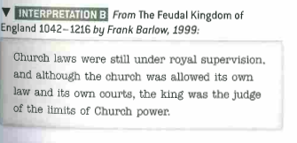
Exam Practice
Normans Q1 – 8 marks
How convincing is this interpretation about the role of the Church in England? Use the interpretation and your own knowledge.
____________________________________________________________________________________________________________________________________________________________________________________________________________________________________________________________________________________________________________________________________________________________________________________________________________________________________________________________________________________________________________________________________________________________________________________________________________________________________________________________________________________________________________________________________________________________________________________________________________________________________________________________________________________________________________________________________________________________________________________________________________

Slide 20
Exam Practice
______________________________________________________________________________________________________________________________________________________________________________________________________________________________________________________________________________________________________________________________________________________________________________________________________________________________________________________________________________________________________________________________________________________________________________________________________________________________________________________________________________________________________________________________
____________________________________________________________________________________________________________________________________________________________________________________________________________________________________________________________________________________________________________________________________________________________________________________________________________________________________________________________________________________________________________________________________________________________________________________________________________________________________________________________________________________________________________________________________________________________________________________

Slide 21
Exam Practice
Normans Q2 – 8 marks
Explain what was important about the changes made by the Normans to education. (8)
______________________________________________________________________________________________________________________________________________________________________________________________________________________________________________________________________________________________________________________________________________________________________________________________________________________________________________________________________________________________________________________________________________________________________________________________________________________________________________________________________________________________________________________________
____________________________________________________________________________________________________________________________________________________________________________________________________________________________________________________________________________________________________________________________________________________________________________________________________________________________________________________________________________________________________________________________________________________________________________________________________________________________________________________________________________________________________________________________________________________________________________________

Slide 22
Exam Practice
Normans Q3 – 8 marks
Write an account of how monastic life changed under the Normans (8)
______________________________________________________________________________________________________________________________________________________________________________________________________________________________________________________________________________________________________________________________________________________________________________________________________________________________________________________________________________________________________________________________________________________________________________________________________________________________________________________________________________________________________________________________
____________________________________________________________________________________________________________________________________________________________________________________________________________________________________________________________________________________________________________________________________________________________________________________________________________________________________________________________________________________________________________________________________________________________________________________________________________________________________________________________________________________________________________________________________________________________________________________

Slide 23
Pevensey- Key Areas
Guard the conquest | Rule England
Built on a peninsula surrounded by marshland, Pevensey gave William a safe, secure landing zone for unloading 3000 horses from 700 ships. | Reusing Roman ruins (built c. 290AD) visually linked Norman rule to past imperial power, reinforcing dominance over the Anglo-Saxons.
William reused the strong Roman stone walls (built c. 290AD) to protect troops and supplies immediately after landing. He then explored possible battle sites with his 25 trusted men using Pevensey as a base. | William rewarded his half-brother Robert of Mortain with Pevensey, showing how castles supported feudal control and freed William to focus elsewhere.
Within a day, William’s forces built a timber fort inside the Roman walls with pre-cut materials—showing strong organisation and allowing further advances like Hastings. | Pevensey one of 5 Sussex ‘rapes’, using its castle and river to control land, collect taxes (e.g., £5 yearly from salt houses), and boost Norman trade.
After 1066, Pevensey was garrisoned under Robert of Mortain, with new permanent defences built to suppress rebellion and resist later threats like the 1088 Siege. | Troops from Pevensey raided Harold’s lands to weaken resistance and force an early battle, while its peninsula location kept the Normans well-defended. Harold forced to rush the 200-mile march south.
Influence (of William, Religion) | Preparation
Pevensey was a reward for key nobles like Robert of Mortain, showing how William used feudal ties and promises of castles and land to secure support for the invasion. Alliance with Count Baldwin of Flanders. | Pevensey Bay’s sheltered beach and lagoon made it ideal for William’s landing in 1066, despite some ships getting separated. Safety of Pevensey shown by the death of those who ended up at Romney.
William landed under the Papal Banner at Pevensey, boosting troop morale and showing his conquest had divine approval. | Pevensey let William unload 700 ships’ worth of horses, troops, and supplies, using a mix of Norman Skuldelev design ships and hired Flemish ships.
William’s fall and grabbing of English soil at Pevensey symbolised God’s favour and reinforced his leadership to his men. By the splendour of God I have taken possession of the earth of England in my hands’. | William used Pevensey to safely return to Normandy in 1067, showing its role in controlling the Channel.
Reusing Roman forts like Pevensey (also seen at Colchester and the Tower of London) symbolised power, continuity, and a civilised ruling tradition | Support from the monks of Fécamp, angry at Harold’s family, helped William’s wise decision choose Pevensey for its strategic access.

Slide 24
Task 7: Location Study ____________
For each Theme, Pick out 2 key facts from your Grid
Guarding the Conquest
Key Dates:
Location Study
Preparation
Ruling England
Influence of William & Religion

Slide 25
Exam Practice
Normans – 16 marks
‘The main cause of the Norman Conquest was William’s preparation’
How far does a study of Pevensey Castle support this judgement? (16 marks)
______________________________________________________________________________________________________________________________________________________________________________________________________________________________________________________________________________________________________________________________________________________________________________________________________________________________________________________________________________________________________________________________________________________________________________________________________________________________________________________________________________________________________________________________
____________________________________________________________________________________________________________________________________________________________________________________________________________________________________________________________________________________________________________________________________________________________________________________________________________________________________________________________________________________________________________________________________________________________________________________________________________________________________________________________________________________________________________________________________________________________________________________

Slide 26
Exam Practice
______________________________________________________________________________________________________________________________________________________________________________________________________________________________________________________________________________________________________________________________________________________________________________________________________________________________________________________________________________________________________________________________________________________________________________________________________________________________________________________________________________________________________________________________
____________________________________________________________________________________________________________________________________________________________________________________________________________________________________________________________________________________________________________________________________________________________________________________________________________________________________________________________________________________________________________________________________________________________________________________________________________________________________________________________________________________________________________________________________________________________________________________
____________________________________________________________________________________________________________________________________________________________________________________________________________________________________________________________________________________________________________________________________

