Slide 1
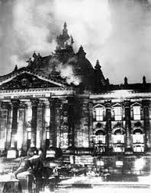
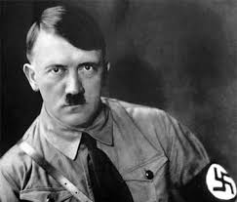
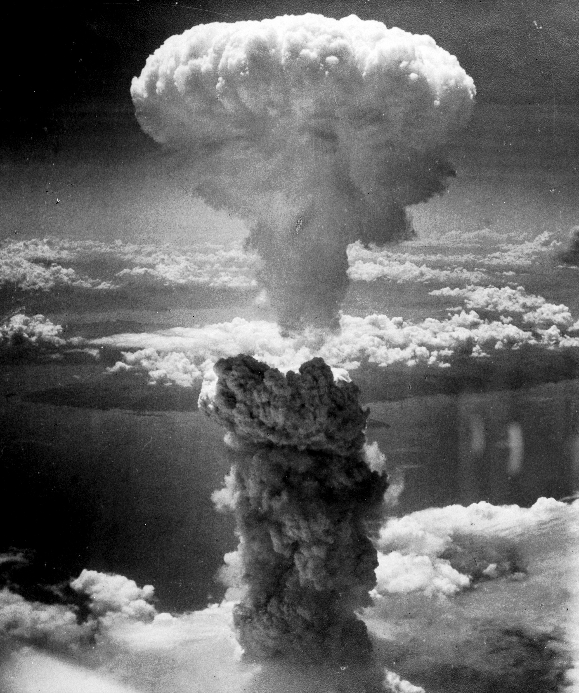
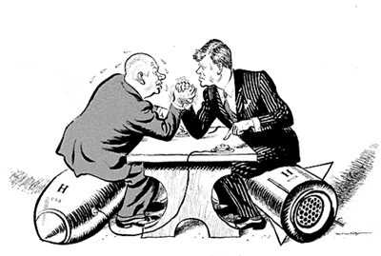
Paper 1 Therapy Pack
Germany 1890-1945
Conflict & Tension 1945-1972
Independent learning tasks
Complete the tasks in this booklet based on your target area.
Once these tasks have been completed you will be ready to tackle full past papers

Slide 2
Germany under the Kaiser
A: Introduction
1888-1918 Germany was a monarchy under the rule of Kaiser Wilhelm II. The term ‘Kaiser’ came from Caesar meaning Emperor with absolute power. The Kaiser was an absolute monarch and retained power until death. He had the ability to choose the Chancellor (Prime Minister). He also had power over Foreign Policy and influence on Domestic Policy. He was supported by the landowning class called the Junkers.
B: The Context - Unification of Germany
Prior to 1871 Germany was a group of 25 separate German-speaking states and city-states between France, Russia and the North Sea coast. Each state had its own traditions, culture and in some cases language. In 1871 these states were unified to form Germany and this was fueled by a rise in German nationalism pushed on by Prussia, the leading state before unification. Leading Germany to its success would be its army and navy which it needed to compete with other nations such as Britain, America, France and Russia.
C: Powers of the Kaiser:
The new German constitution (system of running a country) was a mix of strong monarchical power and individual rights. The emperor retained absolute power over ministers and government decisions: he could hire and fire the chancellor (prime minister), determine foreign policy and was commander-in-chief of the armed forces. He also had some influence over domestic policy but this was mainly the Chancellor’s area of power.
D: Foreign Policy
Germany’s foreign policy approach during this period was called Weltpolitik; it was more confident, assertive, some might say aggressive; with the aim of strengthening Germany. Weltpolitik began to generate tensions and fears of a European conflict. The Kaiser allowed its 1887 treaty with Russia to expire, and its aggressive diplomacy pushed the Russians into an alliance with France, losing them an ally. Germany also began to expand her army and navy and used this to gain new colonies or possessions in Africa, East Asia and the Pacific.
E: Domestic Policy
The government adopted policies to encourage industrial growth and Germany experienced an economic and technological boom for most of the late 1800s. The unification of Germany boosted industrial growth, railway construction, coal production, iron ore mining and foreign investment. Examples of companies that grew in the period are Siemens and Benz. With its large and rapidly growing population (40 million in 1880, 58.5 million by 1910) overcrowding became an issue in Germany’s cities, for example the population of Berlin doubled and 60% of the population were now living in towns, during the Kaiser’s reign. By 1900 Germany had overtaken Britain economically, and was second only to the United States.

Slide 3
F: Challenges to his reign
During his reign the Kaiser faced challenges due to the complexity of ruling a newly united Germany. Some extremist groups viewed him as too authoritarian or ‘power-hungry’ in comparison to the previous Kaiser and sought to challenge him. Extremist groups such as Anarchists grew in popularity in this period. Anarchists believed that the government limited people’s freedom and without laws and coercion (violence) from the government, people would live freely with no need for a government. A handful of bombings around Europe caused great concern for many people. Any people involved in extremist activities were closely monitored and arrested if necessary.
G: Socialism and Trade Unions
In 1900 the membership of the trade unions was 680,000. Trade unions were groups who protected workers’ rights and could go on strike (refuse to work) to try and force this. They were generally socialist (believed in fairness and equality), which many of the ruling classes (business and land owners) didn’t like. By 1913 membership had risen to around 3 million. They had influence over the Social Democratic Party (SDP) who became the largest party in the Reichstag in 1912, winning 35% of the vote. The Socialists pushed business owners to improve wages and working conditions - In 1901 new courts were made to solve arguments between trade unions and businesses.
H: Naval Laws
In his attempt to build a world empire, increase Germany’s trade, and challenge Britain’s supremacy at sea, the Kaiser would need to have a large modern navy. In the years 1898, 1900, 1906, 1908 and 1912, the Kaiser and the Reichstag passed laws to increase the number of warships to be built. These laws were supported by Grand Admiral Alfred von Tirpitz. This led to an arms race with Britain to build the greatest number and most advanced battleships in the world. Although many nationalists were pleased with the growth of Germany’s prestige at sea, the Social Democrats and conservatives complained that too much money was being spent on the military. Germany’s debt was increased to 490 million marks and socialists believed that the money should be used to help improve living and working conditions of the poor.
I: The Great War and the Collapse of GermanyAfter early successes for Germany during the first stages of the First World War, it eventually ground to a stalemate. The Schlieffen Plan, designed by the Germans to win a war against both Russia and France failed. They managed to put Russia out of the war in 1917, but unfortunately they were replaced by the USA. With all their money, resources and manpower, Germany would find it extremely difficult to win. The Royal Navy also blockaded the German ports which meant that very little food, fuel and raw materials could be imported. Industry began to grind to a halt and many people began to starve. Food was so scarce that people were forced to eat animal feed in the Turnip Winter of 1916. In total 800,000 starved to death during WWI. 150,000 people also died of Spanish Flu.
With all the suffering in Germany, many people began to complain about the war and sided with Social Democrats. The Kaiser, fearing a violent revolution, stepped down from the throne and fled to Holland. He was replaced by Friedrich Ebert and the Social Democrats who then signed the armistice for peace.

Slide 4
Task 1: Germany under the Kaiser
For each event, add at least 2 details to help you remember what happened
The Great War (WW1)
Powers of the Kaiser
Germany under the Kaiser
Naval Laws
Foreign Policy
Challenges to the Kaiser
Domestic Policy
Socialism & Trade Unions

Slide 5
Task 2: Key Terms – Germany under the Kaiser
After reading the first sections of the content pack, scan for the terms below and then describe them
Key Term | Your definition
Constitution
Weltpolitik
Berlin
Anarchists
Siemens and Benz
Trade Unions
Navy Laws
Social Democratic Party
Reichstag
Turnip Winter
Friedrich Ebert
Armistice

Slide 6
Exam Practice
Germany Q4 – 4 marks: Describe 2 problems faced by the Kaiser in ruling Germany between 1890-1945
____________________________________________________________________________________________________________________________________________________________________________________________________________________________________________________________________________________________________________________________________________________________________________________________________________________________________________________________________________________________________________________________________________________________________________________________________________________________________________________________________________________________________________________________________________________________________________________
Germany Q4 – 4 marks: Describe 2 problems faced by the German government during WW1
____________________________________________________________________________________________________________________________________________________________________________________________________________________________________________________________________________________________________________________________________________________________________________________________________________________________________________________________________________________________________________________________________________________________________________________________________________________________________________________________________________________________________________________________________________________________________________________

Slide 7
Weimar Germany
A: The Treaty of Versailles
The Treaty of Versailles was signed in 1919 by the new leaders of the Weimar Republic. It severely restricted Germany militarily (only allowed any army of 100,000, 6 battleships, no military aircraft, tanks or submarines).
Germany also lost territories like Alsace and Lorraine to France, West Prussia to Poland, overseas empire given to Britain and the Saar coalfields put under international control. The Rhineland was also demilitarised.
Germany was also politically humiliated by being forced to accept responsibility for starting the war and not being allowed to join the international peace keeping organisation called the League of Nations. Consequently, they were also forced to financially pay for all the damages called reparations. Germany would find it impossible to pay the £6.6 billion demanded of them. The treaty was hated by the German people and they called it “The Diktat” Later, in 1927, Germany would declare that Clause 231, “The Guilt Clause”, was a lie.
B: The Weimar Constitution
After the Kaiser abdicated and left Germany, he was replaced by a new democratic system of government. This new government was led by the Social Democrats (SDP) under the leadership of Friedrich Ebert. Because Berlin was a dangerous place, the government was moved to a city in southern Germany called Weimar.
This new system of government gave the German people many new political rights such as freedom of speech. Everyone over the age of 20 could vote. The members of the Reichstag were elected every 4 years and the President was elected every 7 years. The Reichstag had control over law making and the police and army.
There were various problems for the new government. The nationalists believed they were responsible for Germany’s defeat and did not support it. They did not respect Ebert and wanted the Kaiser back. The communists wished to overthrow it and set up a communist state like the one in Russia. Germany had a huge debt to pay in reparations.
C: Political problems 1919 to 1922
Many Germans were unhappy with the new constitution and the new government. Many political groups hated each other especially the communists and the nationalists.
Communists attempted to overthrow the government three times: with the Spartakist revolt (1919); Bavaria declared independence (1919); and the Red Rising in the Ruhr (1920). All three attempts were defeated when the government ‘unleashed’ the Freikorps.
Nationalists caused problems for the government: when the Treaty of Versailles announced in May 1919 the people called government ministers who signed the treaty “November criminals,”; Kapp Putsch (1920)- which was defeated by a strike and the murder of Walter Rathenau (1922)

Slide 8
D: The Year of Crisis 1923.
The invasion of the Ruhr: France invaded the industrial heartland of Germany, the Ruhr, because they failed to pay their second reparation payment. The German workers in the factories were told to slow down production or go on strike. This became known as the policy of “passive resistance.” The French reacted with violence and forced evictions of 150,000 workers and policemen.
Hyperinflation: To pay the striking workers, the government printed off more money. This caused the money to become hyperinflated making in worthless. Bread prices rose from 2 marks in 1919 to 200,000 million marks by 1923. People like pensioners and students struggled to make buy the basics in life. People’s life savings became worthless in a matter of days. Some people did benefit however. Those who had mortgages and debts could pay them off with the worthless money. Farmers also benefitted from the rising prices for their products.
The Munich/Beer Hall Putsch: With a strong 55,000 strong membership and Germany in a financial mess, Hitler believed the Nazi’s were strong enough to take over. Hitler was arrested and charged with treason after he had burst into a Bavarian government meeting and threatened to shoot them if they didn’t follow him. He was put on trial and given 5 years in Landsberg Prison but was released after just 9 months. It was while he was in prison he wrote his book “Mein Kampf “and decided to try to get into power by legitimate democratic means.
E: Stresemann years 1924- 1929 (The Golden Age)
Stresemann led Germany to recovery during this period:
He called off Passive Resistance
He burned the old money that was hyperinflated and replaced it with the Rentenmark.
In 1924 he makes the Dawes Plan with the U.S.A. The U.S.A agreed to lend Germany money.
He also signed the Young Plan that reduced the reparations that Germany had to pay.
By 1929 Germany was well on the way to recovery. People were attending the cinema to see films like Metropolis, theatre, cabaret and enjoying new forms of design like Bauhaus. In 1925, Germany agreed to the Locarno Treaty and was later allowed to join the League of Nations (1926). Exports increased by 40%. IG Farben became the biggest chemical company in Europe.
However, the improvement was limited as it all depended upon US loans and more was spent on imports than exports.

Slide 9
Task 3: Weimar Germany
For each event, add at least 3 details to help you remember what happened
Treaty of Versailles
Stresemann Years
Weimar Germany
The Weimar Constitution
Six Problems
1923 Year of Crisis

Slide 10
Exam Practice
Germany Q4 – 4 marks: Describe 2 problems faced by the German government between 1919-1922
____________________________________________________________________________________________________________________________________________________________________________________________________________________________________________________________________________________________________________________________________________________________________________________________________________________________________________________________________________________________________________________________________________________________________________________________________________________________________________________________________________________________________________________________________________________________________________________
Germany Q4 – 4 marks: Describe 2 problems faced by the German government in 1923
____________________________________________________________________________________________________________________________________________________________________________________________________________________________________________________________________________________________________________________________________________________________________________________________________________________________________________________________________________________________________________________________________________________________________________________________________________________________________________________________________________________________________________________________________________________________________________________

Slide 11
Exam Practice
Germany Q5 – 8 marks: Explain how the lives of German people changed between 1924-1929
____________________________________________________________________________________________________________________________________________________________________________________________________________________________________________________________________________________________________________________________________________________________________________________________________________________________________________________________________________________________________________________________________________________________________________________________________________________________________________________________________________________________________________________________________________________________________________________
____________________________________________________________________________________________________________________________________________________________________________________________________________________________________________________________________________________________________________________________________________________________________________________________________________________________________________________________________________________________________________________________________________________________________________________________________________________________________________________________________________________________________________________________________________________________________________________

Slide 12
Hitler's Rise
A: The Great Depression and the rise of Extremist Parties 1929-32.
In October 1929 the American Stock Market collapsed. After the Wall Street Crash, American money dried up. Unemployment rose in Germany from 1,300,000 in 1929 to 6,000,000 by 1932. As unemployment grew, so did the support for extremist parties like the Communists and Nazis.
The Nazis attracted extra support by offering ‘Work and Bread’ to the unemployed. They also offered a range of different policies and ideas.
The word Nazi is a shortened version of National Socialist. The Nazi took ideas from Nationalists and Socialists so that they could win over votes from both sides.
Socialist ideas: profit sharing in industry; a generous pension for old age; the abolition of incomes not earned by work
Nationalist ideas: Land for the benefit of those of German blood. Only they may be members of the German nation. No Jewish person can be part of the German nation. All German speakers in one country; the abolition of the Treaty of Versailles.
People also voted for Hitler because of his personality and abilities. He was a great public speaker and inspired people to vote for the Nazis. He promised he would get them out of the Depression. He was seen as the saviour of Germany.
By 1932, the Nazis were the largest party in the Reichstag with 230 seats.
B: How did Hitler become Chancellor?
Hitler became Chancellor in 1933 due to a range of different reasons.
Economic :- Effects of the depression
Hitler’s Popularity :- Speeches and policies
Weakness of Weimar Political System :- Proportional Representation meant there were too many political parties and so, no clear majority. This prevented frequently changing governments passing effective laws. President Hindenburg used Article 48 to pass emergency laws without going through the Reichstag.
Hindenburg and Von Papen :- Both people believed that if they appointed Hitler as Chancellor , they could use him and his supporters to get things done the way they wanted.
C: From Chancellor to Dictator (1933-1934).
Hitler was appointed Chancellor in Jan 1933. Hitler used this position to give himself more and more power. Within 18 months Hitler made himself as Dictator.
As soon as he became Chancellor Hitler called new elections to gain more Nazis in the Reichstag.
Reichstag Fire: Parliament building was burnt down. A Communist called Van Der Lubbe was found guilty
Hitler convinced President Hindenburg to issue The Law for Protection of People and State. This allowed the Nazis to start to round up his main opponents, the Communists and place them in Dachau concentration camp.

Slide 13
The Enabling Law: After the election the new parliament voted to hand over all law-making power to Hitler.
Hitler used this new power to close down Local Governments and Trade Unions, ban other political parties and place Nazis in charge of Germany’s regions (Gauleiters and Blockleiters).
Hitler made the Concordat to stop opposition from the Roman Catholic Church.
Hitler then eliminated who he saw as his enemies within the Nazi Party: he launched the Night of the Long Knives (Ernst Rohm and the leaders of the SA were rounded up and approx 1000 people were shot by Himmlers’s SS.)
Hindenburg died (in August 1934). Hitler took on the title ‘Fuhrer’ and the army now swore an oath of loyalty to him.

Slide 14
Task 4: Hitler’s rise
For each event, add 5 points of detail to help you remember what happened
The Great Depression
Hitler’s Rise
Chancellor to Dictator
How did Hitler become Chancellor?

Slide 15
Task 5: Key Terms of Weimar Germany & Hitler’s ruise
After reading the 2nd and 3rd sections of the content pack (Weimar Germany and Hitler’s Rise) define these key terms
Key Term | Your definition
Treaty of Versailles
Weimar
Freikorps
The Ruhr
Hyperinflation
The Golden Age
Wall Street Crash
Great Depression
‘Work and Bread’
Enabling Law
Night of the Long Knives

Slide 16
Exam Practice
Germany Q4 – 4 marks: Describe 2 challenges faced by the government during the Great Depression
____________________________________________________________________________________________________________________________________________________________________________________________________________________________________________________________________________________________________________________________________________________________________________________________________________________________________________________________________________________________________________________________________________________________________________________________________________________________________________________________________________________________________________________________________________________________________________________
Germany Q4 – 4 marks: Describe 2 problems faced by Hitler in establishing his control after January 1933
____________________________________________________________________________________________________________________________________________________________________________________________________________________________________________________________________________________________________________________________________________________________________________________________________________________________________________________________________________________________________________________________________________________________________________________________________________________________________________________________________________________________________________________________________________________________________________________

Slide 17
Life in Nazi Germany
A: Hitler’s Ideology and Plans for Germany
When Hitler came to power he set about implementing his vision for Germany.
Restoring the Economy by using rearmament, public work schemes, and national service. He hoped to eliminate unemployment by 1939
Introduce Social Policy by promoting the superiority of the pure German Aryan race and the removal of ‘Undesirables’ called the ‘Untermenschen’. These included Jews, Slavs, Gypsy Roma, homosexuals, physically and mentally disabled.
Control the People through fear using the secret police and concentration camps, and propaganda using radio, cinema, rallies and posters.
Make Germany great again by restoring Germany’s pride. Building up its army and taking over European and Russian territory
B: Nazi Economy
The Nazis created 80,000 jobs building motorways (autobahns), schools, hospitals and the 1936 Olympic stadium. They created jobs for young men in the National Labour Front, undertaking conservation work in the countryside. Rearmament created jobs in the army and factories producing armaments and equipment for the army.
Hitler also tried to make Germany self-sufficient (Autarky), so that Germany was not dependent upon foreign imports. Unfortunately, they were still importing 33% of their raw materials by 1939
.
Winners: - Big rearmament business owners, farmers, loyal Nazis rewarded with holidays, through the Strength Through Joy organisation.
Losers:- Trade Unions made illegal, small business owners (20% closed down), non-rearmament workers (wages fell by 15%), Jews and women removed from the workplace.
C: Women in Nazi Germany.
Before the Nazis came to power, Women in Germany had equal rights and made up 10% of the Reichstag.
In Nazi Germany women were removed from the workplace and expected to follow the KKK: Kinde, Kuche, Kirke (children, cooking, and church). 360,000 women were removed from jobs in the first year of Nazi rule.
Women were expected to stay at home and look after the family ( Kuche / Kitchen)
The Motherhood Cross was awarded to women who had the most children. The Law for the Encouragement of Marriage encouraged them to have at least four children by being offered 1000 marks for each child (Kinder)
Women were also expected to go to church (Kirche) as it taught obedience and the values of family life.
Women had to follow traditional German fashion. (hair in braids or buns; no make-up; no high heels or trousers; no slimming)

Slide 18
D: Children in Nazi Germany
Students were indoctrinated at school: teachers had to put across Nazi ideas in lessons. The Hitler Youth was also set up. Boys wore a uniform and were taught history, eugenics and trained in military skills. Girls (in the League of German Maidens) also wore a uniform and were taught eugenics, PE and how to look after their families and home. Both boys and girls were taught Nazi ideas and were encouraged to inform upon their parents. By 1939, approximately 90% of all boys were members of the Hitler Youth.
E: Religion
With 45 million Protestants and 22 million Catholics in Germany, Hitler and the Nazi’s saw religion as a major source of opposition. Christianity taught peace, love and equality, whereas the Nazis believed in the superiority of the German race and the need for war to achieve their aims. The Nazi’s set up the Reich Church which taught a Nazi form of religion. They tried to ban the ‘Jewish’ Old Testament and sent over 1,200 anti-Nazi priests to concentration camps. Catholic youth clubs and newspapers were shut down. Some Army generals tried to blow up Hitler because they believed he was anti-Christian. The Pope also criticised Hitler in one of his speeches. The Nazis failed to reduce the numbers of Christians in Germany.
F: Propaganda and Censorship
Dr Joseph Goebbels was in charge of propaganda. He wrote speeches for himself and for Hitler. He ran propaganda campaigns in the form of Mass rallies (in huge stadiums like Nuremburg) and made effective use of the Nazi control over radio, films, newsreels and newspapers. Films like “The Eternal Jew” were used to spread antisemitism. The Nazis also used censorship in several ways: they banned opposition leaders (like the Communists); all newspapers like “Der Sturmer” had to print pro-Nazi stories or be shut down; anti-Nazi books were burnt; Jazz music and Tarzan films were banned. Art and the 1936 Olympic Games were used to boost the image of the Aryan race.
G: The Police State and Fear
In Nazi Germany the Gestapo (Secret Police) spied on the general population and targeted people who were known as enemies of the state. It was set up by Heinrich Himmler who also controlled the SS. The SS ran the concentration camps and were fanatical Nazis. The Gestapo relied upon denunciations (reports) from the ordinary public. 80% of arrests came as a result of denunciations. The courts were also controlled by the Nazi’s. Judges and Lawyers had be members of the Nazi party. 46 crimes carried the death penalty and over 40,000 German people were executed. Political opponents like the Communists and Social Democrats were sent to concentration camps. After 1938, these camps would be used against the Jewish population.
H: Persecution and the Final Solution
The Nazis believed the German Aryan race was superior to all other races. Some races of people like Jews, Slavs and Gypsies were regarded as “Untermensch” meaning subhuman.
In 1933, the Nazi’s tried to Boycott Jewish businesses. In 1935 they introduced the Nuremburg Laws which took away civil and political rights from Jewish people. They also banned marriages between non Jewish and Jewish people. In 1938 400 Synagogues were attacked and burnt as part of Kristallnacht. Between 100 and 300 Jewish people were killed.
People who had physical and mental disabilities were sterilised. Many were killed (Euthanasia). Homosexuals, pacifists and beggars were also targeted and sent to concentration camps.

Slide 19
The outbreak of war meant that more people were persecuted in the occupied territories. Initially the Jews were forced into confined areas of cities called Ghettos. Many died of disease and starvation. Later, special SS death squads called Einsatzgruppen, went around occupied territories executing whole communities of Jews.
In 1943, Reinhard Heydrich planned the mass murder of the Jewish people at the Wannsee Conference. Death camps like Auschwitz were created to do this. By the end of the war, 6 million Jews had been murdered as well as millions of other people. This would become known as the Holocaust
I: Opposition
Despite the attempts made by the Nazi’s to control the German population, there was some opposition coming mainly from young people and disillusioned members of the army.
Youth groups:-
Edelweiss Pirates went around writing anti-Nazi graffiti. Over 700 arrested. 12 members were hanged for killing a Gestapo officer.
Swing Youth met together to listen to banned jazz music and went to nightclubs.
White Rose were students led by Hans and Sophie Scholl. They wrote pamphlets which were mass produced and circulated in university buildings. They were seen by university caretaker and reported. They were arrested and executed
The Army:-
Admiral Canaris tried to plot Hitler’s overthrow in the early stages of the war believing he would lead Germany to defeat. Canaris was later executed for High Treason.
In 1944, a group of Generals plotted to kill Hitler with a bomb. The bomb went off, but Hitler survived. The Generals, including Colonel Von Stauffenberg, were rounded up and executed.
J: The Second World War
In the early stages of the war, Germany did very well with its tactic of Blitzkrieg. By the end of June 1940, the Nazis controlled most of Europe. However, they failed to conquer Britain due their failure to win the Battle of Britain. Hitler’s invasion of the Soviet Union in 1941 and their loss at Stalingrad in 1942 would see the tide of war turn against Germany.
During the war, the German economy would suffer. Food rationing was introduced and workforce shortages would emerge as more and more skilled workers were being called up to fight in the army. Women and slave labour from conquered areas were used to replace them. Area bombing by the Allies smashed German cities and factories causing 7.5 million homeless refugees and approximately 400,000 civilian deaths.
After further defeats in North Africa, Italy and Russia, the Germans would experience increased pressure with the D Day landings in June 1944. Germany would not be able to compete with the combined economic and military might of the Allies and consequently the German army was pushed all the way back to Berlin. Hitler committed suicide in his bunker in May 1945 bringing the war and Nazi Germany to an end.

Slide 20
K: Germany during the war, 1939-45
Germany experience during the Second World War can be summed up to two sections:
1. For the first three years Germans did well because Germany was winning the war (victory in battle, Germany was strong again, Germans in work in munitions factories, workers brought into Germany from captured areas; very little affect on lives of Germans as fighting took place in other countries).
2. For the last three years life for ordinary Germans was much harder because Germany was losing the war (10 million Germans died, from 1943 onwards there are massive air-raids on German cities. Many of these cities were reduced to rubble, shortages of fuel and of food in the last year of the war, millions of German refugees in the East of Germany trying to get away from the invading Russian army).

Slide 21
Task 6: Life in Nazi Germany 1
For each event, add at least 2 details to help you remember what happened. Sections A to F.
Hitler’s Ideology
Propaganda & Censorship
Life in Nazi Germany
Section A to F
Nazi Economy
Religion
Children in Nazi Germany
Women in Nazi Germany

Slide 22
Task 7: Life in Nazi Germany 2
For each event, add at least 2 details to help you remember what happened. Sections G to K
Police State and Fear
Germany During the War
Life in Nazi Germany
Section G to K
Persecution and the Final Solution
The Second World War
Opposition

Slide 23
Task 8: Key Terms from Life in Nazi Germany
After reading the final section of the content pack - define these key terms
Key Term | Your definition
Autarky
KKK
Hitler Youth
Propaganda
Gestapo
Nuremburg Laws
Kristallnacht
Edelweiss Pirates
Swing Youth
White Rose group

Slide 24
Exam Practice
Germany Q4 – 4 marks: Describe 2 problems faced by Jewish people between 1933-1939
____________________________________________________________________________________________________________________________________________________________________________________________________________________________________________________________________________________________________________________________________________________________________________________________________________________________________________________________________________________________________________________________________________________________________________________________________________________________________________________________________________________________________________________________________________________________________________________
Germany Q4 – 4 marks: Describe 2 problems faced by German people during WWII
____________________________________________________________________________________________________________________________________________________________________________________________________________________________________________________________________________________________________________________________________________________________________________________________________________________________________________________________________________________________________________________________________________________________________________________________________________________________________________________________________________________________________________________________________________________________________________________

Slide 25
Exam Practice
Germany Q5 – 8 marks: Explain how the lives of women changed between 1933-1945
____________________________________________________________________________________________________________________________________________________________________________________________________________________________________________________________________________________________________________________________________________________________________________________________________________________________________________________________________________________________________________________________________________________________________________________________________________________________________________________________________________________________________________________________________________________________________________________
____________________________________________________________________________________________________________________________________________________________________________________________________________________________________________________________________________________________________________________________________________________________________________________________________________________________________________________________________________________________________________________________________________________________________________________________________________________________________________________________________________________________________________________________________________________________________________________

Slide 26
Exam Practice
Germany Q6 – 12 marks
What was the main challenge faced by the Kaiser between 1890-1914
Political challenges
Economic issues?
______________________________________________________________________________________________________________________________________________________________________________________________________________________________________________________________________________________________________________________________________________________________________________________________________________________________________________________________________________________________________________________________________________________________________________________________________________________________________________________________________________________________________________________________
____________________________________________________________________________________________________________________________________________________________________________________________________________________________________________________________________________________________________________________________________________________________________________________________________________________________________________________________________________________________________________________________________________________________________________________________________________________________________________________________________________________________________________________________________________________________________________________

Slide 27
______________________________________________________________________________________________________________________________________________________________________________________________________________________________________________________________________________________________________________________________________________________________________________________________________________________________________________________________________________________________________________________________________________________________________________________________________________________________________________________________________________________________________________________________________________________________________________________________________________________________________________________________________________________________________________________________________________________
____________________________________________________________________________________________________________________________________________________________________________________________________________________________________________________________________________________________________________________________________________________________________________________________________________________________________________________________________________________________________________________________________________________________________________________________________________________________________________________________________________________________________________________________________________________________________________________

Slide 28
Exam Practice
Germany Q6 – 12 marks
What was the main reason for Hitler’s consolidation of power between 1933-1934
Legal Powers
Elimination of opposition?
______________________________________________________________________________________________________________________________________________________________________________________________________________________________________________________________________________________________________________________________________________________________________________________________________________________________________________________________________________________________________________________________________________________________________________________________________________________________________________________________________________________________________________________________
____________________________________________________________________________________________________________________________________________________________________________________________________________________________________________________________________________________________________________________________________________________________________________________________________________________________________________________________________________________________________________________________________________________________________________________________________________________________________________________________________________________________________________________________________________________________________________________

Slide 29
______________________________________________________________________________________________________________________________________________________________________________________________________________________________________________________________________________________________________________________________________________________________________________________________________________________________________________________________________________________________________________________________________________________________________________________________________________________________________________________________________________________________________________________________________________________________________________________________________________________________________________________________________________________________________________________________________________________
____________________________________________________________________________________________________________________________________________________________________________________________________________________________________________________________________________________________________________________________________________________________________________________________________________________________________________________________________________________________________________________________________________________________________________________________________________________________________________________________________________________________________________________________________________________________________________________

Slide 30
Exam Practice
Germany Q6 – 12 marks
What was the main reason for Hitler’s control of the German people
Economic policies
The Police State
______________________________________________________________________________________________________________________________________________________________________________________________________________________________________________________________________________________________________________________________________________________________________________________________________________________________________________________________________________________________________________________________________________________________________________________________________________________________________________________________________________________________________________________________
____________________________________________________________________________________________________________________________________________________________________________________________________________________________________________________________________________________________________________________________________________________________________________________________________________________________________________________________________________________________________________________________________________________________________________________________________________________________________________________________________________________________________________________________________________________________________________________

Slide 31
______________________________________________________________________________________________________________________________________________________________________________________________________________________________________________________________________________________________________________________________________________________________________________________________________________________________________________________________________________________________________________________________________________________________________________________________________________________________________________________________________________________________________________________________________________________________________________________________________________________________________________________________________________________________________________________________________________________
____________________________________________________________________________________________________________________________________________________________________________________________________________________________________________________________________________________________________________________________________________________________________________________________________________________________________________________________________________________________________________________________________________________________________________________________________________________________________________________________________________________________________________________________________________________________________________________

Slide 32
End of the Wartime Alliance - 1945
A: The Wartime Alliance:
The Wartime Alliance (the Allies) was made up of Britain, Russia and the USA. Britain was led by Winston Churchill, Russia (also known as the USSR/Soviet Union) by Josef Stalin and the USA by Roosevelt (FDR). Although the countries had fought together during the war, clear differences were becoming more obvious towards the end of the war. There was also mistrust between the leaders, especially between Churchill and Stalin. There was mistrust because Russia had initially supported Germany in the war, until Hitler had turned on Russia in 1941 and so Churchill didn’t fully trust someone who had been allies with Germany.
B: Communism and Capitalism:
Russia’s ideology (belief in how to run a country) was entirely different from Britain and America’s ideology. Russia believed in communism: the belief in equality and fairness, no profits, equality of ownership and wealth was shared equally. However, there was also no freedom of speech and no right to vote in Russia: Stalin ran Russia as a dictatorship. Britain and the USA were capitalist countries. They believed in freedom of speech, free elections, and private ownership of businesses, wealth is not shared equally.
C: The Yalta Conference
The first meeting of the Allies was at Yalta, in Ukraine. This took place during the war (Feb, 1945) when it was clear they would defeat Germany in the next few months. The leaders (Stalin/FDR/Churchill) met to discuss post-war Europe. The leaders got on very well at this conference. They agreed: that Poland should have free elections, the UN (United Nations) should be set up, that Germany would be divided into zones (each to be ruled by the allies), and that Eastern Europe should become a ‘soviet sphere of influence’, but allowed to have elections.
D: The Potsdam Conference
By July 1945 the war in Europe had ended, and the Allies met again. Stalin was still in charge of the USSR, but Churchill had been replaced as British PM by Clement Atlee. FDR had died in April 1945, he was replaced by Harry Truman. Truman took a much ‘harder line’ stance against Stalin than FDR had, resulting in further tensions at the meeting. Truman disliked Stalin, and disagreed with the idea that Eastern Europe should automatically become a ‘soviet sphere of influence’. Stalin had not stuck to the agreement for free elections in Poland (ensuring that a Communist government came to power) and Truman did not like this. There were also disagreements over how to treat Germany: Russia wanted to cripple Germany financially, but Truman rejected this idea. As the meeting moved into August, the USA dropped the atomic bomb on Japan. They did this without telling the Russians, which caused mistrust to develop between them.

Slide 33
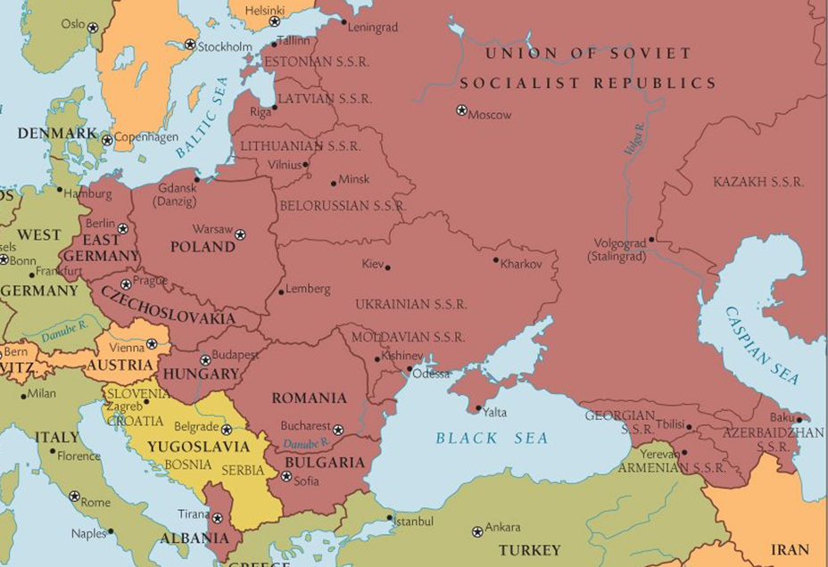
The 1940s - The Cold War Begins
A: Reasons for the Soviet take-over of Eastern Europe
Stalin decided to go against the Yalta Agreement and take over countries within Eastern Europe in order to create a ‘Soviet sphere of influence’ and ‘buffer zones’ that would protect the Soviet Union. The USSR had previously been invaded by Nazi Germany through Eastern Europe (Poland) and Stalin wanted to ensure that this would not happen again.
Stalin and the communists used a method called ‘slicing the salami’, where step by step, communists would take power by removing opposition, murdering or forcing opponents out of the country, and seizing control of the army. In Czechoslovakia a politician, Jan Masaryk, was murdered by being defenestrated (thrown out a window!).The 7 countries that were taken over by the Soviets were: Albania (1945), Bulgaria (1945), East Germany (1945), Hungary (1947), Poland (1947), Czechoslovakia (1948), Romania (1948). Yugoslavia, led by Tito, turned Communist without Stalin’s help, so were free from Russia’s control.
B: Truman Doctrine & Marshall Plan
Truman feared the ‘domino theory’ where communism would spread between countries. He wanted to push a policy of ‘containment’ to stop the spread of communism. This idea of containing communism, and protecting capitalist countries, is called the Truman Doctrine, which was created in 1947. Because of the Truman Doctrine the Americans created the Marshall Plan in 1948; the plan gave financial support to countries at risk from Communism. As a consequence of this $13 billion was invested in European countries. Truman offered financial support to Turkey and Greece when it looked likely they may be taken over by the Communists. The Marshall Plan was, in theory, to provide ‘aid’ to rebuild Europe after WWII. The Russian’s thought it was a method to gain more control in Europe. They nicknamed it ‘Dollar Imperialism’, and banned Communist countries from receiving the ‘aid’.

Slide 34
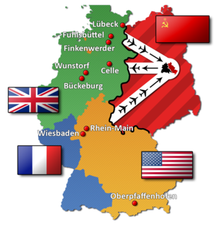
C: Cominform & Comecon
As a result of the Marshall Plan, Stalin set up Cominform, an organisation that helped control the governments of Eastern Europe. He also set up Comecon in 1949, which was the USSR’s version of the Marshall Plan. This promoted trade between all Communist countries, but favoured the USSR by pushing countries to buy products off the USSR and sell their products to the USSR cheaply.
D: Berlin Blockade, 1947-49
At Yalta, Germany had been split into an eastern zone (controlled by the Soviets) and 3 western zones (controlled by USA, Britain and France). Berlin (in the eastern zone) had also been split into Soviet controlled east, and USA controlled west. Stalin believed that the USA would want to turn the whole of Germany into a capitalist country. Therefore, in June 1948, he shut all road, canal and train routes into the western sector of Berlin, preventing all supplies getting into western Berlin. West Berlin only had 36 days of food left. As a result, the allies started the ‘Berlin Airlift’ where they flew food, fuel and medicine into West Berlin to keep it going. At its most busy, one plane landed in West Berlin every minute, and the USA spent $350 million keeping West Berlin supplied. By May 1949, Stalin realised the airlift was making him look weak, and he called off the Blockade. As a consequence of this event two separate German states were created: East Germany and West Germany.
E: NATO formed & USSR get the Atomic Bomb - 1949
In response to the Berlin Blockade, the capitalist countries feared the USSR may invade or attack another country. As a result, they created NATO – the North Atlantic Treaty Organisation. The members of this group were capitalist, and all agreed to defend each other if attacked. West Germany didn’t join NATO at first, but would do later in 1955. A few months after NATO was created, Russia successfully go their own atomic bomb. This meant both sides had nuclear weapons, and tension between the countries increased.
F: Chinese Revolution
In 1949 China, led by Chairman Mao, turned Communist. This was a major victory for the communists as China had a population of 450 million, and could now influence events in Asia. Truman, because of Domino Theory, believed that the USA would have to take action against any other countries in Asia that wanted to follow China into Communism. Russia signed the Treaty of Friendship with China in 1950.

Slide 35
Task 1: Overview of the 40s
For each event, add at least 2 details to help you remember what happened
Yalta & Potsdam
NATO
Tension in the 1940s
Early Arms Race
Soviet Expansion in Eastern Europe
Cominform & Comecon (Stalin’s response to TD)
Marshall Plan & Truman Doctrine
Berlin Blockade

Slide 36
Task 2: Key Terms of the 1940s
After reading the first 2 sections of the content pack (Wartime Alliance & Soviet Expansion) define these key terms
Key Term | Your definition
Wartime Alliance
Communism
Capitalism
Yalta
Potsdam
Buffer Zone
Truman
Stalin
Truman Doctrine
Marshall Plan
Dollar Imperialism
Comecon
Cominform
Berlin Blockade
Berlin Airlift

Slide 37
Exam Practice
Cold War Q3 – 8 marks: Write an account of how events in Berlin caused tension in the 1940s
____________________________________________________________________________________________________________________________________________________________________________________________________________________________________________________________________________________________________________________________________________________________________________________________________________________________________________________________________________________________________________________________________________________________________________________________________________________________________________________________________________________________________________________________________________________________________________________
____________________________________________________________________________________________________________________________________________________________________________________________________________________________________________________________________________________________________________________________________________________________________________________________________________________________________________________________________________________________________________________________________________________________________________________________________________________________________________________________________________________________________________________________________________________________________________________

Slide 38
Exam Practice
Cold War Q3 – 8 marks: Write an account of how the Soviet Takeover in eastern Europe increased Cold War tension
____________________________________________________________________________________________________________________________________________________________________________________________________________________________________________________________________________________________________________________________________________________________________________________________________________________________________________________________________________________________________________________________________________________________________________________________________________________________________________________________________________________________________________________________________________________________________________________
____________________________________________________________________________________________________________________________________________________________________________________________________________________________________________________________________________________________________________________________________________________________________________________________________________________________________________________________________________________________________________________________________________________________________________________________________________________________________________________________________________________________________________________________________________________________________________________

Slide 39
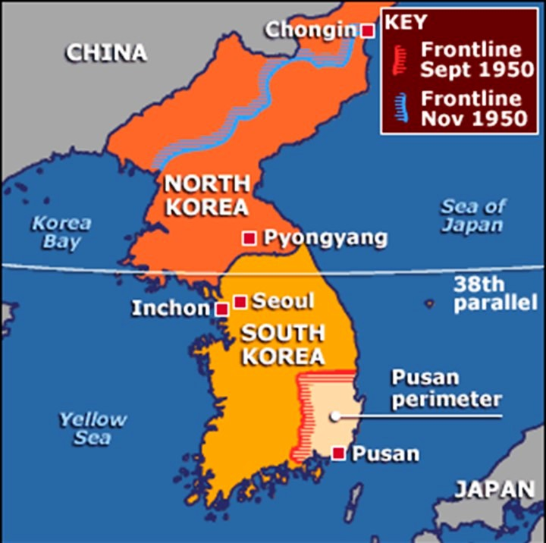
Developing hostilities 1950s
A: The Korean War
In 1950 Communist North Korea invaded the Capitalist South. The North were encouraged by Russia and backed by China – which had turned communist the year before.
The USA, fearing the spread of communism, pressurised the UN into agreeing to support capitalist South Korea. At first, the North pushed the South all the way down the Pusan on the south coast, but then America and the UN forces managed to ‘roll back’ the communists all the way up Korea to its border with China. China then sent 250,000 troops to support the northern forces.
The USA’s troops were led by General MacArthur, who wanted President Truman to drop the atomic bomb on China. The President refused, fearing nuclear war with the communists, and the sacked MacArthur in 1951. The war eventually ended in a stalemate in 1953, when both sides realised that neither could win. The border was agreed at the 38th parallel.
B: The Arms and Space Race 1950s
After both sides had developed atomic bombs in the 40s, the so called ‘arms’ and ‘space’ races began between the two superpowers. In the Arms Race, the next step was Hydrogen bombs, which were 1000 times more powerful than atomic bombs. The USA tested the first H bomb in 1952, with the USSR testing theirs only a year later. In 1957, the USSR took the lead in the Space Race launching the first ICBM (Inter-continental ballistic missile).
In the Space Race, the Soviets shocked America by launching the first man made satellite into space (Sputnik) in 1957, followed shortly in the same year by Sputnik II, which took Laika the dog into space. Both ‘races’ would continue into the 1960s.
C: West Germany join NATO and the Warsaw Pact
In 1955, West Germany was allowed to join NATO; Russia saw this as an aggressive move which broke the Yalta Agreement on Germany. In 1955 a similar agreement had been made between eastern, communist countries called the Warsaw Pact. After Stalin’s death in 1953, the new leader of the USSR, Khrushchev, (though very different from Stalin in many ways) wanted to continue the policy of the creating protective ‘buffer’ states that would support each other in the event of a military attack.

Slide 40
D: Hungarian Uprising, 1956
Throughout the 1950s Hungary had been run by the hard line Communist, Rakosi, whose leadership had led to increasing unrest amongst the population. Following Stalin’s death there was increasing opposition to Rakosi’s rule, especially following Khrushchev’s description of Stalin as a ‘wicked tyrant’. Khrushchev replaced Rakosi with Erno Gero, but this plan failed, leading to the placement of Imre Nagy, who was highly respected by the Hungarian public. Nagy immediately announced his plans to reform and soften communism in Hungary, including his desire to remove Hungary from the Warsaw Pact. Khrushchev refused to allow this to happen and, in November ordered Soviet troops into Hungary to ‘restore order’. Nagy was eventually executed, and Kadar was placed as leader of Hungary, by Khrushchev, who had signalled his intent to refuse to allow the breakdown of the Warsaw Pact.

Slide 41
Task 3 Cross decade conflicts
For each event, add 3 points of detail to help you remember what happened
NOTE (you may need to turn ahead to the 60s knowledge section!
Space Race
Cross-decade conflicts
Vietnam
Arms Race

Slide 42
Task 4: Overview of the 50s
For each event, add 3 points of detail to help you remember what happened
Korean War
Tension in the 1950s
1950s Arms & Space Race
Warsaw Pact
Hungarian Uprising

Slide 43
Task 5: Key Terms of the 1950s & Asia
After reading the first 2 sections of the content pack (Wartime Alliance & Soviet Expansion) define these key terms
Key Term | Your definition
Chairman Mao
Korean War
Kim il Sung
Vietnam
Atomic Bomb
ICBM
Sputnik
Warsaw Pact
Rakosi
Imre Nagy
Khrushchev

Slide 44
Exam Practice
Cold War Q3 – 8 marks: Write an account of events in Hungary increased Cold War tension
____________________________________________________________________________________________________________________________________________________________________________________________________________________________________________________________________________________________________________________________________________________________________________________________________________________________________________________________________________________________________________________________________________________________________________________________________________________________________________________________________________________________________________________________________________________________________________________
____________________________________________________________________________________________________________________________________________________________________________________________________________________________________________________________________________________________________________________________________________________________________________________________________________________________________________________________________________________________________________________________________________________________________________________________________________________________________________________________________________________________________________________________________________________________________________________

Slide 45
Exam Practice
Cold War Q3 – 8 marks: Write an account of events in Asia increased tension in the 1950s
____________________________________________________________________________________________________________________________________________________________________________________________________________________________________________________________________________________________________________________________________________________________________________________________________________________________________________________________________________________________________________________________________________________________________________________________________________________________________________________________________________________________________________________________________________________________________________________
____________________________________________________________________________________________________________________________________________________________________________________________________________________________________________________________________________________________________________________________________________________________________________________________________________________________________________________________________________________________________________________________________________________________________________________________________________________________________________________________________________________________________________________________________________________________________________________

Slide 46
The Cold War heats up! - 1960s
A: The U2 spy plane crisis
The USA had been flying spy plane missions over Russia throughout the 1950s. Khrushchev was furious when he found out. In May 1960, just two weeks before the Four Powers meeting in Paris, the Soviets shot down an American U2 spy plane, and capture the pilot Gary Powers. At first, America refused to apologise, and claimed the plane was flying in order to check weather conditions. Khrushchev refused to attend the meeting in Paris, which was going to solve the issue of the Cuban Revolution (1959), solve tension over weapons, and resolve problems in Berlin. Powers was sentenced to 10 years in prison but he was released when the USA agreed to free Soviet prisoners in exchange. Eventually the USA admitted to spying on USSRs military bases, but this crisis meant that lots of other issues went unsolved.
B: The Berlin Wall, 1961
By the 1960s, West Germany (and West Berlin) had become a thriving economy, with all the benefits of capitalist culture for the population: such as supermarkets and the latest technology. Many East Germans decided to move to the West as better jobs and pay were available. This was called the ‘brain drain’. Meanwhile in the East jobs were decreasing and citizens had no freedom of speech. There was also concerns that Berlin was an easy location for spies to enter communist Europe. As a result of these issue, the USSR responded by constructing the Berlin Wall in August 1961. Overnight, families had been divided. No East Germans were permitted to cross over into the west.
A big flashpoint of tension occurred in October 1961, when Soviet and American tanks met each other at the newly created border (Checkpoint Charlie) until eventually they began to draw back, metre by metre. The two superpowers had come close to out and out war; Kennedy (USA President) commented (on the wall) that ‘it’s not a nice solution, but it’s better than a war’.
C: Cuban Missile Crisis, 1959-62
Cuba was (an island 90 miles off the coast of America). In 1959, Fidel Castro led a Communist revolution, and managed to turn Cuba into a communist country. This alarmed America. So, in 1961, they launched an attack on Cuba at the Bay of Pigs. The American attack failed, and Cuba continued as a Communist country. In early 1962 America placed missiles in Turkey within range of Russia. The Soviets decided to exploit the situation by placing missiles in Cuba; however, U2 spy planes managed to take pictures of the missile site in Cuba. Khrushchev denied any knowledge of the missile site, so the Americans set up a quarantine around Cuba that allowed them to stop and search Russian ships entering Cuba.

Slide 47
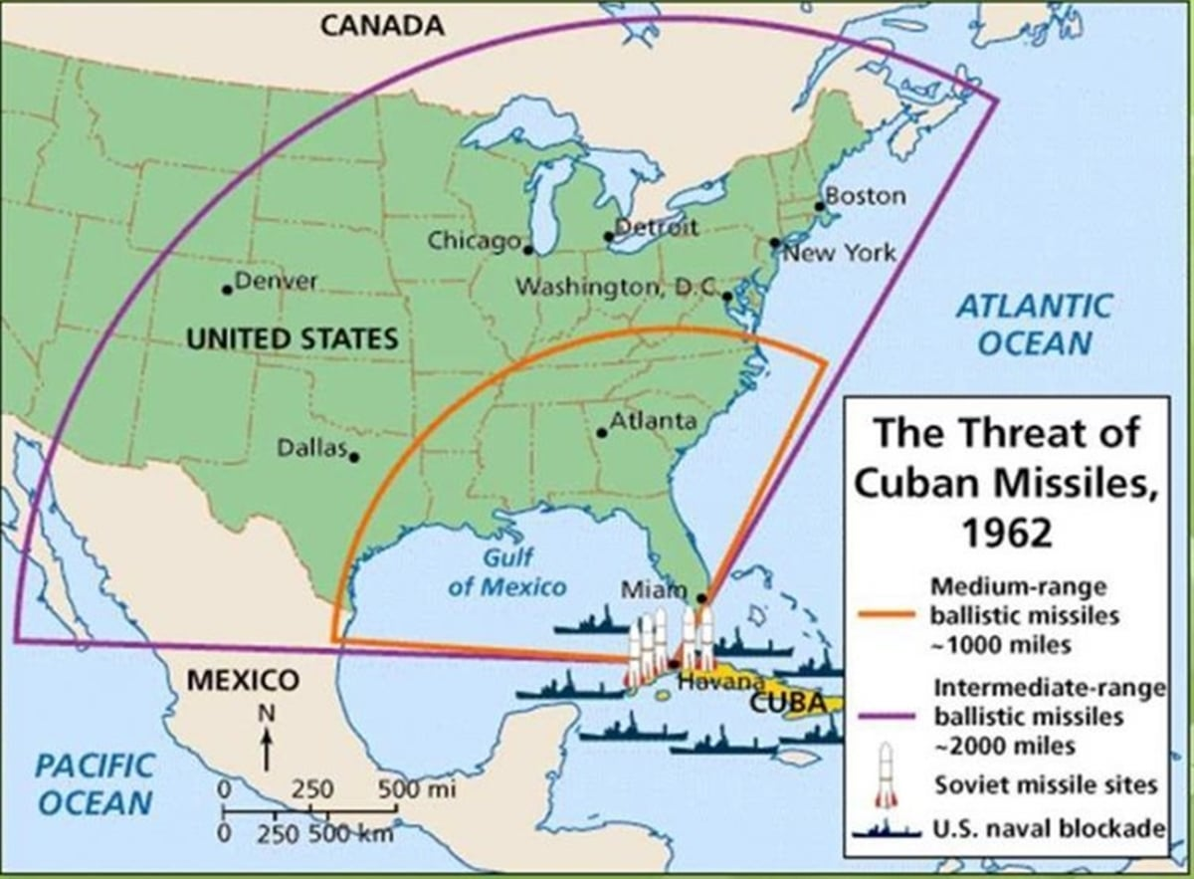
Both Kennedy and Khrushchev were urged to use their nuclear missile by their advisors. Instead, Khrushchev wrote a letter to the Kennedy stating that the Soviets would remove their nuclear weapons from Cuba if the USA did not attack Cuba. He then sent a second letter stating that they would remove their missiles from Cuba, if America removed theirs from Turkey. Kennedy responded and agreed to the first letter, and (at a later meeting) it was agreed that the missiles from Turkey would also be removed. Nuclear war had been avoided, and both leaders were alarmed at how close the superpowers had come to nuclear war.
D: The Space and Arms Race 1960s
The Arms Race continued into the 1960s, with the USSR conducting a test of the Tsar Bomba (type of H bomb), the most powerful bomb ever detonated, in 1961. Through the decade both sides would build up their supply of weapons. In 1961, the USSR also managed to put the first man into space, Yuri Gagarin. As a result of Russia taking the lead in the Space Race, the Americans began to pour money into space research; they created the Apollo mission which resulted in the first moon landing in 1969.
E: Prague Spring - 1968
In 1968 Alexander Dubcek was the leader of Czechoslovakia: a strong, communist country within the Warsaw Pact. Dubcek proposed a ‘reform’ of communism with less restrictions to be placed on the public and the creation of new political parties. This was called ‘socialism with a human face’. Because of these new ideas the period was given the nickname the ‘Prague Spring’. The new Soviet leader, Brezhnev, attempted to intimidate Dubcek into slowing down his reforms by placing Soviet troops on the border with Czechoslovakia. However, on the 20th August Soviet troops arrived in Prague, and Dubcek was removed from his position. Brezhnev had (like Khrushchev before him) signalled his intention to refuse to allow the breakdown of the Warsaw Pact, leading to the ‘poisoning’ of relations between East and West. The USA had again showed they wouldn’t act to help in the soviet part of Europe, as they were busy in the Vietnam War.
F: Vietnam War - 1960s
During the 1960s, America became involved in the Vietnam War. The country had descended into civil war between the communist North (led by Ho Chi Minh) and capitalist South (led by Ngo Dinh Diem). The Communist forces (the Vietcong) were provided with weapons and supplied by the USSR. In 1964, The first US troops arrived, with numbers peaking at just over 500,000 in 1969. They used advanced weapons and planes such as B-52s, and also deployed chemicals liked napalm and Agent Orange to help them fight in the jungle. However, these tactics failed, and the Vietcong inflicted heavy losses using guerrilla tactics (surprise attacks and traps). In 1968 the Vietcong launched the Tet Offensive, where they attacked all over south Vietnam. By then, it was clear the US would not win. President Nixon began to cut troop numbers down from 1969. The USA were defeated in the 1970s.

Slide 48
The Cold War Thaws - 1970s
A: Détente and SALT
In the late 60s and early 70s the word ‘détente’ (meaning an easing of tensions) became used to describe relations between the USA and Soviets. The USA President Nixon and USSR President Brezhnev were the two leaders at time and have become associated with the idea of ‘détente’ and the creation of a ‘thaw’ in relations. Both Presidents had come to realise that the ongoing cost of the Cold War, including the Asian conflicts and Arms Race, could not carry on forever. In 1972 SALT (strategic arms limitations talks) began and the deal, SALT I was signed in that year. This limited the number of weapons each side could have. This signalled an improving relationship between the East and West, and the move to more peaceful relations, based on trade and boosting their economies.
B: US Withdraw from Vietnam
President Nixon began the process of Vietnamisation in the 1970s, which is where they planned to slowly withdraw troops and let South Vietnam defend themselves. The US continued to take heavy losses, and the South were unable to stand up to the communist North. In 1975, the last US troops and diplomats fled Saigon, the capital of the south. 58,000 US soldiers had died, and between 1-4 million North Vietnamese were killed in the conflict.
C: Sino-Soviet Split
China and Russia had begun to drift apart, and the USA become closer to China. In the early 1970s the USA Ping-Pong Team visited Beijing and played the Chinese team. This ‘Ping-Pong Diplomacy’ paved the way from a visit from the US President. President Nixon made a historic visit to Beijing, the capital of China in 1972, and dropped their opposition to them joining the UN. After this, tension was further reduced when, later in 1972, Nixon visited the Russian leader Brezhnev in Moscow. Tensions were easing in the Cold War.

Slide 49
Task 6: Overview of the 60s
For each event, add at least 2 details to help you remember what happened
U2 Crisis
1970s - Detente
Tension in the 1960s
Berlin Wall
Late Space & Arms Race
Prague Spring
Cuban Missile Crisis

Slide 50
Task 7: Key Terms of the 1960s
After reading the first 2 sections of the content pack (Wartime Alliance & Soviet Expansion) define these key terms
Key Term | Your definition
Gary Powers
Four Powers
Berlin Wall
Checkpoint Charlie
Fidel Castro
Bay of Pigs
Kennedy
Quarantine
Alexander Dubeck
Brezhnev
Detente
SALT

Slide 51
Exam Practice
Cold War Q3 – 8 marks: Write an account of events in Czechoslovakia increased tension in the 1950s
____________________________________________________________________________________________________________________________________________________________________________________________________________________________________________________________________________________________________________________________________________________________________________________________________________________________________________________________________________________________________________________________________________________________________________________________________________________________________________________________________________________________________________________________________________________________________________________
____________________________________________________________________________________________________________________________________________________________________________________________________________________________________________________________________________________________________________________________________________________________________________________________________________________________________________________________________________________________________________________________________________________________________________________________________________________________________________________________________________________________________________________________________________________________________________________

Slide 52
Exam Practice
Cold War Q3 – 8 marks: Write an account of how the arms and space race increased tension in the 1950s and 1960s
____________________________________________________________________________________________________________________________________________________________________________________________________________________________________________________________________________________________________________________________________________________________________________________________________________________________________________________________________________________________________________________________________________________________________________________________________________________________________________________________________________________________________________________________________________________________________________________
____________________________________________________________________________________________________________________________________________________________________________________________________________________________________________________________________________________________________________________________________________________________________________________________________________________________________________________________________________________________________________________________________________________________________________________________________________________________________________________________________________________________________________________________________________________________________________________

Slide 53
Exam Practice
Cold War Q4 – 16 marks
‘The post-war conferences were the main cause of tension in the 1940s’ How far do you agree with this statement?
______________________________________________________________________________________________________________________________________________________________________________________________________________________________________________________________________________________________________________________________________________________________________________________________________________________________________________________________________________________________________________________________________________________________________________________________________________________________________________________________________________________________________________________________
____________________________________________________________________________________________________________________________________________________________________________________________________________________________________________________________________________________________________________________________________________________________________________________________________________________________________________________________________________________________________________________________________________________________________________________________________________________________________________________________________________________________________________________________________________________________________________________

Slide 54
______________________________________________________________________________________________________________________________________________________________________________________________________________________________________________________________________________________________________________________________________________________________________________________________________________________________________________________________________________________________________________________________________________________________________________________________________________________________________________________________________________________________________________________________________________________________________________________________________________________________________________________________________________________________________________________________________________________
____________________________________________________________________________________________________________________________________________________________________________________________________________________________________________________________________________________________________________________________________________________________________________________________________________________________________________________________________________________________________________________________________________________________________________________________________________________________________________________________________________________________________________________________________________________________________________________

Slide 55
Exam Practice
Cold War Q4 – 16 marks
‘NATO and the Warsaw Pact were the main drivers of the cold war between 1949-60’
How far do you agree with this statement?
______________________________________________________________________________________________________________________________________________________________________________________________________________________________________________________________________________________________________________________________________________________________________________________________________________________________________________________________________________________________________________________________________________________________________________________________________________________________________________________________________________________________________________________________
____________________________________________________________________________________________________________________________________________________________________________________________________________________________________________________________________________________________________________________________________________________________________________________________________________________________________________________________________________________________________________________________________________________________________________________________________________________________________________________________________________________________________________________________________________________________________________________

Slide 56
______________________________________________________________________________________________________________________________________________________________________________________________________________________________________________________________________________________________________________________________________________________________________________________________________________________________________________________________________________________________________________________________________________________________________________________________________________________________________________________________________________________________________________________________________________________________________________________________________________________________________________________________________________________________________________________________________________________
____________________________________________________________________________________________________________________________________________________________________________________________________________________________________________________________________________________________________________________________________________________________________________________________________________________________________________________________________________________________________________________________________________________________________________________________________________________________________________________________________________________________________________________________________________________________________________________

Slide 57
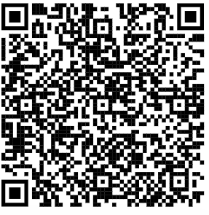

Video playlists for Paper 1
Germany
Cold War

