Slide 1
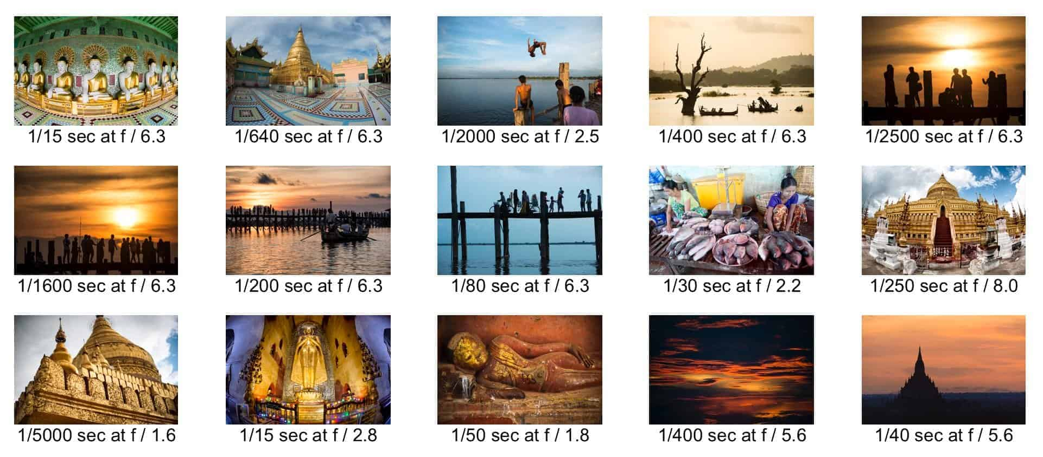

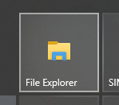
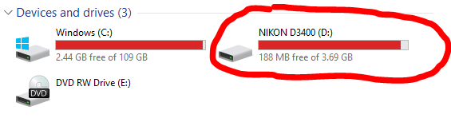
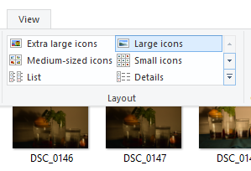
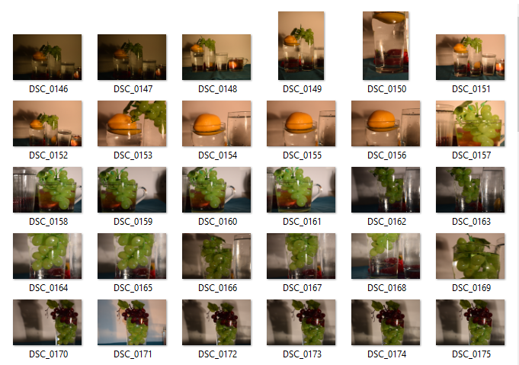
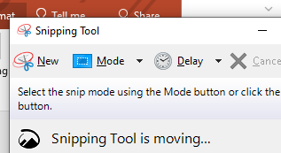
Contact sheet
Definition: A sheet of paper presenting ALL of the photographs from your photoshoot in one place.
1. Open up file explorer.
Why we need to make a contact sheet
To show off our photoshoot as a whole.
To save space in our books rather than having to print off your whole photoshoot large.
It allows us to see if our ideas are working.
So we can see the image numbers which is important so we know the order of your photographs and if any were deleted.
It helps us to reflect and evaluate how to take better photographs.
It allows us to plan how we may edit the photographs.
2. Under devices and drives open up the camera.
3. Click on ‘view’ then ‘large icons’ to change how you see the photographs.
4.Use the snipping tool to capture the whole photoshoot.
Present the contact sheet alongside enlarged versions of your favourite outcomes from the photoshoot. Be ready to analyse them.

Slide 2
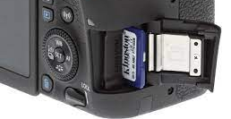
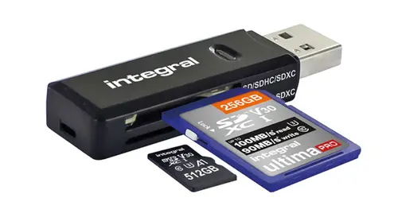
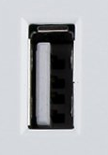

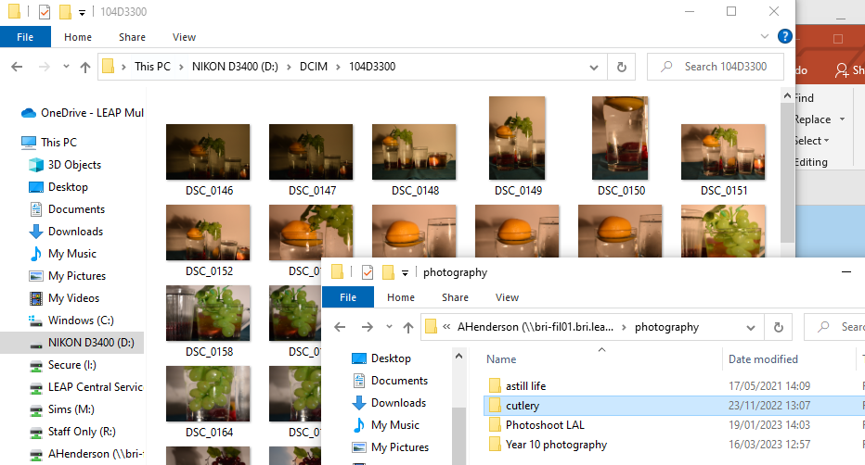
Uploading photographs
What makes a good photograph?
Different angles
Controlled lighting
Thoughtful compositions
Symbolic colour choices
Appropriate camera settings for intentions
1. Open up file explorer.
2. Under devices and drives open up the camera.
What makes a good photoshoot?
When you take LOTS of photographs.
When you use the skills listed above to enhance what would otherwise be snapshot images.
The photographs you take link with your idea, research and artists’/ photographers’ work.
When you don’t delete images just because you don’t like them.
3. Click on ‘view’ then ‘large icons’ to change how you see the photographs.
NOTES: Remember to put your memory card safely back into the correct camera.
4.Open up another file explorer and have the screen side by side. On the newest screen, find the folder you would like to save the images into. Drag and drop the photographs into the folder.

