Slide 1



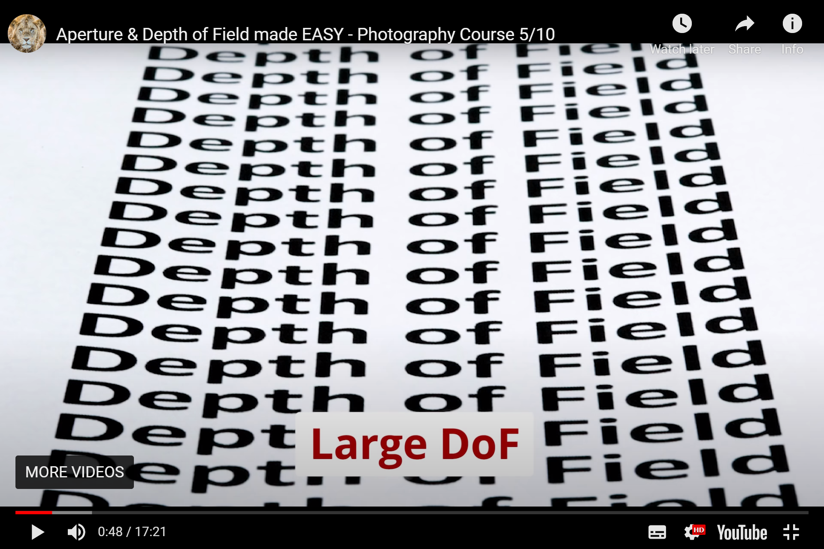
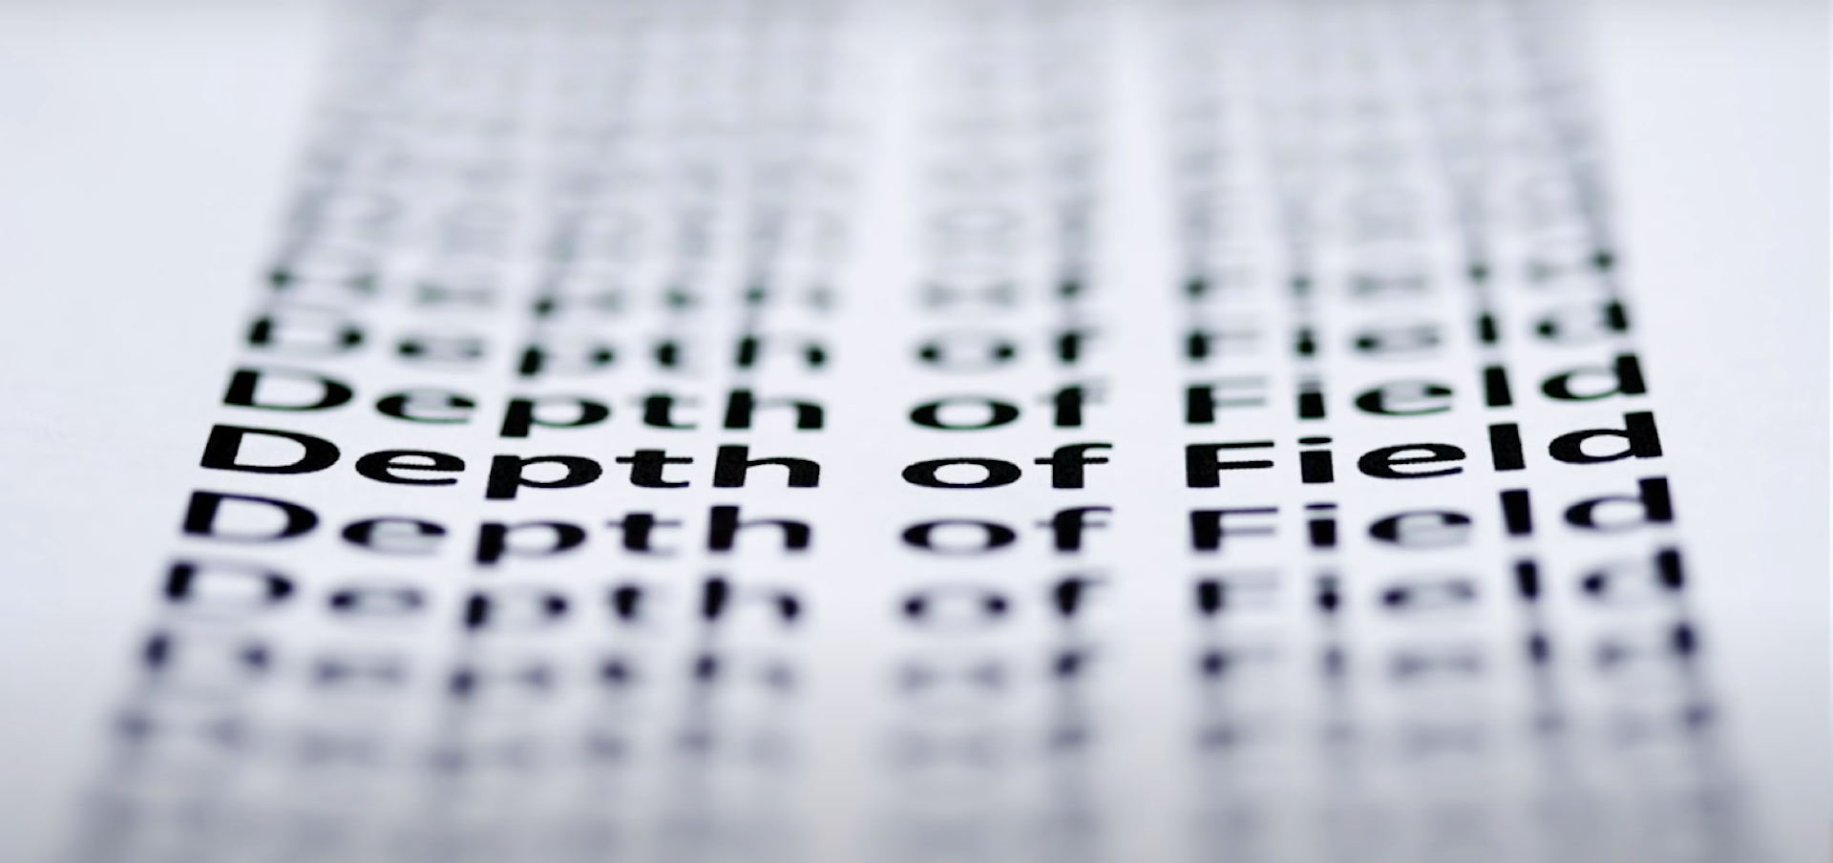
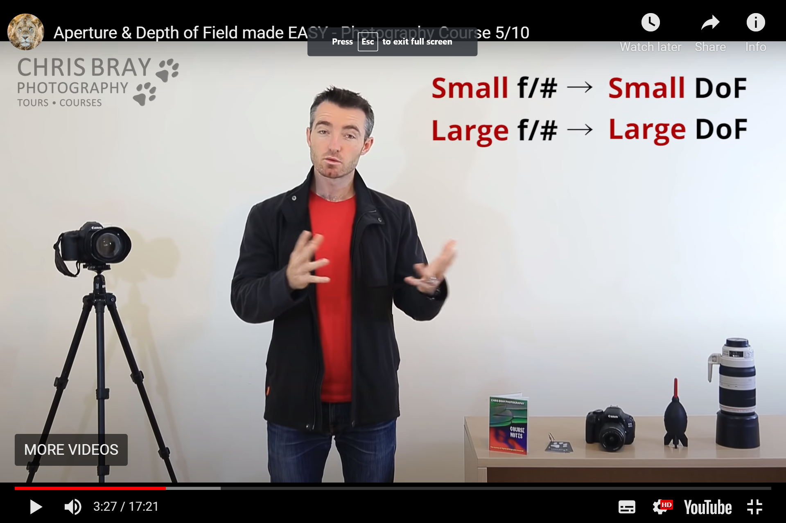
Depth of field refers to the amount or proportion of the image that is in sharp focus.
A narrow/shallow/small DoF means only a small proportion of the image is in sharp focus.
A large /wide DoF means the more of the image is in sharp focus.
Depth of Field (DoF)
Depth of field can be changed by adjusting the aperture setting on the camera and moving the camera when focusing.
Aperture is measured in F-Stops or the F-number on your camera.

Slide 2
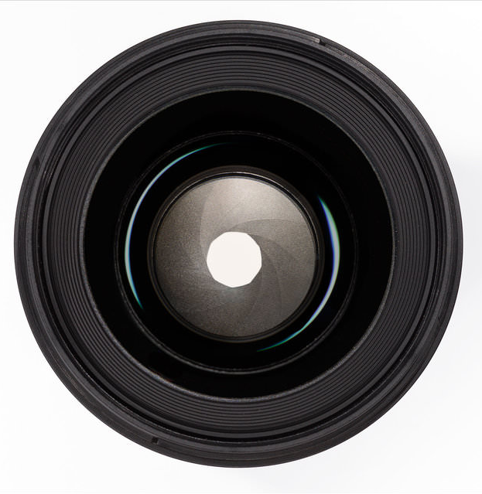
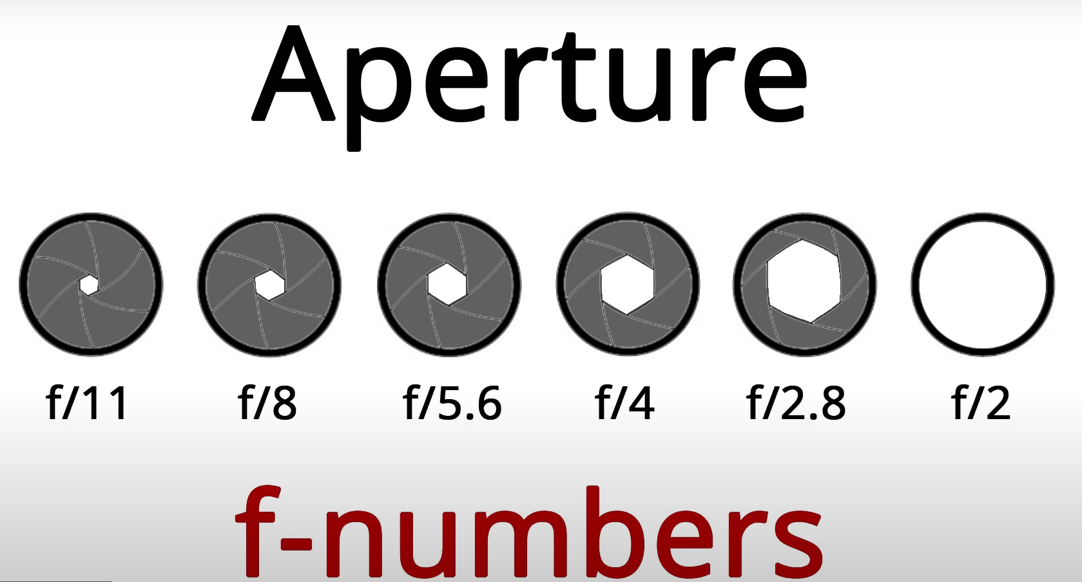
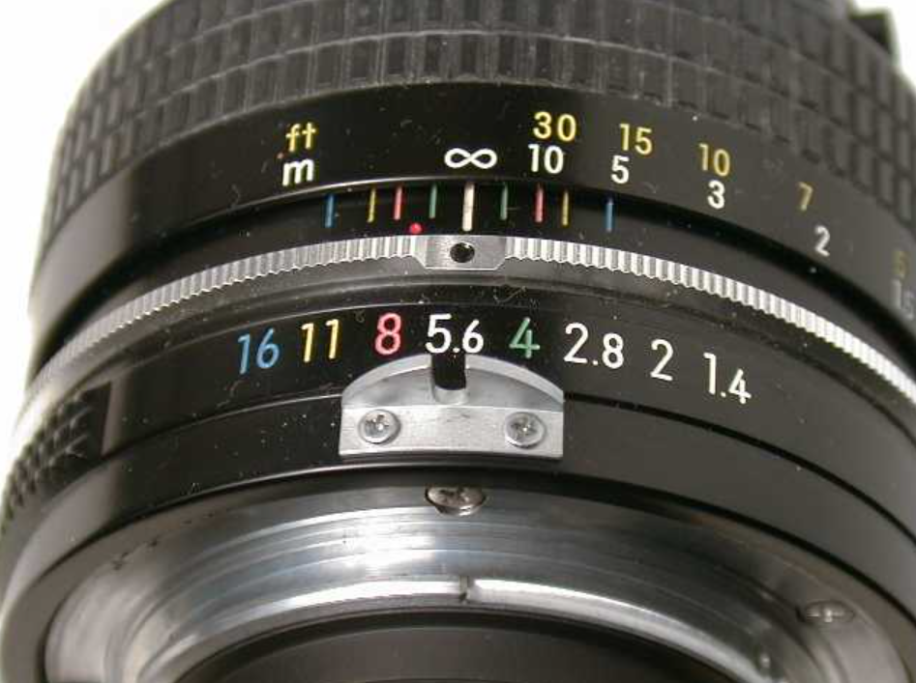
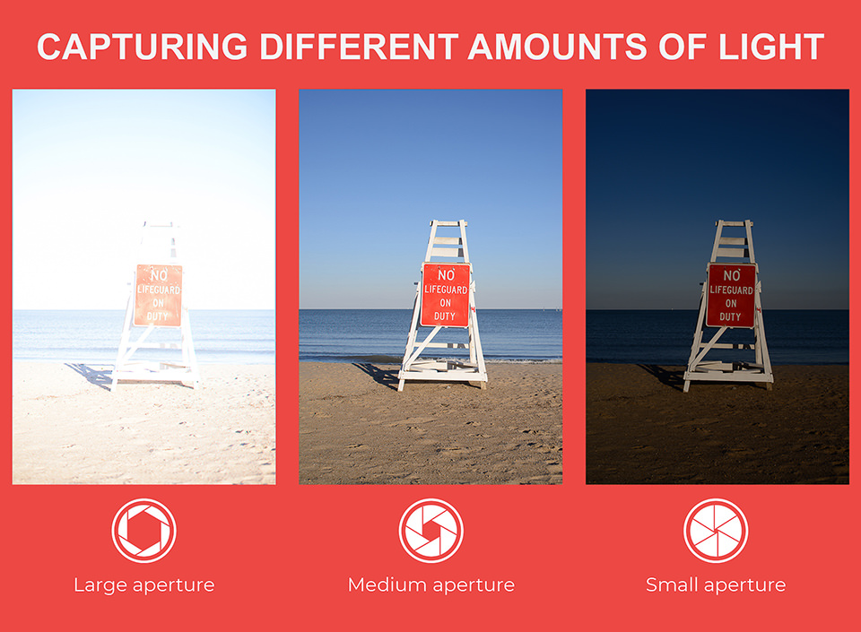

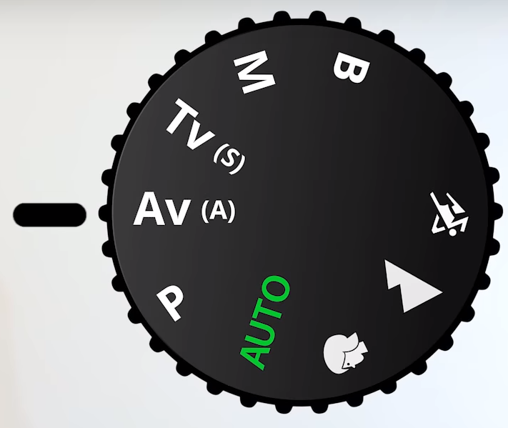
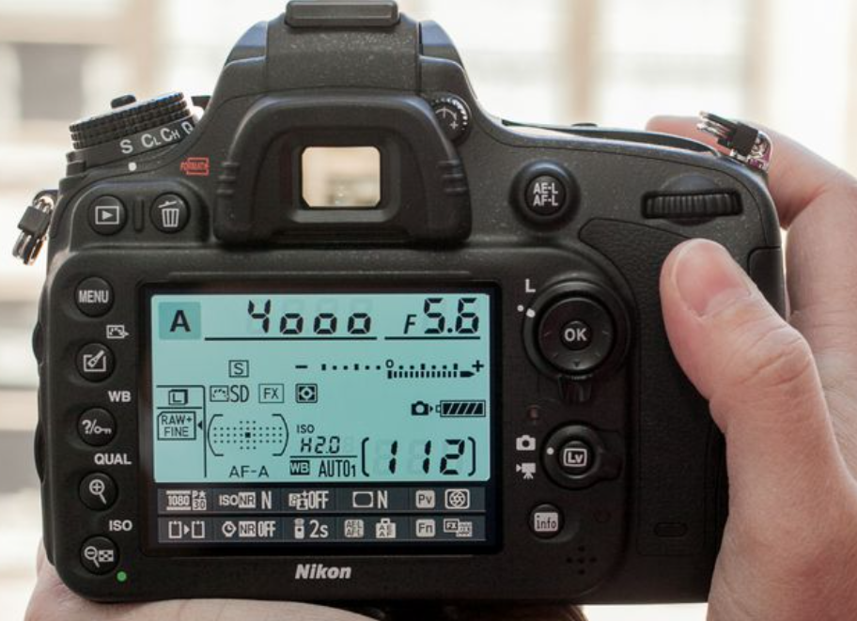
In photography, the “pupil” of your lens is called aperture. You can shrink or enlarge the size of the aperture to allow more or less light to reach your camera sensor.
What is the aperture?
What does adjusting the aperture change?
Analogue camera aperture ring
Digital camera aperture priority setting
Lighting Depth of field
Digital camera aperture adjust

Slide 3

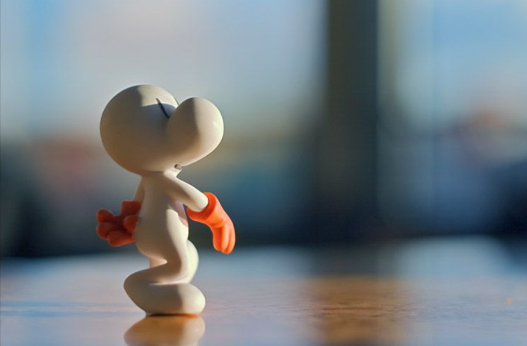



Shallow Depth of Field

