Slide 1
Introduction
Component 1

Slide 2



Shared Lesson Focus
Keywords
Secret Skills
Know: Some of the key facts of the where Delta Blues came from
Understand: What social and economic factors shaped the musical genre
Do: Write your own introduction to your Component 1 Powerpoint and an overview of the Delta Blues.
Be confident
Delta Blues
Mississippi
Hardship
Emotion filled
Slavery
Resilience
Note taking
Researching online
Timekeeping
Be creative
Be collaborative

Slide 3
Learning Outcome A: Demonstrate an understanding of styles of music
Task 1: Styles portfolio - Compile a portfolio of evidence that demonstrates your understanding of four different styles of music. For each style you should consider the use of: Compositional features: melody, harmony, tonality, rhythm & structure. Sonic features: instrumentation, texture, timbre & production. Your portfolio of evidence must include: At least one short musical example (12-30 seconds) of each of your chosen musical styles. You can create/perform these or use found/pre-existing examples. Individual commentary to support points in the most appropriate format, such as video, audio, written commentary or a combination of these.

Slide 4
BTEC Level 2 Tech Award in Music: Component 1
Learning Outcome A – Demonstrate an understanding of styles of Music
A1: Iconic composers, artists, bands and producers who have influenced and
impacted musical styles.
Impact of technology on musical styles, instruments, production and recording.
A2: Musical elements, stylistic features and characteristics (music theory)

Slide 5

Component 1
Genre 1: Delta Blues

Slide 6
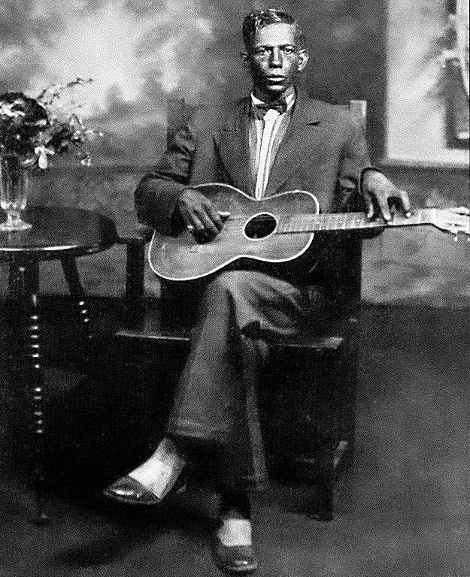
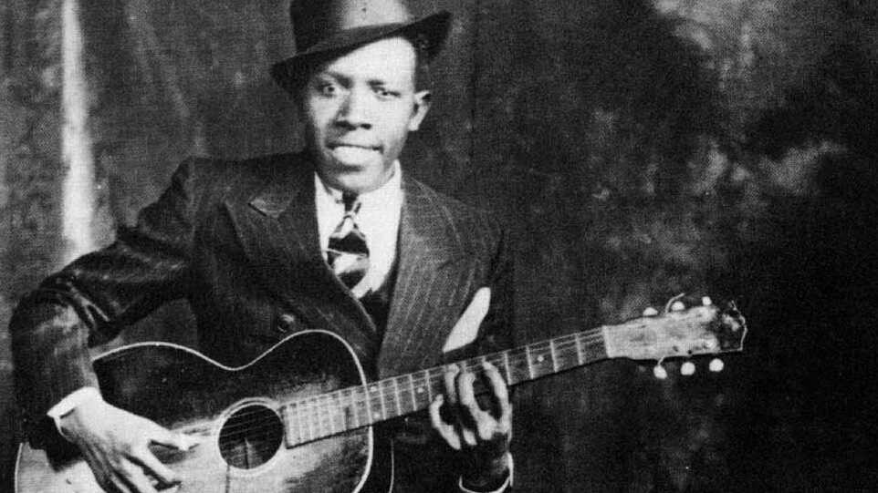
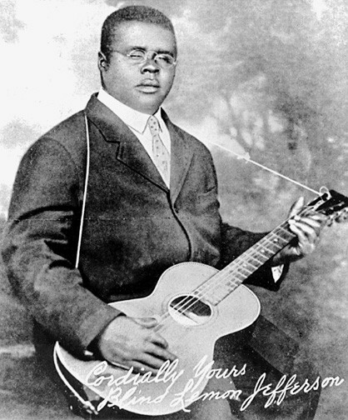
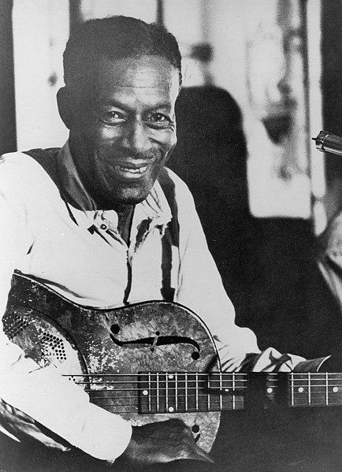
Background information:
Delta Blues
Overview
Delta Blues is a style of blues music that originated in the Mississippi Delta region of the United States in the late 19th century. It is characterised by its simple instrumentation, repetitive forms, and emotion-filled lyrics.
The first Delta Blues musicians were African Americans living in the Mississippi Delta region. These early blues musicians sang about the struggles of living in a rural, agricultural society, and their songs often contained lyrics about love, hard work, and hardship. Early Delta Blues musicians included Charley Patton, Blind Lemon Jefferson, Son House, and Robert Johnson.
Clockwise L-R: Charley Patton, Robert Johnson, Son House, Blind Lemon Jefferson

Slide 7
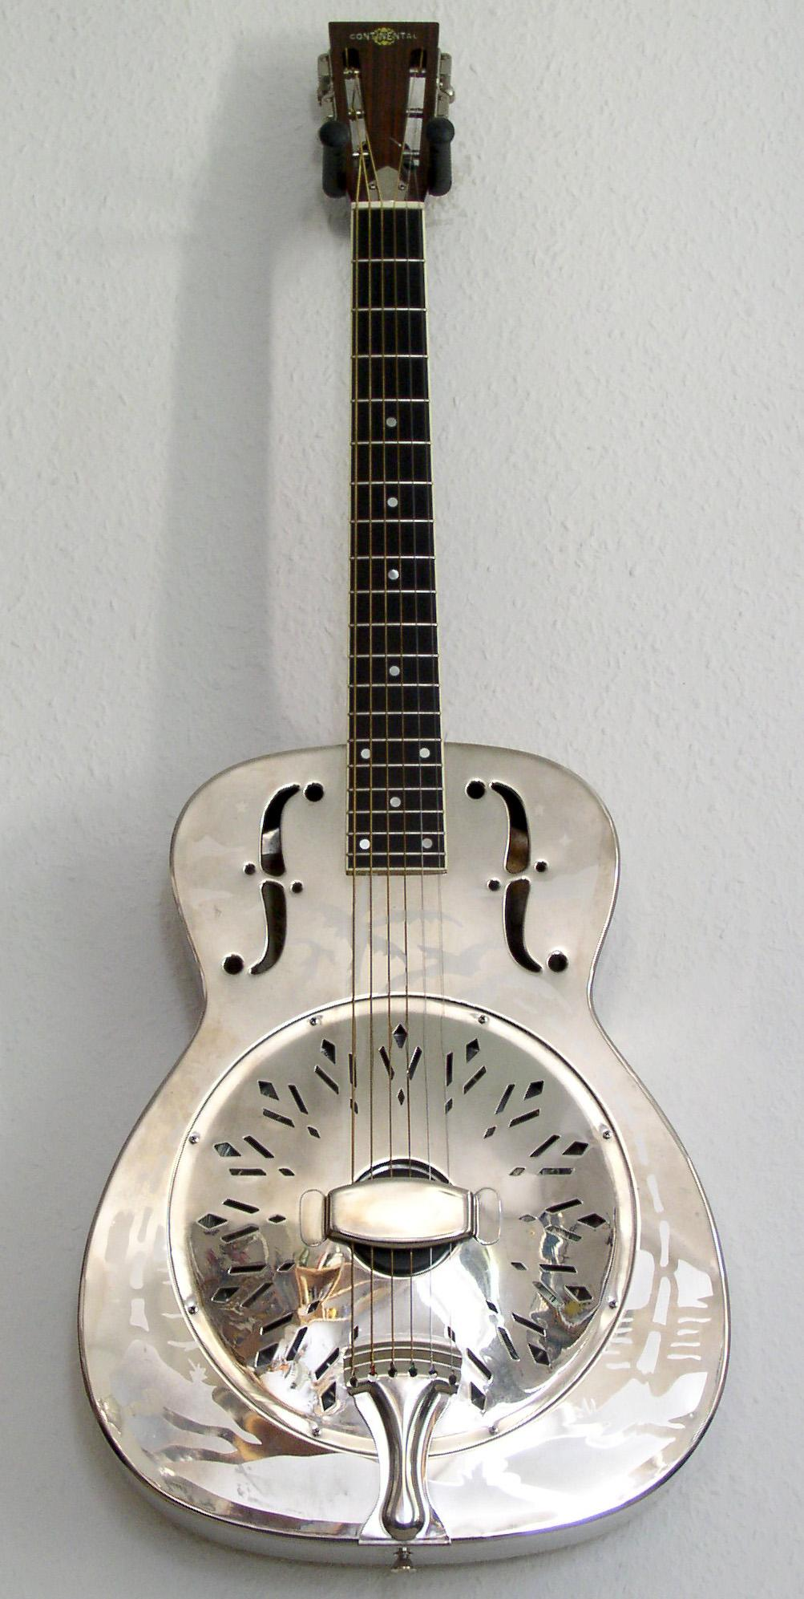
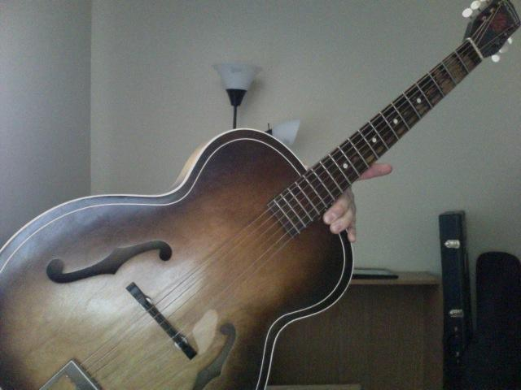
Sonic Feature: Instrumentation: Guitars
Acoustic Guitars
Played with pitch bending
Albert King - Blues Power
F-hole guitars
Guitars with “f hole” cut outs making it sound more mellow and “twangy”
Resonator Guitars
A steel string guitar shaped like a cone where the traditional sound hole would be.
Slide Guitar
Playing with a pipe or other piece of metal
Slide Guitar Example

Slide 8

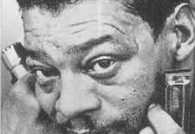
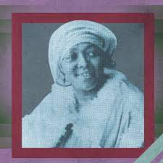
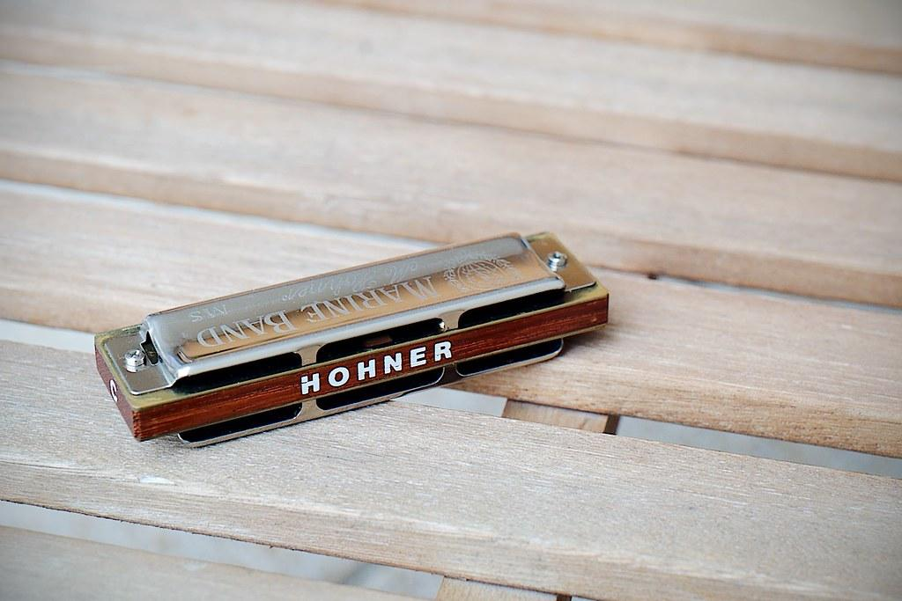
SONIC FEATURE:
Other main instruments
Vocals
Blues vocals pitch range would be in the “bass” vocal range, between the pitches of E2 to E4
Passionate and fiery, conveying the suffering, heartache and anguish..
There are female delta blues musicians, however not many were recorded. The best example is Geeshie Wiley: “Last Kind Word Blues”
Harmonica
Diatonic Harmonicas - Harmonicas that are tuned to a particular key
Chromatic Harmonicas - Harmonicas that play all the notes chromatically (sharps and flats)
An example of Harmonica can be found on the Delta Blues standard “Rollin’ and Tumblin’” by famous Harmonica musician Little Walter

Slide 9
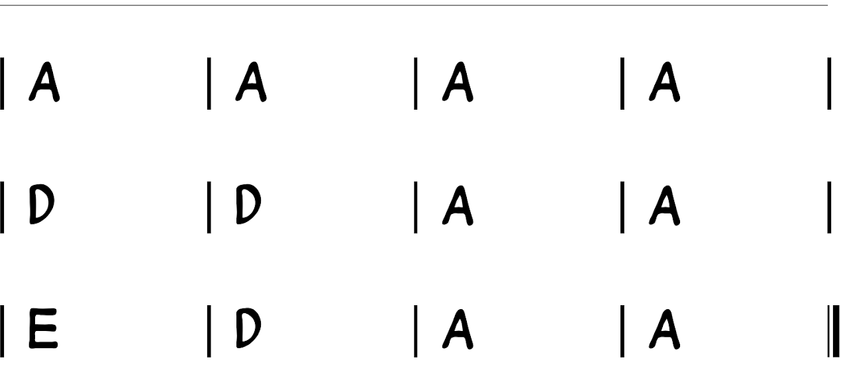
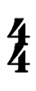
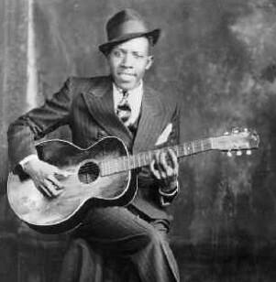
Harmony and Tonality - Harmony: The 12 bar blues chords
Note taking & build on this with your own research - copy out the table!
The 12-bar blues progression predominantly uses chords
I IV & V of the major scale.
When you use chords that belong to the key signature, this is called a diatonic chord progression
Each chord plays for 1 bar of 4/4 time in the pattern shown.
You do get some forms of improvisation, where a musician may play an extra bar of the same chord, but it will never play a chord that doesn’t belong to the scale.
The final line is often called the turn around and the final chord can be substituted to the dominant V (V7th) to show that the verse is going around again.
I
I
I
I
IV
IV
I
I
V
IV
I
I
E7
V7
Crossroads - Robert Johnson

Slide 10
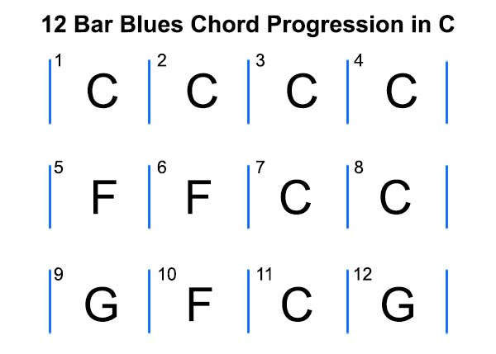
Harmony and Tonality - Harmony: The 12 bar blues chords
I
I
I
I
IV
IV
I
I
V
IV
I
I
Crossroads - Robert Johnson

Slide 11
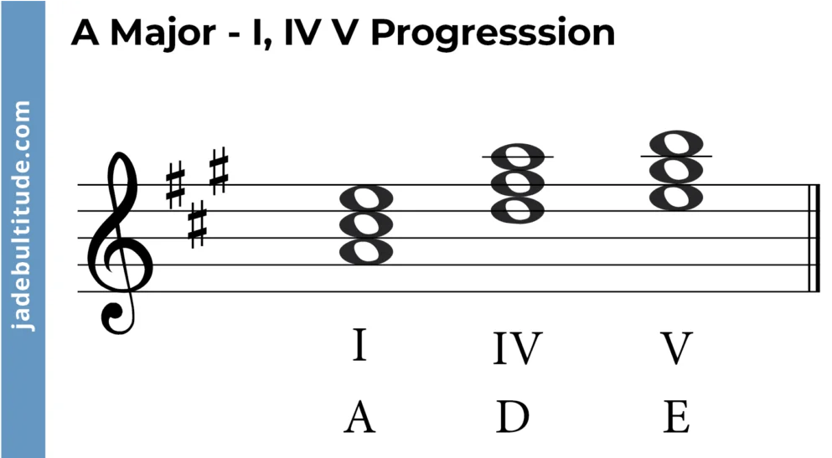
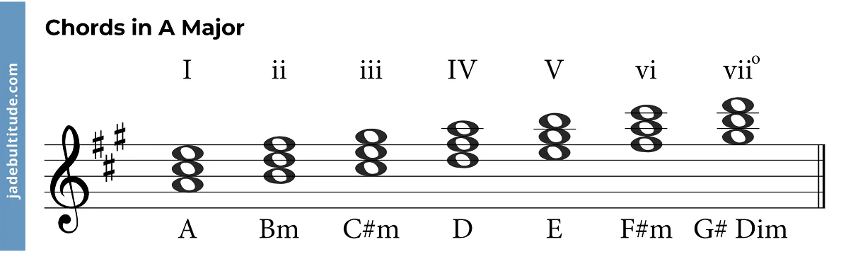
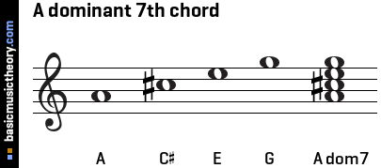
Harmony and Tonality - Harmony: Key signatures of Delta Blues:
Note taking & build on this with your own research - copy out the table!
There are two key signatures that are used in Delta Blues:
A major
A - I | A - I | A - I | A - I
D - IV | D - IV | A - I | A - I
E - V | D - IV | A - I | A - I E7 - V7
The Blues Chord (Dominant 7th chord
Dominant 7th chords are made up by stacking a minor 3rd (3 semitones) on top of an existing major triad (chord). This gives it the chord spelling of 1,3,5,b7
Dominant 7th chords are a massive feature of blues music and give it that distinctive “Blues” sound

Slide 12
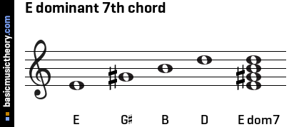
Harmony and Tonality - Harmony: The 12 bar blues chords
Extended harmony - Dominant 7th chords create a bluesy sound

Slide 13
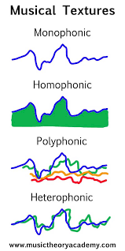
Texture
Texture - How many instruments can we here and their role:
Delta blues can be described in a variety of textures, Monophonic, Homophonic and Heterophonic
Heterophonic Texture
Eg. a harmonica playing a separate riff whilst somebody sings over the top
Here is an example by Mississippi John Hurt “Got the Blues (Can’t be satisfied) 00:00 - 01:00” (1928)
Monophonic Texture
An example would be the intro to “Devil Got My Woman” (00:00 - 00:20) by Skip James (1931)
Grinnin’ in your face by Son House - An example of acapella
Homophonic Texture:
Here is an example by Robert Johnson (Kind Hearted Woman Blues 1936)

Slide 14
Structure - How the song is presented
I | I | I | I
IV | IV | I | I
V | IV | I | I
I | I | I
I
These rules are not always followed!
Some songs choose do deviate from the typical structure. This is usually to play a blues lick (melodic fill/riff)
Crossroads by Robert Johnson

Slide 15
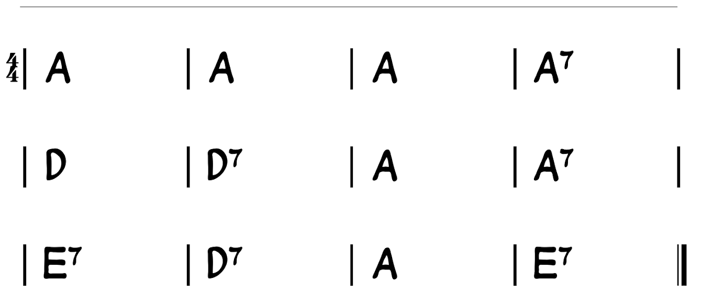
Melodic Technique:
Vocals:
Vocal melody uses the classic blues AAB rhyming pattern.
I went to the crossroad, fell down on my knees
I went to the crossroad, fell down on my knees
Asked the Lord above, "Have mercy, now, save poor Bob if you please"
Crossroads - Robert Johnson - 00:00 - 00:41

Slide 16
Melodic Technique:
Call and Response
Two different instruments/ voices responding to each other
These improvised guitar riffs are a direct response to RJ’s vocal melody throughout the 12 bar structure (00:08 - 00:38)

Slide 17
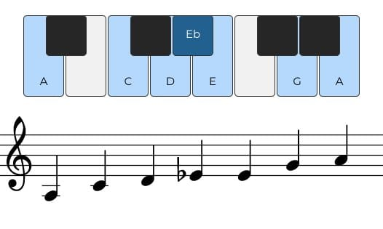
Melodic Technique:
Blues scale

Slide 18
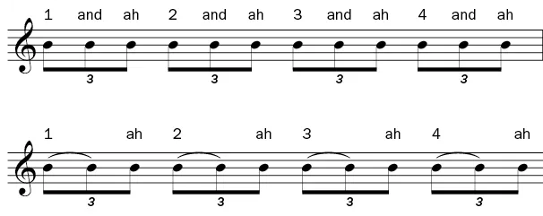
Rhythms In Blues Music
Patterns alternate between long and short durations
Triplet Swing
Swing rhythm guitar with solo: Kind Hearted Woman - 01:46 - 02:23 - Robert Johnson
Swing Rhythm using slide guitar - Crossroads Intro - 00:00 - 00:08 - The swing rhythm continues throughout.
Notes:
Encouraging students to clap the triplet patterns, accented the 1

Slide 19
Sonic Features: Production techniques:
Note taking & build on this with your own research
Production - How Delta Blues was recorded:
An example of the first blues recording in 1923, which was from the acoustic era

Slide 20
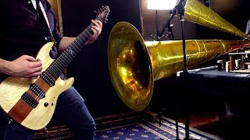
Sonic Features: Production techniques:
Note taking & build on this with your own research
Production - How Delta Blues was recorded:
An example of the first blues recording in 1923, which was from the acoustic era

Slide 21
Sonic Features: Production techniques:
Note taking & build on this with your own research
Production - How Delta Blues was recorded:
Before 1925, performers would play in front of a flared metal horn, which would capture all the soundwaves through vibration. A small, needle, know as a stylus, which would etch the vibrations into the metal disk. These disks would either be coated in wax or could be made or softer metals, capturing the sound at that precise time.
This process however did evolve and from 1925, a combination of this process and using microphones which could regulate the volume and filter the sound made recordings a much easier process.
Below is an example of the first blues recording in 1923, which was from the acoustic era
Below is an example of a blues recording from the electric era, this was recorded in 1929

