Slide 1

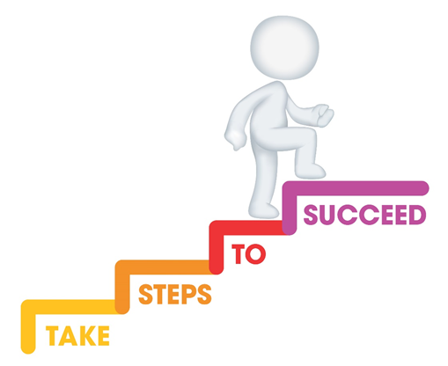






Do it now task | Success criteria | The bigger picture | New information | Application | Demonstrate success | Plenary
Content Area 8 Revision Booklet
Todays date:
14/03/25
Last lesson What is one challenge of a child-centred approach? | Last lesson What is one purpose of the planning cycle?
Last week What is one benefit of a child-centred approach? | Last topic What does PANCO stand for? What is their main role?
Notes:
https://www.youtube.com/watch?v=5gumm5mhL5M

Slide 2
Do it now task | Success criteria | The bigger picture | New information | Application | Demonstrate success | Plenary
Content Area 8 Revision Booklet
Success Criteria
By the end of the lesson you should be able to…
Evaluate observation techniques.
Apply your knowledge of observations to exam questions.
Explain what observations are
Notes:
https://www.youtube.com/watch?v=5gumm5mhL5M

Slide 3
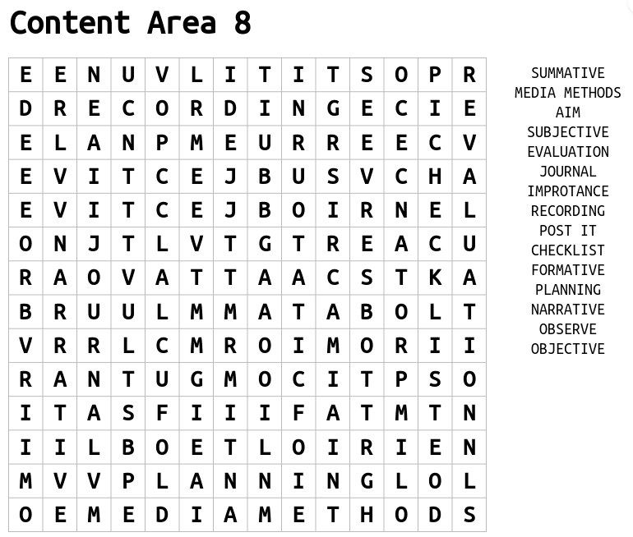
Do it now task | Success criteria | The bigger picture | New information | Application | Demonstrate success | Plenary
Content Area 8 Revision Booklet
Task
Find all the key terms in the word search
S&C – define the key terms in your exercise book
Notes:
https://www.youtube.com/watch?v=5gumm5mhL5M

Slide 4
Do it now task | Success criteria | The bigger picture | New information | Application | Demonstrate success | Plenary
Content Area 8 Revision Booklet
Observation
Holistic development
The action or process of closely observing or monitoring something or someone
The overall development of the child
Key Terms
Objective observations
Subjective observations
A record of what is seen and heard
It does not include an opinion
Only states facts and details
Avoid interpretation
Influenced by past events
Based on personal experiences
Based on opinion, feelings and assumptions
Subject to interpretation
Notes:
https://www.youtube.com/watch?v=5gumm5mhL5M

Slide 5
Do it now task | Success criteria | The bigger picture | New information | Application | Demonstrate success | Plenary
Content Area 8 Revision Booklet
Key Term | Definition
Formative Assessment | Assessments that inform planning and immediate responses to children Find out the child’s interest Helps identify stages of development Understand triggers in behaviour Gain insight to share with parents/carers/professionals Supports provision for the characteristics of effective learning Plan development activities
Summative Assessment | Assessments that provide a summary of the child’s learning and development at a point in time Evaluates effectiveness of interventions Supports assessment of the child’s development Supports other professionals Plan learning and development activities Track progress against current frameworks
Notes:
https://www.youtube.com/watch?v=5gumm5mhL5M

Slide 6
Do it now task | Success criteria | The bigger picture | New information | Application | Demonstrate success | Plenary
Content Area 8 Revision Booklet
Learning journal
Collection of notes, observations and thoughts built up over a period of time
Media methods
Make a video recording
Take a photograph
Record observations in a digital format
Checklist
Check whether the child can achieve a specialised skill
Record findings
Different methods of observation
Post-it notes
- Make a note of a child’s behaviour or skill, temporally attach a note to a document or surface
Narrative/written account
A short observation focused on the child, write everything down during the period of observation of the child
Notes:
https://www.youtube.com/watch?v=5gumm5mhL5M

Slide 7
Do it now task | Success criteria | The bigger picture | New information | Application | Demonstrate success | Plenary
Content Area 8 Revision Booklet
Todays date:
21/03/25
Last lesson Define the term observation | Last lesson Name one method of observation
Last week Describe the method of observation you named | Last topic What is one purpose of the planning cycle?
Notes:
https://www.youtube.com/watch?v=5gumm5mhL5M

Slide 8
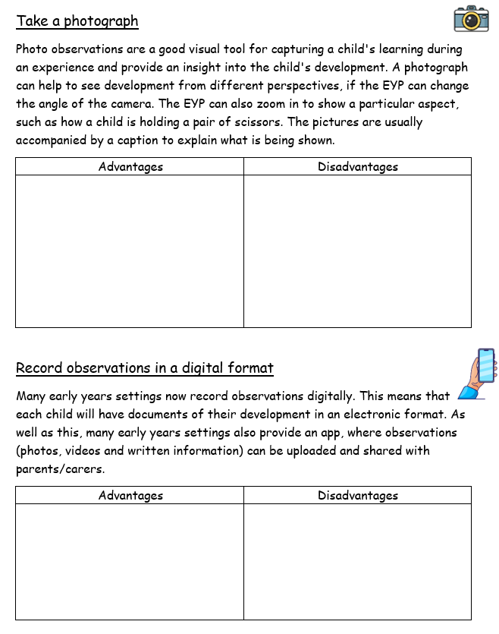
Do it now task | Success criteria | The bigger picture | New information | Application | Demonstrate success | Plenary
Content Area 8 Revision Booklet
Task
Read through the descriptions for the different types of observations, using the information from your books and your knowledge, have a go at adding the evaluation points
Notes:
https://www.youtube.com/watch?v=5gumm5mhL5M

Slide 9
Do it now task | Success criteria | The bigger picture | New information | Application | Demonstrate success | Plenary
Content Area 8 Revision Booklet
Making a video recording
Advantages | Disadvantages
The recording will mean the EYP is less likely to miss anything important. It will also help the EYP to write up more accurate notes after the observation has taken place. | Requires special equipment and knowledge to use it effectively. Lighting and background noise can affect the recording. Children may be inhibited, move away or play to the camera.
This allows the EYP to record details of what is seen and what is heard when observing a child. The EYP may set up an activity in one area of the room, that focusses on a particular area of development, and video record the child taking part in the activity.
Notes:
https://www.youtube.com/watch?v=5gumm5mhL5M

Slide 10
Do it now task | Success criteria | The bigger picture | New information | Application | Demonstrate success | Plenary
Content Area 8 Revision Booklet
Take a photograph
Advantages | Disadvantages
Photographs are good to capture emotions/facial expressions Great way to feedback to parents | The camera may distract the child away from the activity the EYP is wishing to evidence. A photograph by itself may sometimes be meaningless without written information to accompany it.
Photo observations are a good visual tool for capturing a child's learning during an experience and provide an insight into the child's development. A photograph can help to see development from different perspectives, if the EYP can change the angle of the camera. The EYP can also zoom in to show a particular aspect, such as how a child is holding a pair of scissors. The pictures are usually accompanied by a caption to explain what is being shown.
Notes:
https://www.youtube.com/watch?v=5gumm5mhL5M

Slide 11
Do it now task | Success criteria | The bigger picture | New information | Application | Demonstrate success | Plenary
Content Area 8 Revision Booklet
Record observations in a digital format
Advantages | Disadvantages
A great way to feedback to parents Useful/safe for storing information | The EYP may require additional training on how to use digital formats.
Many early years settings now record observations digitally. This means that each child will have documents of their development in an electronic format. As well as this, many early years settings also provide an app, where observations (photos, videos and written information) can be uploaded and shared with parents/carers.
Notes:
https://www.youtube.com/watch?v=5gumm5mhL5M

Slide 12
Do it now task | Success criteria | The bigger picture | New information | Application | Demonstrate success | Plenary
Content Area 8 Revision Booklet
Advantages | Disadvantages
Paper learning journals often look lovely, creating a wonderful keepsake for children With digital learning journals, connecting with parents is easier, as they can log in and view their child’s learning journey, often being able to comment and easily contribute photographs and activities from home (usual via an app) | They can be time-consuming for the EYP, with photographs and observations taking time to collate and stick in/upload. There is sometimes the feeling that practitioners may spend more time on tablets, filling in the observations and potentially miss some additional learning moments.
Learning journals
This is a record of a child’s learning and development, throughout their time in an early year setting. The journal is based on the EYFS framework. It will be built up over the years and show the child’s achievements. The child’s key worker will often create activities and experiences to meet a child’s individual needs. Through the use of observations, this record can then be built.
Notes:
https://www.youtube.com/watch?v=5gumm5mhL5M

Slide 13
Do it now task | Success criteria | The bigger picture | New information | Application | Demonstrate success | Plenary
Content Area 8 Revision Booklet
Post-it Notes
Advantages | Disadvantages
A quick way of recording observations throughout the day, without needing to plan resources for activities, etc. Allows for lots of observations to be done on multiple children in one session | Ironically, the most skill is required to complete the shortest observation – this is because the practitioner must recognise the moment to begin with and then record it quickly, succinctly and accurately. The post-it notes need to be kept safe until they can be logged/added to learning journals.
This method is useful for capturing ‘magic moments’. They are the briefest observations the EYP will make. EYPs can record, for example, a child’s ‘firsts’, e.g., the first time they climb steps unaided. It is then easy for the EYP to put the post-it notes into the child’s learning journey (or record later if learning journey is electronic). The aim of this type of observation is to build a picture about children’s interests and development from many pieces of information.
Notes:
https://www.youtube.com/watch?v=5gumm5mhL5M

Slide 14
Do it now task | Success criteria | The bigger picture | New information | Application | Demonstrate success | Plenary
Content Area 8 Revision Booklet
Narrative methods
Advantages | Disadvantages
Needs no preparation. Can be used to observe all areas of development. Can be used to observe more than one area of development at once. | Can be hard to write everything down quickly. The observer may have to keep stopping, or keep having to re-focus the child. Can be hard to record accurately and without judgement.
These types of observation are written methods. The method will describe what a child is doing or has done, for example "Jack is playing with wooden bricks. He is using one brick at a time to build a tower." Narrative observations may record what a child is doing over a few seconds or much longer. Sometimes photographs or film clips are used with narrative observations.
Notes:
https://www.youtube.com/watch?v=5gumm5mhL5M

Slide 15
Do it now task | Success criteria | The bigger picture | New information | Application | Demonstrate success | Plenary
Content Area 8 Revision Booklet
Advantages | Disadvantages
They are easy to fill in and can be completed fairly quickly. The same checklist can be repeated and used again to see if the child has made progress. Having a list of criteria to observe helps to keep the observer focussed on specific skills. | The checklist doesn’t usually allow for extra written detail. Observers may come to different conclusions about whether a child has mastered a skill, for example, a child may be able to do the skill with some encouragement. The method doesn’t show how quickly or confidently a child has mastered a skill.
Checklist/Tick chart
They are a simple way to assess children's skills. A list of statements is prepared, for example, 'Is able to put on coat without fastening it up', 'Is able to use spoon to feed'. The statements are normally based on milestones for children's development or outcomes from the early years’ curriculum.
Notes:
https://www.youtube.com/watch?v=5gumm5mhL5M

Slide 16
Do it now task | Success criteria | The bigger picture | New information | Application | Demonstrate success | Plenary
Content Area 8 Revision Booklet
Help the EYP to understand what the child enjoys.
Help the EYP plan the curriculum.
Developing positive relationships with parents/carers.
Why it is important that the EYP conducts observations on children?
Identify any concerns about the child’s development, so that early intervention can be provided for support.
Continuity of care to ensure those involved in the care of the child are united in approach.
Identify what the child is learning.
Monitoring progress to make sure that the child’s development can be tracked.
Child-centred approach to make sure that the child’s individual needs are met.
Notes:
https://www.youtube.com/watch?v=5gumm5mhL5M

Slide 17
Do it now task | Success criteria | The bigger picture | New information | Application | Demonstrate success | Plenary
Content Area 8 Revision Booklet
Todays date:
28/03/25
Last lesson Give one reason why it is important that EYPs conduct observations on children | Last lesson What is one advantage of using a photograph as an observation method?
Last week What is one disadvantage of using narrative methods as an observation method? | Last topic Draw the planning cycle
Notes:
https://www.youtube.com/watch?v=5gumm5mhL5M

Slide 18
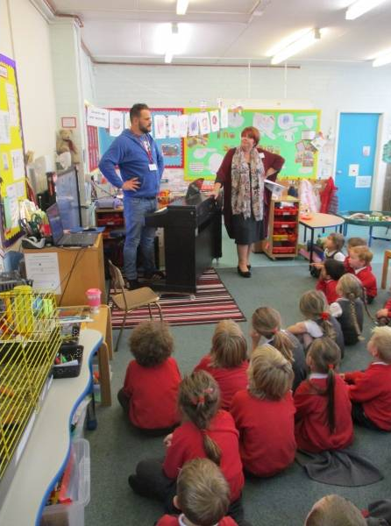
Do it now task | Success criteria | The bigger picture | New information | Application | Demonstrate success | Plenary
Content Area 8 Revision Booklet
Task
Rachel is wanting to observe a group of Year 1 children singing a number song that involves actions
Which media method should Rachel use? Why?
Can you explain any difficulties that Rachel may face when using this method?
Notes:
https://www.youtube.com/watch?v=5gumm5mhL5M

Slide 19


Do it now task | Success criteria | The bigger picture | New information | Application | Demonstrate success | Plenary
Content Area 8 Revision Booklet
Task
As we watch the video –
Pick one child from the TV show
As we watch, write on your post-it notes, the ‘magic moments’ of the child you have picked
The Secret Life Of 4, 5 & 6 Year Olds S01 E05 - video Dailymotion
Keywords: observations, subjective, objective, formative, summative, methods
Notes:
https://www.youtube.com/watch?v=5gumm5mhL5M

Slide 20
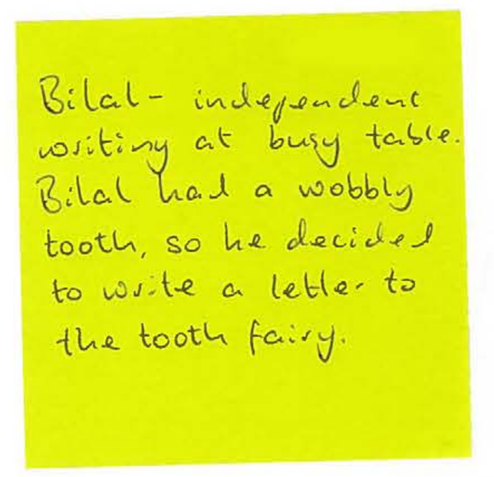
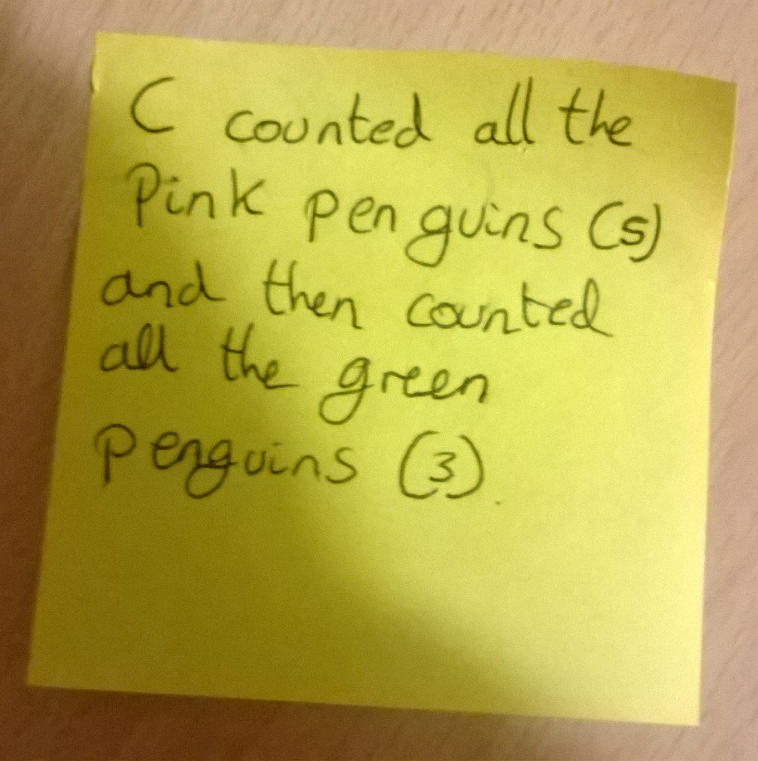
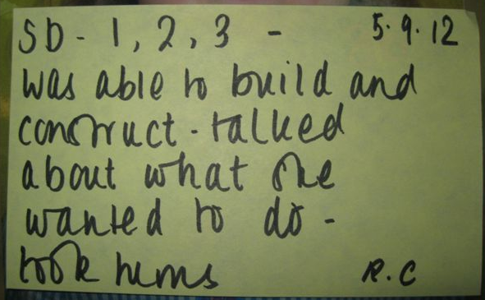
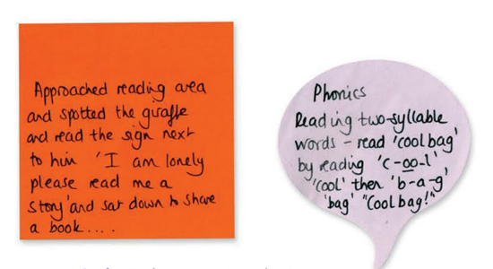
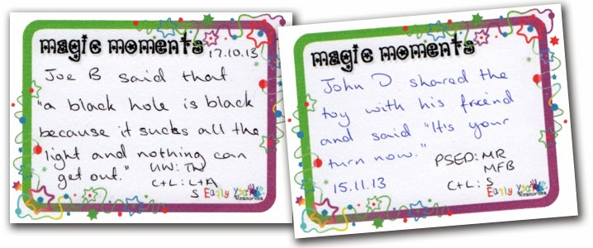
Do it now task | Success criteria | The bigger picture | New information | Application | Demonstrate success | Plenary
Content Area 8 Revision Booklet
Examples
Keywords: observations, subjective, objective, formative, summative, methods
Notes:
https://www.youtube.com/watch?v=5gumm5mhL5M

