Slide 1

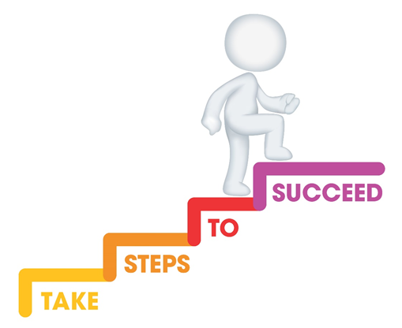






Do it now task | Success criteria | The bigger picture | New information | Application | Demonstrate success | Plenary
CA7 Revision Booklet
Todays date:
25/04/24
Last lesson What does a key person do? | Last lesson What does a childminder do?
Last week What does partnership working mean? | Last topic What are the benefits of partnership working?
Notes:
https://www.youtube.com/watch?v=5gumm5mhL5M

Slide 2
Do it now task | Success criteria | The bigger picture | New information | Application | Demonstrate success | Plenary
CA7 Revision Booklet
Success Criteria
By the end of the lesson you should be able to…
Evaluate the benefits of partnership working.
Apply this to exam style questions
Explain partnership working
Notes:
https://www.youtube.com/watch?v=5gumm5mhL5M

Slide 3
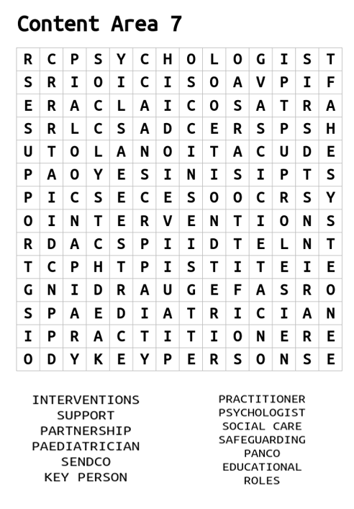
Do it now task | Success criteria | The bigger picture | New information | Application | Demonstrate success | Plenary
CA7 Revision Booklet
Task
Complete the wordsearch to find key terms from CA7
Have a go at defining any of these key terms
Notes:
https://www.youtube.com/watch?v=5gumm5mhL5M

Slide 4
Do it now task | Success criteria | The bigger picture | New information | Application | Demonstrate success | Plenary
CA7 Revision Booklet
Roles in an early years setting
Specialist | What is their role?
Manager or person in charge of setting | Required to create policies and procedures, build relationships with parents and carer's and manage practitioners to ensure that all workers are doing their best for the children.
Early years practitioner | Support children’s holistic development, observe children’s progress, keep records of their development and work within the EYFS framework. Required to keep children safe and report any concerns.
Room leader | Responsible for the overall running of your assigned playroom in an early years setting. A room leader will work as part of the management team and supervise playroom staff. They will also be responsible for promoting high quality childcare.
Notes:
https://www.youtube.com/watch?v=5gumm5mhL5M

Slide 5
Do it now task | Success criteria | The bigger picture | New information | Application | Demonstrate success | Plenary
CA7 Revision Booklet
Roles in an early years setting
Specialist | What is their role?
Key person | Named member of staff with responsibilities for a small group of children and will work closely with each child within their group to ensure they are being cared for, meeting milestones and that the child feels safe.
Childminder | Responsible for planning and preparing a programme of play based activities for children. All childminders have a responsibility to promote children's development.
Teaching assistant | Required to get the classroom ready for lessons, supervise pupils and assist the classroom teacher. May be required to work with children in a small group, this can be called intervention work.
Notes:
https://www.youtube.com/watch?v=5gumm5mhL5M

Slide 6
Do it now task | Success criteria | The bigger picture | New information | Application | Demonstrate success | Plenary
CA7 Revision Booklet
Roles in an early years setting
Specialist | What is their role?
Nanny | Required to take care of one or multiple children within a home setting. Usually will organise educational activities at home, prepare meals for children and support children by transporting them to school or activity clubs
Notes:
https://www.youtube.com/watch?v=5gumm5mhL5M

Slide 7
Do it now task | Success criteria | The bigger picture | New information | Application | Demonstrate success | Plenary
CA7 Revision Booklet
Keep children safe
Includes preparing and maintaining a safe environment
Completing risk assessments
Providing supervision of children
Support healthy development
Provide access to healthy snacks
Have clean drinking water provided
Opportunities for exercise
Responsibilities
Work in partnership
Work as part of a team in the setting
May seek guidance and advice from external professionals
Offer advice to parents/cares
Promote development
Plan activities that build on knowledge and skills
Observe learning and development
Offer encouragement
Notes:
https://www.youtube.com/watch?v=5gumm5mhL5M

Slide 8
Do it now task | Success criteria | The bigger picture | New information | Application | Demonstrate success | Plenary
CA7 Revision Booklet
Partnership working
Definition:
Different services and professionals working together with other teams or people to meet the child’s and/or family’s needs.
Notes:
https://www.youtube.com/watch?v=5gumm5mhL5M

Slide 9
Do it now task | Success criteria | The bigger picture | New information | Application | Demonstrate success | Plenary
CA7 Revision Booklet
Benefits of Partnership working
How partnership working benefits the child | How partnership working benefits the family | How partnership working benefits the early years practitioner (EYP)
supports child-centred practice that meets children’s holistic needs ensures supportive intervention is made when a child is not meeting age-expected milestones promotes safeguarding to ensure that children are protected from harm provides consistent care, giving emotional and physical security | gains support from practitioners with a different perspective or experience ensures shared goals can be achieved and everyone is united in approach builds trust so that information can be shared to support the child | access to advice and information which will inform planning of activities and routines to promote children’s development builds trust and creates a supportive relationship where information can be shared supports shared goals, and everyone can work to their strengths and support each other
Notes:
https://www.youtube.com/watch?v=5gumm5mhL5M

Slide 10
Do it now task | Success criteria | The bigger picture | New information | Application | Demonstrate success | Plenary
CA7 Revision Booklet
Specialist roles within the early years setting
Specialist | What is their role?
SENDCO | Main role of a SENDCO is to coordinate provision for children who have special educational needs. Responsible for overseeing, assessing, planning and monitoring the progress of children to ensure their needs are being met.
DSL | Ensure individuals are kept safe and protected from harm. Is the named person who is responsible for all child protection meaning that other staff members will seek help and guidance from the DSL. DSL is also responsible for ensuring that policies and procedures are in place and up to date. Referrals will be made from the DSL to other agencies and professionals if additional support is required for the child
Notes:
https://www.youtube.com/watch?v=5gumm5mhL5M

Slide 11
Do it now task | Success criteria | The bigger picture | New information | Application | Demonstrate success | Plenary
CA7 Revision Booklet
Specialist roles within the early years setting
Specialist | What is their role?
PANCO | Champions best practice in physical activity and nutrition and acts as the agent for change. They lead positive change to ensure an environment and ethos that supports the prevention of obesity and health and wellbeing of children, families, and staff.
Key person | Responsible for a small group of children. If parents and carers have any concerns, then their child’s key person should be their first contact point.
Notes:
https://www.youtube.com/watch?v=5gumm5mhL5M

Slide 12
Do it now task | Success criteria | The bigger picture | New information | Application | Demonstrate success | Plenary
CA7 Revision Booklet
Specialist roles outside the setting
Specialist | What is their role?
Physiotherapist | Support individuals who are affected by injuries, disabilities and illnesses. Support can be given through movement and exercises, manual therapy, education and advice. Physiotherapists work with the child to ensure they are supported and can continue with day-to-day tasks. Provide advice to school staff where needed and provide training to help staff to develop skills to support children with specific needs and enhance all children’s learning.
Educational Psychologist | Educational psychologists will provide expert advice and support to schools and teachers This will help staff to develop skills to support children with specific needs and enhance all children’s learning.
Notes:
https://www.youtube.com/watch?v=5gumm5mhL5M

Slide 13
Do it now task | Success criteria | The bigger picture | New information | Application | Demonstrate success | Plenary
CA7 Revision Booklet
Specialist roles outside the setting
Specialist | What is their role?
General Practitioner (GP) | A general practitioner (GP) is a health care professional who works with all individuals within society. A GP’s main role is to diagnose and treat medical conditions. They aim to treat all common conditions and refer patients onto more specialised care services or services which can provide urgent medical treatment
Health Visitor | Works with children and families to support and promote health and development. Health visitors aim to identify children’s needs as early as possible to promote health, prevent ill health and reduce inequalities
Notes:
https://www.youtube.com/watch?v=5gumm5mhL5M

Slide 14
Do it now task | Success criteria | The bigger picture | New information | Application | Demonstrate success | Plenary
CA7 Revision Booklet
Specialist roles outside the setting
Specialist | What is their role?
Family Support Worker | Family support workers are likely to work in partnership with children’s social workers. They aim to provide practical or emotional advice and support to individuals and families who are in need of help due to a range of issues. Support may be offered particularly when difficulties arise around parenting and the wellbeing of a child.
Social worker | Social workers are required to provide assessments of a child and their families needs. They will also offer a range of support to ensure a child is protected and well cared for within their life. Social workers aim to find solutions to individuals problems, this includes helping to protect vulnerable people from harm and abuse and supporting people to live independently.
Notes:
https://www.youtube.com/watch?v=5gumm5mhL5M

Slide 15
Do it now task | Success criteria | The bigger picture | New information | Application | Demonstrate success | Plenary
CA7 Revision Booklet
Task
Have a go at the below exam questions –
Identify a possible role within the early years [1 mark]
Explain two (2) ways that early year’s practitioners can keep children safe. [2 marks]
Explain 2 benefits of partnership working for the Early Years Practitioner (EYP) [2 marks]
Discuss the role of a designated safeguarding lead (DSL) [3 marks]
Explain how SEND teams benefit the child and the family [6 marks]
Notes:
https://www.youtube.com/watch?v=5gumm5mhL5M

Slide 16
Do it now task | Success criteria | The bigger picture | New information | Application | Demonstrate success | Plenary
CA7 Revision Booklet
Identify a possible role within the early years [1 mark]
• Manager/person in charge of setting
• Early years practitioner
• Room leader
• Key person
• Childminder
• Teaching assistant
• Nanny
Notes:
https://www.youtube.com/watch?v=5gumm5mhL5M

Slide 17
Do it now task | Success criteria | The bigger picture | New information | Application | Demonstrate success | Plenary
CA7 Revision Booklet
Explain two (2) ways that early year’s practitioners can keep children safe. [2 marks]
▪ prepare and maintain a safe environment
▪ complete risk assessments
▪ work in partnership with others
▪ provide supervision of children
▪ follow policies
Notes:
https://www.youtube.com/watch?v=5gumm5mhL5M

Slide 18
Do it now task | Success criteria | The bigger picture | New information | Application | Demonstrate success | Plenary
CA7 Revision Booklet
Explain 2 benefits of partnership working for the Early Years Practitioner (EYP) [2 marks]
o has access to advice and information which will inform planning of activities and routines to promote children’s development
o builds trust and creates a supportive relationship where information can be shared
o supports shared goals, and everyone can work to their strengths and support each other
Notes:
https://www.youtube.com/watch?v=5gumm5mhL5M

Slide 19
Do it now task | Success criteria | The bigger picture | New information | Application | Demonstrate success | Plenary
CA7 Revision Booklet
Discuss the role of a designated safeguarding lead (DSL) [3 marks]
• The main role of a DSL is to ensure individuals are kept safe and protected from harm. As part of their role they will be the named person who is responsible for all child protection, this means that other staff members will seek help and guidance from the DSL.
• The DSL is also responsible for ensuring that policies and procedures are in place and up to date.
• Referrals will be made from the DSL to other agencies and professionals if additional support is required for the child.
• The DSL will also work closely with the child and their families, this will mean they are able to monitor their needs and provide additional support where necessary.
Notes:
https://www.youtube.com/watch?v=5gumm5mhL5M

Slide 20
Do it now task | Success criteria | The bigger picture | New information | Application | Demonstrate success | Plenary
CA7 Revision Booklet
5. Explain how SEND teams benefit the child and the family [6 marks]
1. Explanation of SEND Teams:
2. Benefits to the Child:
3. Benefits to the Family:
o4. Depth of Explanation:
o Providing examples or anecdotes to illustrate key points and enhance understanding.
5. Evaluation (for higher marks):
o Ability to critically evaluate the significance and impact of SEND teams on both the child and the family.
Notes:
https://www.youtube.com/watch?v=5gumm5mhL5M

