Slide 1

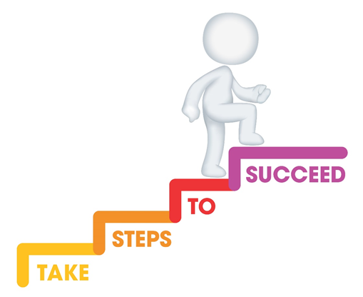






Do it now task | Success criteria | The bigger picture | New information | Application | Demonstrate success | Plenary
CA6 Revision Booklet
Todays date:
02/05/25
Last lesson What is one specialist role in an early years setting? | Last lesson What is one responsibility of an early years worker?
Last week What is one specialist role outside an early years setting? | Last topic Give one advantage or disadvantage of recording observations in a digital format
Notes:
https://www.youtube.com/watch?v=5gumm5mhL5M

Slide 2
Do it now task | Success criteria | The bigger picture | New information | Application | Demonstrate success | Plenary
CA6 Revision Booklet
Last lesson What is one specialist role in an early years setting? Manager/person in charge of setting Early years practitioner Room leader Key person Childminder Teaching assistant | Last lesson What is one responsibility of an early years worker? Keep children safe Support healthy development Work in partnership Promote development
Last week What is one specialist role outside an early years setting? GP Health visitor Physiotherapist Educational psychologist | Last topic Great way to feedback to parents Useful/safe for storing information EYP may require additional training on how to use digital formats
Notes:
https://www.youtube.com/watch?v=5gumm5mhL5M

Slide 3
Do it now task | Success criteria | The bigger picture | New information | Application | Demonstrate success | Plenary
CA6 Revision Booklet
Success Criteria
By the end of the lesson you should be able to…
Apply knowledge to exam question scenarios
Define and apply key terms from CA6
Recall key concepts from CA6
Notes:
https://www.youtube.com/watch?v=5gumm5mhL5M

Slide 4
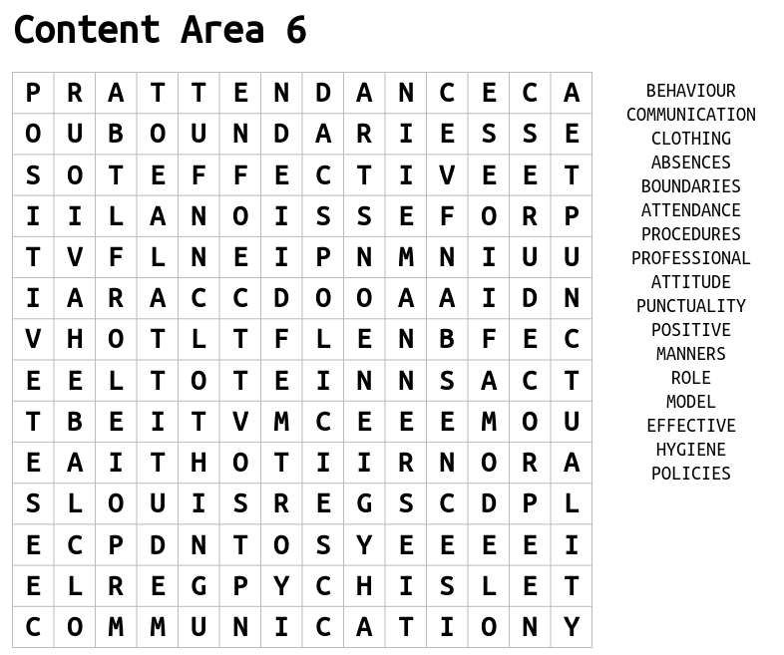
Do it now task | Success criteria | The bigger picture | New information | Application | Demonstrate success | Plenary
CA6 Revision Booklet
Task
Complete the word search to find the key terms from CA6
S&C – Have a go at defining these key terms
Notes:
https://www.youtube.com/watch?v=5gumm5mhL5M

Slide 5
Do it now task | Success criteria | The bigger picture | New information | Application | Demonstrate success | Plenary
CA6 Revision Booklet
Expected Appearance of an EYP
Acceptable appearance | Unacceptable appearance
Short nails Clean hair, tied back Fresh smelling and clean skin Piercings removed- Tattoo’s covered (if they cause any offence) Clothing and accessories in line with uniform policy | Dirty or long nails Dirty hair Refusing to remove piercings/cover tattoo’s- unprofessional. Piercings could cause harm to children if grabbed. Casual clothing with slogans/brands Too much skin revealed
Notes:
https://www.youtube.com/watch?v=5gumm5mhL5M

Slide 6
Do it now task | Success criteria | The bigger picture | New information | Application | Demonstrate success | Plenary
CA6 Revision Booklet
Expected Behaviours of an EYP
Dignity –
Treating someone with honour and respect and valuing their individual circumstances, needs and wishes at all times.
It is important that EYP’s behave in a way which maintains professional boundaries with colleagues, children and their families. When working in partnership, EYP’s must maintain boundaries but also communicate effectively with their team, parents, families and carers. They must also work within the policies and procedures of the setting.
Notes:
https://www.youtube.com/watch?v=5gumm5mhL5M

Slide 7
Do it now task | Success criteria | The bigger picture | New information | Application | Demonstrate success | Plenary
CA6 Revision Booklet
Expected Behaviours of an EYP
EYP Behaviour | Description
Work within the policies and procedures of the setting | OFSTED and the EYFS require all early years providers to have appropriate policies and procedures in place. Organisations need to consider how they implement these policies and procedures and how they provide adequate training.
Maintain professional boundaries | Professional boundaries can be described as the boundary between what is acceptable and unacceptable for a professional both at work and outside of work.
Notes:
https://www.youtube.com/watch?v=5gumm5mhL5M

Slide 8
Do it now task | Success criteria | The bigger picture | New information | Application | Demonstrate success | Plenary
CA6 Revision Booklet
EYP Behaviour | Description
Communicate effectively, verbally and non-verbally | Effective verbal communication: Reflects the child’s age and stage of development Promotes the child’s learning and development Use of clear language Appropriate for the situation Effective non-verbal communication Active listening Sensitive and respectful Body language
Demonstrate a positive attitude | Enthusiastic Patient Uses initiative Motivated Respectful Positive role model Caring
Notes:
https://www.youtube.com/watch?v=5gumm5mhL5M

Slide 9
Do it now task | Success criteria | The bigger picture | New information | Application | Demonstrate success | Plenary
CA6 Revision Booklet
Attendance and Punctuality Expectations
Part of a functional and successful workplace is ensuring that everyone fulfils the responsibilities of their role. Being on time and coming to work consistently is important regardless of your position.
Punctuality –
the ability to be prompt, meet deadlines and plan ahead
Attendance –
how often you show up to work (or school). This involves coming to work for your scheduled shifts and staying at work for the entire duration of your shifts
Notes:
https://www.youtube.com/watch?v=5gumm5mhL5M

Slide 10
Do it now task | Success criteria | The bigger picture | New information | Application | Demonstrate success | Plenary
CA6 Revision Booklet
 | Impact on the nursery staff | Impact on the children | Impact on parents/carers | Impact on EYP
If an EYP is always late and has bad attendance | Reduced productivity/quality of care Increased stress Resentment/frustrations | Safety Not having their keyworker at drop off and pick up needs may not be fully met Damage to attachment change in daily routine | Consistency to trust the service Impact their work if the early years setting can’t open due to staff absence Stress/Upset Financial impact- paying for services in advance | Miss out on development Strained relationships with colleagues/management Change in relationships with children/parent’s/carers Income could be impacted.
Notes:
https://www.youtube.com/watch?v=5gumm5mhL5M

Slide 11
Do it now task | Success criteria | The bigger picture | New information | Application | Demonstrate success | Plenary
CA6 Revision Booklet
 | Impact on the nursery staff | Impact on the children | Impact on parents/carers | Impact on EYP
If an EYP is punctual and has good attendance | Relationships will be positive and supportive Effective teamwork Ensures the setting will be open and function as normal | Activities will be ready for the children as they arrive Children will be keep to their daily routines including accessing their key worker Children’s needs will be met | Parents/carers will rely on the setting and know it is trustworthy Recommendations/word of mouth will produce new service users | Known as reliable, trustworthy and have integrity.
Notes:
https://www.youtube.com/watch?v=5gumm5mhL5M

Slide 12
Do it now task | Success criteria | The bigger picture | New information | Application | Demonstrate success | Plenary
CA6 Revision Booklet
Arrive on time at the start of the day and finish at the agreed time at the end of the day
Return on time after a break
How to improve attendance and punctuality
If you have a planned absence, discuss with your manager
If you are going to have an unplanned absence, follow the correct polices:
Ringing in to notify the manager by a certain time
Communicating any deadlines/work that needs to be prioritised that day.
Where possible, ensure appointments are booked outside of work time
Notes:
https://www.youtube.com/watch?v=5gumm5mhL5M

Slide 13
Do it now task | Success criteria | The bigger picture | New information | Application | Demonstrate success | Plenary
CA6 Revision Booklet
Exam Question Practice
The early years workers do not wear a uniform in the nursery. Identify three (3) items of clothing the early years workers should not wear for work in the nursery. (3)
An early years practitioner is unable to go to work. Explain how this could impact on children’s safety in the nursery. (3)
State one action an early year’s practitioner can take to reduce the impact of not being able to be at work. (1)
4. (a) Sam is preparing to start a placement in a local private nursery next week. State 3 questions she could ask to help to prepare herself (3)
4. (b) Give 2 ways that Sam could show that she is professional when on placement. (2)
4. (c) Explain why Sam should present herself professionally when on placement. (4)
4. (d) Give 2 responsibilities that Sam has whilst on placement. (2)
Notes:
https://www.youtube.com/watch?v=5gumm5mhL5M

Slide 14
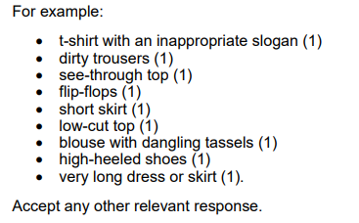

Do it now task | Success criteria | The bigger picture | New information | Application | Demonstrate success | Plenary
CA6 Revision Booklet
The early years workers do not wear a uniform in the nursery. Identify three (3) items of clothing the early years workers should not wear for work in the nursery. (3)
Notes:
https://www.youtube.com/watch?v=5gumm5mhL5M

Slide 15
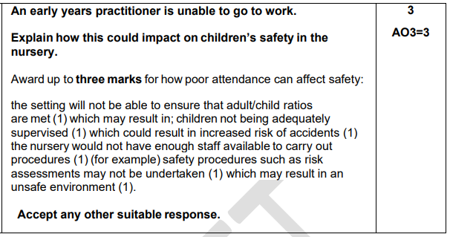
Do it now task | Success criteria | The bigger picture | New information | Application | Demonstrate success | Plenary
CA6 Revision Booklet
An early years practitioner is unable to go to work. Explain how this could impact on children’s safety in the nursery. (3)
Notes:
https://www.youtube.com/watch?v=5gumm5mhL5M

Slide 16
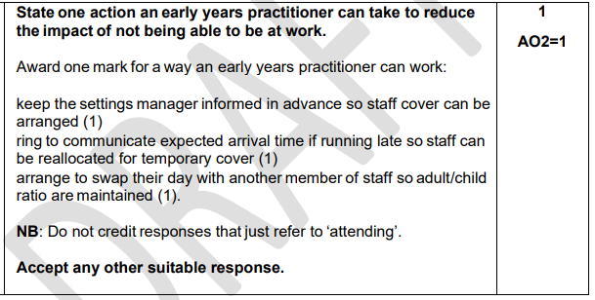
Do it now task | Success criteria | The bigger picture | New information | Application | Demonstrate success | Plenary
CA6 Revision Booklet
State one action an early year’s practitioner can take to reduce the impact of not being able to be at work. (1)
Notes:
https://www.youtube.com/watch?v=5gumm5mhL5M

Slide 17
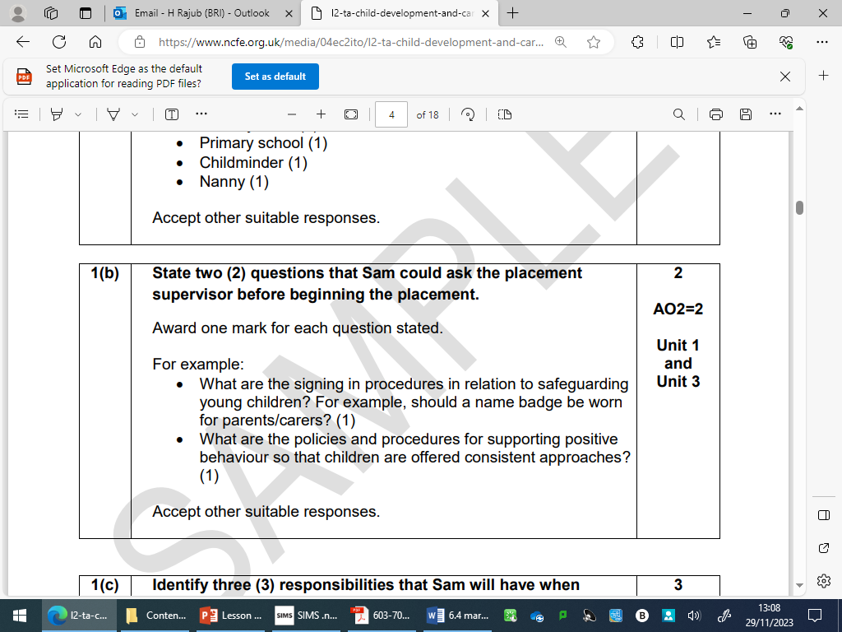
Do it now task | Success criteria | The bigger picture | New information | Application | Demonstrate success | Plenary
CA6 Revision Booklet
4. (a) Sam is preparing to start a placement in a local private nursery next week. State 3 questions she could ask to help to prepare herself (3)
Notes:
https://www.youtube.com/watch?v=5gumm5mhL5M

Slide 18
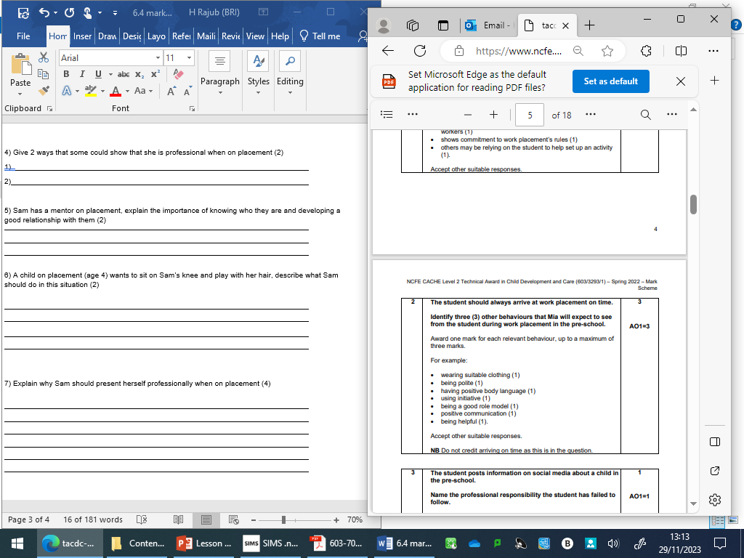
Do it now task | Success criteria | The bigger picture | New information | Application | Demonstrate success | Plenary
CA6 Revision Booklet
4. (b) Give 2 ways that Sam could show that she is professional when on placement. (2)
Notes:
https://www.youtube.com/watch?v=5gumm5mhL5M

Slide 19
Do it now task | Success criteria | The bigger picture | New information | Application | Demonstrate success | Plenary
CA6 Revision Booklet
4. (c) Explain why Sam should present herself professionally when on placement. (4)
• She is a role model to the children – set good examples (1), children might copy their behaviour (1)
• Set a good example for herself and make good connections/networking (1) – potential employment opportunities or job references in the future (1)
Notes:
https://www.youtube.com/watch?v=5gumm5mhL5M

Slide 20
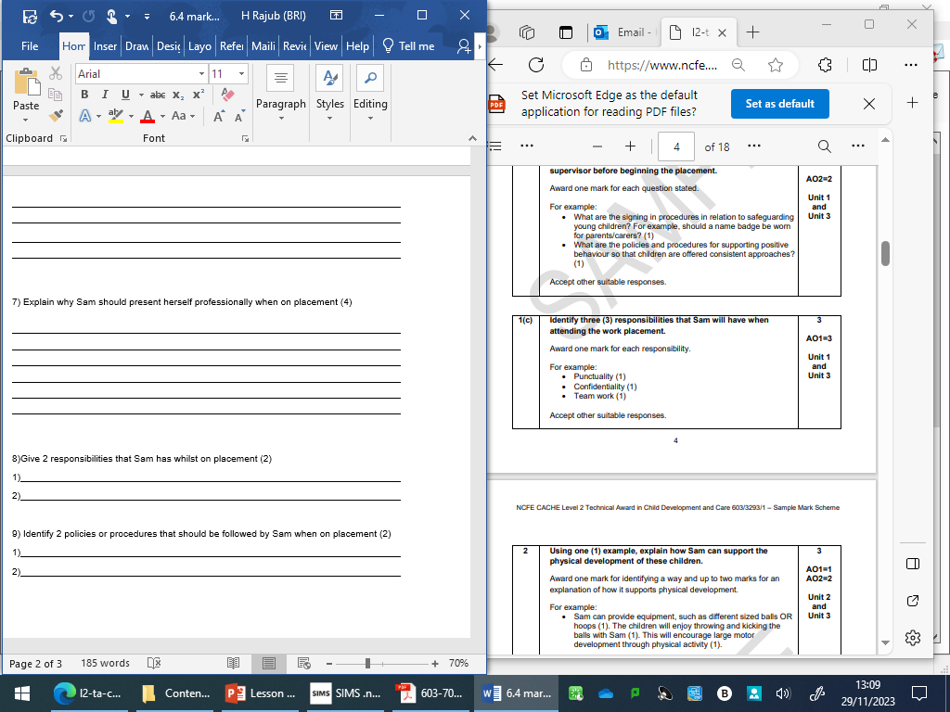
Do it now task | Success criteria | The bigger picture | New information | Application | Demonstrate success | Plenary
CA6 Revision Booklet
4. (d) Give 2 responsibilities that Sam has whilst on placement. (2)
Notes:
https://www.youtube.com/watch?v=5gumm5mhL5M

