Slide 1

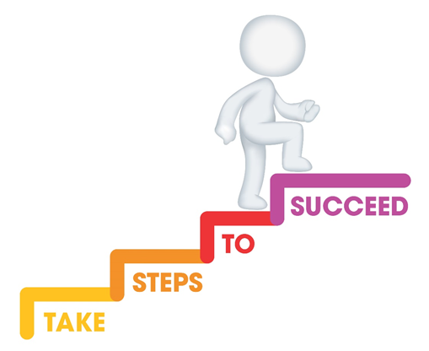






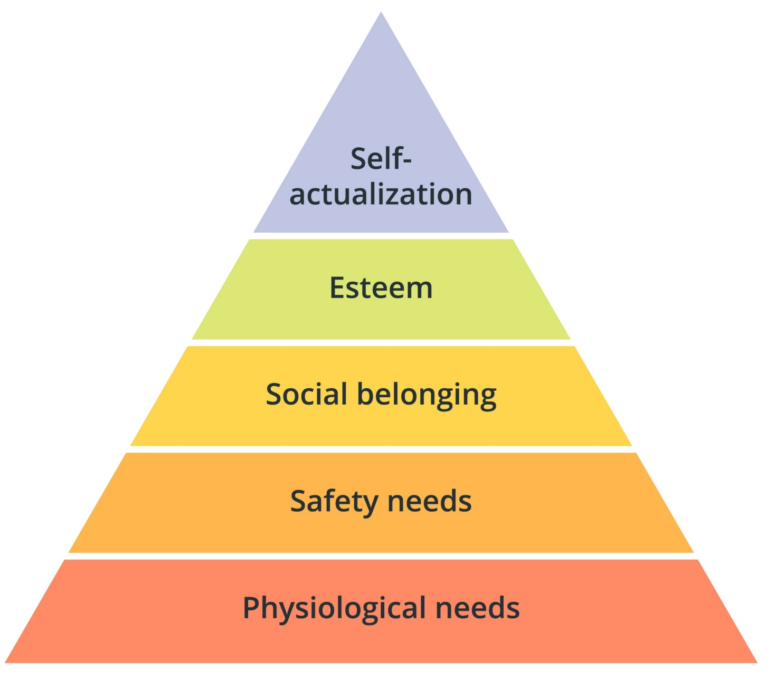
Do it now task | Success criteria | The bigger picture | New information | Application | Demonstrate success | Plenary
CA5 Revision
Last lesson Define the term ‘statutory’ Provided in statue and funded by the government | Last lesson Give one example of an early years setting Crèche, childminder, nursery, pre-school, nursery class, primary school
Last week What is one example of variation in early years provision? Accessibility, capacity, facilities, approach | Last topic Draw Maslow’s hierarchy of needs
Todays date:
02/06/25
Notes:
https://www.youtube.com/watch?v=5gumm5mhL5M

Slide 2
Do it now task | Success criteria | The bigger picture | New information | Application | Demonstrate success | Plenary
CA5 Revision
Success Criteria
By the end of the lesson you should be able to…
Evaluate
Apply
Explain
Notes:
https://www.youtube.com/watch?v=5gumm5mhL5M

Slide 3
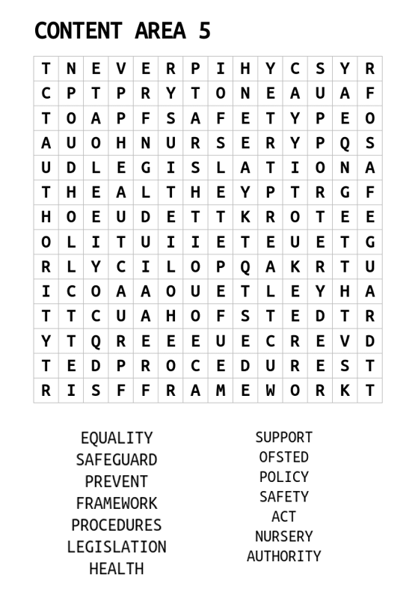
Do it now task | Success criteria | The bigger picture | New information | Application | Demonstrate success | Plenary
CA5 Revision
Task
Complete the wordsearch to find key terms from CA5
S&C – can you define any of the key terms
Notes:
https://www.youtube.com/watch?v=5gumm5mhL5M

Slide 4
Do it now task | Success criteria | The bigger picture | New information | Application | Demonstrate success | Plenary
CA5 Revision
Key Terms
Legislation | A law or set of laws that have been passed by Parliament
Framework | A set of standards that must be met
Policy | An action adopted by an organisation
Procedure | An established way of carrying out a policy
Notes:
https://www.youtube.com/watch?v=5gumm5mhL5M

Slide 5

Do it now task | Success criteria | The bigger picture | New information | Application | Demonstrate success | Plenary
CA5 Revision
OFSTED
OFSTED is a government organisation. OFSTED inspects and regulates early years and social care services that care for children and young people. They also inspect services that provide childcare, education and skills training such as nurseries, child minders, school, colleges, adoption and fostering agencies. They ensure services are suitable for children and vulnerable young people. They complete inspection visits and produce reports on care services. Following an inspection, the setting is given a rating
Notes:
https://www.youtube.com/watch?v=5gumm5mhL5M

Slide 6
Do it now task | Success criteria | The bigger picture | New information | Application | Demonstrate success | Plenary
CA5 Revision
Outstanding | Providers judged ‘outstanding’ for overall effectiveness can go a decade without OFSTED revisiting. However, they may receive a full inspection if its performance declines and/or there are risks, such as potential safeguarding concerns
Good | ‘Good’ providers will usually be inspected within five years of the publication of their previous inspection report. This will normally be a short inspection but may be a full inspection if information suggests that this is the most appropriate way forward, for example, if the provider’s performance has declined
Requires improvement | Providers judged to require improvement will normally receive a full inspection within 12 to 30 months of the publication of their previous inspection report. These providers will be subject to a monitoring visit before the full re-inspection, normally 7 to 13 months after the publication of their previous inspection report.
Inadequate | Providers who receive the lowest possible judgement will receive re-inspection monitoring visits and then a full inspection within 15 months.
OFSTED Ratings
Notes:
https://www.youtube.com/watch?v=5gumm5mhL5M

Slide 7
Do it now task | Success criteria | The bigger picture | New information | Application | Demonstrate success | Plenary
CA5 Revision
Health and Safety at Work Act (1974)
A primary piece of legislation that covers occupational health and safety in Great Britain.
It sets out general duties:
Employers must protect the health, safety and welfare at work of all their employees, as well as visitors and members of the public
Employees also have a responsibility to themselves and to each other.
Notes:
https://www.youtube.com/watch?v=5gumm5mhL5M

Slide 8
Do it now task | Success criteria | The bigger picture | New information | Application | Demonstrate success | Plenary
CA5 Revision
What the employer must do | What the employee must do
1. Decide what could cause harm and the precautions to stop it. This is part of risk assessment. 2. Explain how risks will be controlled and who is responsible for this. 3. Consult and work with health and safety representatives in protecting everyone from harm in the workplace. 4. Free of charge, provide health and safety training to employees to enable them to do their job. 5. Free of charge, provide equipment and protective clothing needed, and ensure it is properly looked after. 6. Provide toilets, washing facilities and drinking water. 7. Provide adequate first-aid facilities. 8. Report major injuries and fatalities at work to our Incident Contact Centre. Report other injuries, diseases and dangerous incidents online at www.hse.gov.uk. 9. Have insurance that covers employees in case they get hurt at work or ill through work. Display a hard copy or electronic copy of the current insurance certificate. 10. Work with any other employers or contractors sharing the workplace or providing employees (such as agency workers), so that everyone’s health and safety is protected | 1. Follow the training received when using any work items, the employer has given them. 2. Take reasonable care of their own and other people’s health and safety. 3. Co-operate with your employer on health and safety. 4. Tell someone (employer, supervisor, or health and safety representative) if they think the work or inadequate precautions are putting anyone’s health and safety at serious risk
Health and Safety at Work Act (1974)
Notes:
https://www.youtube.com/watch?v=5gumm5mhL5M

Slide 9
Do it now task | Success criteria | The bigger picture | New information | Application | Demonstrate success | Plenary
CA5 Revision
Health and Safety at Work Act (1974)
Policies linked to HASAWA | Procedures linked to HASAWA
Health and safety policy Food and drink policy Visitors to the setting policy | Risk assessments (to identify hazards and controls) Safe working practices during food preparation (hand washing and using PPE) Arrival and departures of visitors (signing in and signing out of the setting) Reporting accidents (reports completed following an accident)
Notes:
https://www.youtube.com/watch?v=5gumm5mhL5M

Slide 10
Do it now task | Success criteria | The bigger picture | New information | Application | Demonstrate success | Plenary
CA5 Revision
Risk Management | The practitioner should ensure the environment is safe for the children and staff. A risk assessment should be carried out to highlight any potential hazards (indoors and outdoors). Risk assessments should also check that equipment is safe to use. Risk assessments should also be in place when children are taken off-site (e.g., on a trip/visit/walk).
Accident and Incident | When there is an accident in the workplace, with either an employee or service user, it is important that the accident is logged. Services will have a policy that explains their required procedure for logging accidents (e.g., an accident book/form). RIDDOR (Reporting of Injuries, Diseases and Dangerous Occurrences Regulations 2013) puts duties on employers, the self-employed and people in control of work premises (the Responsible Person) to report certain serious workplace accidents, occupational diseases and specified dangerous occurrences (near misses). It is also important that EYPs follow the setting’s procedures for first aid.
Evacuation Procedures | It is also vital that the services have evacuation procedures in place, so that if an incident occurs (e.g., a fire) service users and employees can safely leave the premises and all can be accounted for. Around services, such as hospitals, posters will be displayed to direct people to the nearest evacuation point.
Infection Prevention and Control | Use and disposal of personal protective equipment (PPE) Disposal of waste and bodily fluids Ensure correct and hygienic hand washing, nappy changing, and toileting routines are followed
Security | Providers must take all reasonable steps to prevent unauthorised persons enter the premises. All visitors should sign in and out and show identification Visitors should be provided with a visitor badge/lanyard Visitors should not be left alone with the children at any time Regular visitors and workers will be DBS checked
Manual Handling | Do not pick children up unless necessary. Do not lift or move heavy resources or furniture. If you need to pick children up, ensure you bend from your knees not your back. If you need to carry children, try to take their weight with your arms rather than your back.
Meal Times | Ensure food hygiene is maintained Respond to dietary needs and requirements Use of PPE Age-appropriate food served
Health and Safety Procedures
Notes:
https://www.youtube.com/watch?v=5gumm5mhL5M

Slide 11
Do it now task | Success criteria | The bigger picture | New information | Application | Demonstrate success | Plenary
CA5 Revision
United Nations Convention on Rights of the Child (1989)
In 1989, world leaders made a historic commitment to the world’s children by adopting the United Nations Convention on the Rights of the Child – an international agreement on childhood. The UNCRC sets out children’s rights and how governments should work together to make them available to all children. Under the terms of the convention, governments are required to meet children’s basic needs and help them reach their full potential. Central to this is the acknowledgment that every child has basic fundamental rights.
Policy linked to UNCRC | Procedures linked to the UNCRC
Safeguarding Play policy Equality and diversity | Report abuse (record keeping and reporting) Provide play (safe opportunities for indoor and outdoor play) Adapt activities (providing additional equipment or adaptation to the environment)
Notes:
https://www.youtube.com/watch?v=5gumm5mhL5M

Slide 12
Do it now task | Success criteria | The bigger picture | New information | Application | Demonstrate success | Plenary
CA5 Revision
Categories and Indicators of Abuse
Physical (someone deliberately harming a child) Bruising Fractures Burns | Emotional (constant verbal instructs, ridiculing, mocking) Low self-esteem Withdrawn social behaviour Stammering and stuttering
Sexual (inappropriate sexual contact, involvement or behaviour harming a child) Bruises in genital areas Pain in genital areas Sudden change in behaviour | Neglect (not providing for or meeting a child’s needs) Untreated illness Constantly hungry Inappropriate clothing for the weather
Safeguarding Procedures
Safeguarding – protecting individuals from harm and abuse
The EYP would be expected to know different categories and indicators of abuse and understand how the procedures they need to follow to deal with suspected abuse in line with the setting’s policy.
Notes:
https://www.youtube.com/watch?v=5gumm5mhL5M

Slide 13
Do it now task | Success criteria | The bigger picture | New information | Application | Demonstrate success | Plenary
CA5 Revision
Safeguarding Procedures
Follow guidance, policies, and procedures for child protection
Put into action lines of reporting
How the EYP should respond to suspected abuse
Observe and record
Maintain professional boundaries
Ensure other professionals provide immediate protection
Notes:
https://www.youtube.com/watch?v=5gumm5mhL5M

Slide 14
Do it now task | Success criteria | The bigger picture | New information | Application | Demonstrate success | Plenary
CA5 Revision
The Equality Act (2010)
Age
Disability
Previously, in the UK we had the Sex Discrimination Act, the Race Relations Act and the Disability Discrimination Act. The Equality Act 2010 was created to simplify these acts to create one new piece of legislation that covers all aspects of possible discrimination.
Gender reassignment
Sexual orientation
Protected Characteristics
Marriage and civil partnership
Religion
Race
Pregnancy and maternity
Sex
Notes:
https://www.youtube.com/watch?v=5gumm5mhL5M

Slide 15
Do it now task | Success criteria | The bigger picture | New information | Application | Demonstrate success | Plenary
CA5 Revision
The Equality Act (2010)
Direct and indirect discrimination on the basis of a protected characteristic is illegal.
Direct discrimination – when you are treated differently or worse than someone else for certain reasons.
Indirect discrimination – when there’s a practice, policy or rule which applies to everyone in the same way, but it has a worse effect on some people than others.
Policy linked to the Equality Act | Procedures linked to the Equality Act
- Equality and diversity | - Provide resources that reflect society - Be a good role model -Adjust activities to ensure everyone can participate
Notes:
https://www.youtube.com/watch?v=5gumm5mhL5M

Slide 16
Do it now task | Success criteria | The bigger picture | New information | Application | Demonstrate success | Plenary
CA5 Revision
What can an EYP do to support equality in their setting?
Explanation | Example
Provide resources that ensure all children can take part in every activity | Providing a range of play activities. For example, having the option of quiet areas or areas for chatting.
Make reasonable adjustments to activities so that all children have an equal chance to join in | Ensuring any activities have enough open space and is accessible (for example, having ramps)
Provide extra explanations so that everyone understands the rules of a game | Having pictures alongside the rules and demonstrating what the rules are
Equality and Inclusion Procedures
Equality - Individuals are not treated less favourably.
Notes:
https://www.youtube.com/watch?v=5gumm5mhL5M

Slide 17
Do it now task | Success criteria | The bigger picture | New information | Application | Demonstrate success | Plenary
CA5 Revision
What can an EYP do to support diversity in their setting?
Explanation | Example
Recognise and celebrate individual differences | Celebrating festivals from different religions (for example, Eid, Christmas, Diwali, Hanukah)
Ensure dignity and respect | Being a positive role-model and demonstrating good behaviours which the children will copy.
Ensure anti-discriminatory practice | Taking part in training to have up-to-date knowledge and skills regarding anti-discriminatory practice.
Provide positive images of all people within society | Having books and toys that are representative of all ethnicities and cultures.
Equality and Inclusion Procedures
Diversity – The difference in values, attitudes, cultures and beliefs of people.
Notes:
https://www.youtube.com/watch?v=5gumm5mhL5M

Slide 18
Do it now task | Success criteria | The bigger picture | New information | Application | Demonstrate success | Plenary
CA5 Revision
What can an EYP do to support diversity in their setting?
Explanation | Example
Recognise and celebrate individual differences | Celebrating festivals from different religions (for example, Eid, Christmas, Diwali, Hanukah)
Ensure dignity and respect | Being a positive role-model and demonstrating good behaviours which the children will copy.
Ensure anti-discriminatory practice | Taking part in training to have up-to-date knowledge and skills regarding anti-discriminatory practice.
Provide positive images of all people within society | Having books and toys that are representative of all ethnicities and cultures.
Equality and Inclusion Procedures
Diversity – The difference in values, attitudes, cultures and beliefs of people.
Notes:
https://www.youtube.com/watch?v=5gumm5mhL5M

Slide 19
Do it now task | Success criteria | The bigger picture | New information | Application | Demonstrate success | Plenary
CA5 Revision
What can an EYP do to support inclusion in their setting?
Explanation | Examples
Provide access to appropriate resources and environment | Providing a safe environment by assessing all potential risks
Make reasonable adjustments for physical or emotional needs | Ensuring all environments are accessible (e.g., having ramps)
Adapt materials and activities to meet the individual neds of the child and families/carers | Providing text in a larger size or on different coloured paper for those with visual difficulties
Provide extra time for activity completion | Provide extra time to give the child more processing time
Follow procedures to support children for whose English is an additional language (EAL) | Translating resources to the child’s first language. Having staff who can speak multiple languages.
Equality and Inclusion Procedures
Inclusion – Every child is given equal access to education and care.
Notes:
https://www.youtube.com/watch?v=5gumm5mhL5M

Slide 20
Do it now task | Success criteria | The bigger picture | New information | Application | Demonstrate success | Plenary
CA5 Revision
The Data Protection Act (2018)
The act defines data protection principles which require fair, lawful, and transparent handling and processing of personal information. The act controls how your personal information is used by organisations, business or the government. The Data Protection Act 2018 is the UK’s implementation of the General Data Protection Regulation (GDPR).
Home address
Date of birth
Names
Data collected in early-years settings
Details regarding learning needs
Gender
Medical information (e.g., allergies)
Parent/carer details
Notes:
https://www.youtube.com/watch?v=5gumm5mhL5M

Slide 21
Do it now task | Success criteria | The bigger picture | New information | Application | Demonstrate success | Plenary
CA5 Revision
The Data Protection Act (2018)
Lawfulness, fairness and transparency | People have a right to know and view any information being held about them and how it’s being used.
Purpose limitation | Information should only be collected for the specific purpose.
Data minimisation | Organisations and settings must not collect any information that is not relevant to them.
Accuracy | Data found to be inaccurate should be destroyed or corrected.
Storage limitation | Information should be kept for no longer than necessary.
Integrity and confidentiality (security) | Information should be held and processed securely, with access restricted, using locked filing cabinets and passwords.
Accountability | Settings must have appropriate systems in place to demonstrate they are complying with the regulations. They must be able to demonstrate how they gained individual’s consent for processing their information. If there is a serious breach of data, they must inform the individual straight away.
General Data Protection Regulation (GDPR) - A set of rules to protect data, now brought in as part of UK law under the Data Protection Act (2018). GDPR sets out 7 key principles:
Notes:
https://www.youtube.com/watch?v=5gumm5mhL5M

Slide 22
Do it now task | Success criteria | The bigger picture | New information | Application | Demonstrate success | Plenary
CA5 Revision
Policies & procedures linked to GDPR
Policy
Confidentiality
Procedures
share information with consent (asking parents for their permission to take photographs)
store information safely (using a password to protect information stored on a computer)
share information on a ‘need to know’ basis (if there is a concern about a child, talk only to the designated safeguarding lead (DSL)
Notes:
https://www.youtube.com/watch?v=5gumm5mhL5M

Slide 23
Do it now task | Success criteria | The bigger picture | New information | Application | Demonstrate success | Plenary
CA5 Revision
Breaking Confidentiality
It is sometimes acceptable to break confidentiality, but it can only be done in a situation where it is deemed to be for the safety of the child or someone else. Even in these situations, the information must only be shared on a “need to know” basis. You must only tell the minimum number of people needed to keep the child safe.
Examples of when it is acceptable to break confidentiality are:
- If the child is at risk of harm from themselves or someone.
- If the child is a risk to others.
- If the child is at risk of being involved in a crime or is a victim of a crime.
- If the information is vital to the child’s wellbeing – allergies, medical needs, illnesses, educational needs.
Notes:
https://www.youtube.com/watch?v=5gumm5mhL5M

Slide 24
Do it now task | Success criteria | The bigger picture | New information | Application | Demonstrate success | Plenary
CA5 Revision
Confidentiality Procedures
Maintain secure environment:
Fob access to classrooms, etc.
Office doors kept locked
Computers not left logged on
Staff complete cyber safety training
Staff complete training on Data Protection
ID badges on staff so that only the correct people have access to records/data.
Password protected computers/IT systems:
Restricts access
Passwords should be secure
Passwords should be changed often
Passwords shouldn’t be shared or written down and left in offices
Safe storage of information
Locked filing cabinets:
- Any paper based data should be locked away
- Keys only given to those who would need access
- Keys kept secure
Notes:
https://www.youtube.com/watch?v=5gumm5mhL5M

Slide 25
Do it now task | Success criteria | The bigger picture | New information | Application | Demonstrate success | Plenary
CA5 Revision
The Early Years Foundation Stage Statutory Framework (EYFS)
There are four key concepts that the EYFS aims to deliver:
- Quality and consistency in all early year’s settings, so that every child makes good progress, and no child gets left behind.
- A secure foundation through planning for the learning and development of each individual child and assessing and reviewing what they have learned regularly.
- Partnership working between practitioners and with parents and/or carers.
- Equality of opportunity and anti-discriminatory practice, ensuring that every child is included and supported.
According to the Department for Education (DfE), the purpose of the statutory framework for the early years foundation stage (EYFS) is to set ‘the standards for learning, development, and care for children from birth to 5’. The statutory framework for the EYFS is a mandatory document that facilitates the provision of consistent, high-quality teaching in England for children between the ages of 0-5.
Notes:
https://www.youtube.com/watch?v=5gumm5mhL5M

Slide 26
Do it now task | Success criteria | The bigger picture | New information | Application | Demonstrate success | Plenary
CA5 Revision
Policies and Procedures linked to EYFS
Policy
Keyworker
Safeguarding
Health and safety
Procedure
Ensure adequate staff/child ratio
Respond to disclosure (being sensitive, record and report to the DSL)
Never use personal mobile phones when working with children
Notes:
https://www.youtube.com/watch?v=5gumm5mhL5M

Slide 27
Do it now task | Success criteria | The bigger picture | New information | Application | Demonstrate success | Plenary
CA5 Revision
Past Paper Questions
Define the term legislation (1 mark)
Give an example of legislation relevant to early years setting (1 mark)
Which one is not a protected characteristic under the Equality Act (2010) (1 mark)
What is the importance of confidentiality? Explain 2 reasons why a practitioner needs to apply it when working with children and families in early years settings. (4 marks)
Identify 2 policies a nursery setting uses to ensure the health, safety and wellbeing of the children in the setting. (2 marks)
Identify 4 categories of abuse. (4 marks)
Describe 2 ways that the practitioner can promote inclusive practice within an early year setting or classroom. (4 marks)
Notes:
https://www.youtube.com/watch?v=5gumm5mhL5M

Slide 28
Do it now task | Success criteria | The bigger picture | New information | Application | Demonstrate success | Plenary
CA5 Revision
Define the term legislation (1 mark)
A law or set of laws that have been passed by parliament. (1)
Notes:
https://www.youtube.com/watch?v=5gumm5mhL5M

Slide 29
Do it now task | Success criteria | The bigger picture | New information | Application | Demonstrate success | Plenary
CA5 Revision
Give an example of legislation relevant to early years setting (1 mark)
HASAWA (1974) (1)
UNCRC (1989) (1)
Equality Act (2010) (1)
GDPR (2018) (1)
Notes:
https://www.youtube.com/watch?v=5gumm5mhL5M

Slide 30
Do it now task | Success criteria | The bigger picture | New information | Application | Demonstrate success | Plenary
CA5 Revision
Which one is not a protected characteristic under the Equality Act (2010) (1 mark)
a) Age
b) Culture
c) Disability
d) Sex
Answer B Culture
Notes:
https://www.youtube.com/watch?v=5gumm5mhL5M

Slide 31
Do it now task | Success criteria | The bigger picture | New information | Application | Demonstrate success | Plenary
CA5 Revision
What is the importance of confidentiality? Explain 2 reasons why a practitioner needs to apply it when working with children and families in early years settings. (4 marks)
• it reduces the risk of harm to children (1) from personal details being breached (1)
• it develops trusting relationships with children/families (1) and supports open communication (1)
• it meets their professional and legal responsibility (1) as required by law (1).
• To follow policies and procedures (1) as these need to be followed as part of your responsibilities and duty of care. (1)
• To show respect to children and their families (1) due to information being sensitive (1)
• To protect the children’s private information, keep them safe (1) as if information is shared it can put a child in danger. (1)
• To not embarrass or shame a child (1) – they shouldn’t be gossiping about a child’s situation or circumstances, for example home life as this shows respect to them. (1)
• It links to the legal requirement – GDPR (data protection law) (1) and can result in a warning or needing to be retrained. (1)
• The staff you work with may not think they can trust you with information (1) and could report the breach of confidentiality (called whistleblowing) (1)
Notes:
https://www.youtube.com/watch?v=5gumm5mhL5M

Slide 32
Do it now task | Success criteria | The bigger picture | New information | Application | Demonstrate success | Plenary
CA5 Revision
Identify 2 policies a nursery setting uses to ensure the health, safety and wellbeing of the children in the setting. (2 marks)
• Health and safety policy (1)
• Food and drink policy (1)
• Visitors to the setting policy (1)
• Safeguarding (1)
• Play policy (1)
• Equality and diversity (1)
• Confidentiality (1)
Notes:
https://www.youtube.com/watch?v=5gumm5mhL5M

Slide 33
Do it now task | Success criteria | The bigger picture | New information | Application | Demonstrate success | Plenary
CA5 Revision
Identify 4 categories of abuse. (4 marks)
1. Physical (1)
2. Emotional (1)
3. Sexual (1)
4. Neglect (1)
Notes:
https://www.youtube.com/watch?v=5gumm5mhL5M

Slide 34
Do it now task | Success criteria | The bigger picture | New information | Application | Demonstrate success | Plenary
CA5 Revision
Describe 2 ways that the practitioner can promote inclusive practice within an early year setting or classroom. (4 marks)
• Provide access to appropriate resources and environment. (1)
• Make reasonable adjustments for physical or emotional needs. (1)
• Adapt materials and activities to meet the individual needs of the child and families/carers. (1)
• Provide extra time for activity completion. (1)
• Follow procedures to support children for whom English is an additional language (EAL). (1)
Example required for the second mark.
Notes:
https://www.youtube.com/watch?v=5gumm5mhL5M

