Slide 1

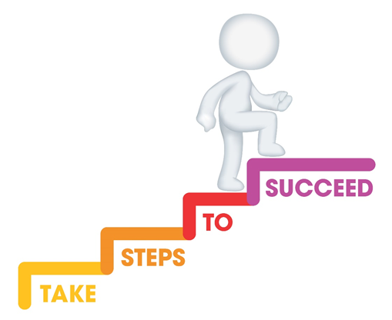





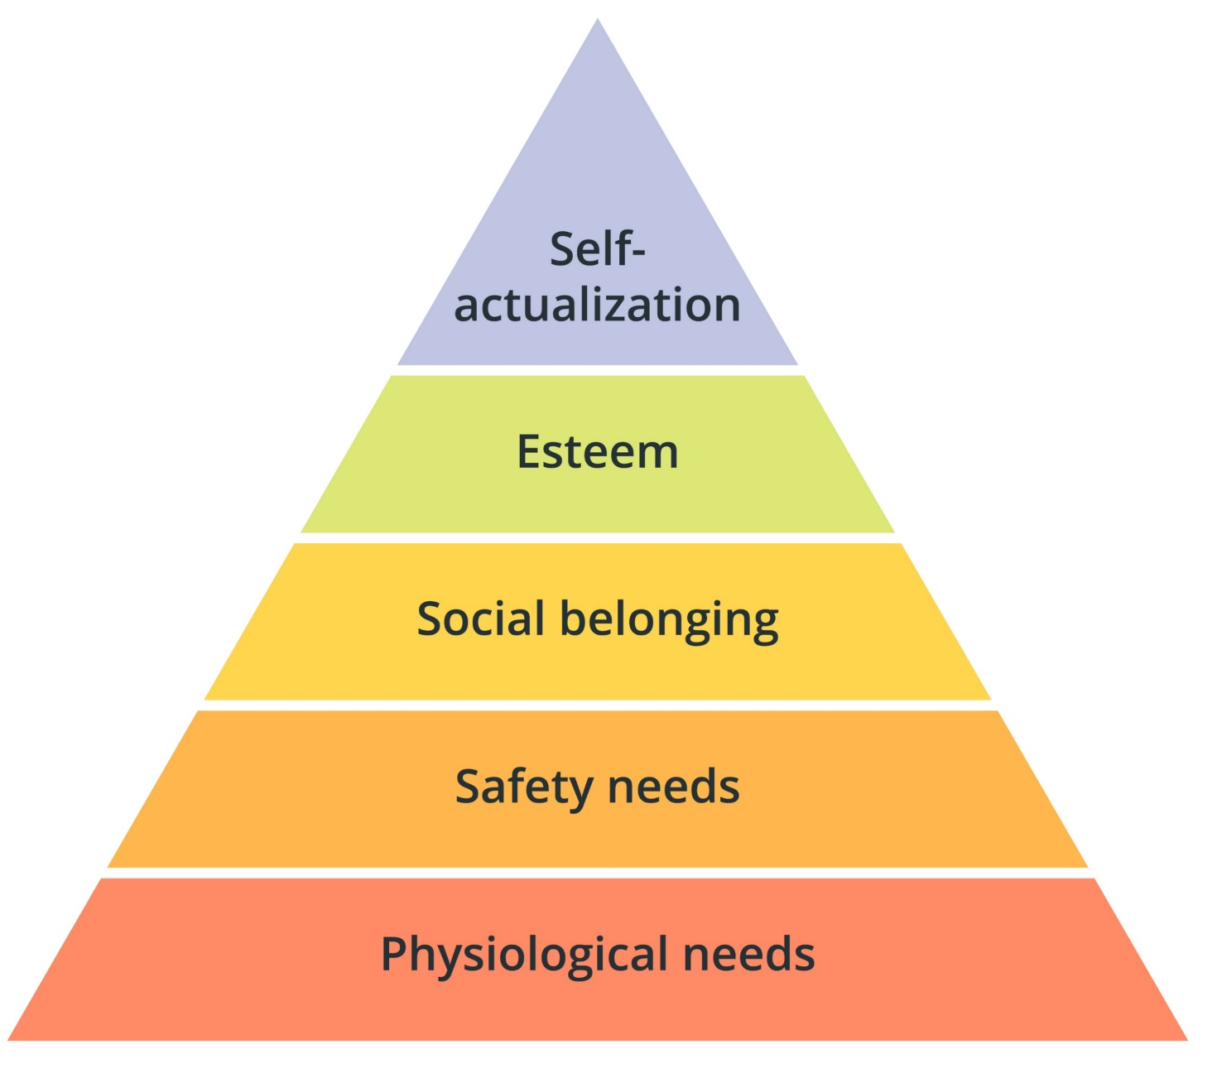

Do it now task | Success criteria | The bigger picture | New information | Application | Demonstrate success | Plenary
CA4 Revision
Last lesson Draw Maslow’s hierarchy of needs | Last lesson Define the term ‘basic needs’ and give an example Required to keep us alive and free from harm (e.g., food and drink, fresh air, rest and sleep, exercise, physical safety, emotional safety)
Last week What are the four types of play? Physical play Creative play Imaginative play | Last topic What is the difference between nature and nurture? Nature = biological influence Nurture = environmental influence
Todays date:
19/05/25
Notes:
https://www.youtube.com/watch?v=5gumm5mhL5M

Slide 2
Do it now task | Success criteria | The bigger picture | New information | Application | Demonstrate success | Plenary
CA4 Revision
Success Criteria
By the end of the lesson you should be able to…
Apply knowledge to exam style questions
Recall and state key definitions from Content Area 4
Notes:
https://www.youtube.com/watch?v=5gumm5mhL5M

Slide 3
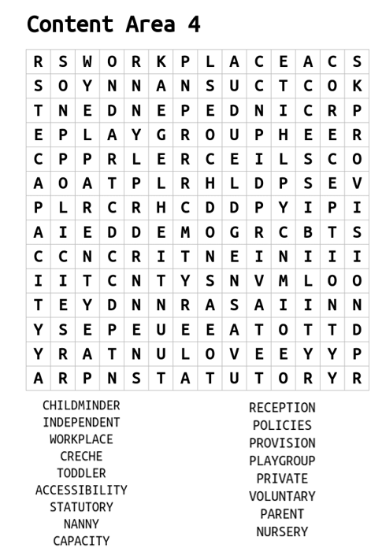
Do it now task | Success criteria | The bigger picture | New information | Application | Demonstrate success | Plenary
CA4 Revision
Task
Complete the wordsearch to find key terms from CA4
S&C – can you define any of the key terms
Notes:
https://www.youtube.com/watch?v=5gumm5mhL5M

Slide 4



Do it now task | Success criteria | The bigger picture | New information | Application | Demonstrate success | Plenary
CA4 Revision
Types of early year provision
Statutory | Provided in statute and funded by the government
Private | Profit making business where services are chargeable
Voluntary | Charities and not for profit organisations set up to meet the needs of the child and their families
Notes:
https://www.youtube.com/watch?v=5gumm5mhL5M

Slide 5
Do it now task | Success criteria | The bigger picture | New information | Application | Demonstrate success | Plenary
CA4 Revision
Early Years Setting | Setting/Location | Age Group | P/S/V
Crèche | Parent/carer stay on premises e.g. shopping centre | Up to 8 years
Childminder | Practitioner’s own home | Birth to early teens
Nursery | Nursery | 0 – 5 years
Pre-school | Community venues | 2 – 4 years
Nursery class | Connected to primary school | 3 – 4 years
Primary school | Primary school | 4 – 11 years
Types of Early Years Setting
Notes:
https://www.youtube.com/watch?v=5gumm5mhL5M

Slide 6
Do it now task | Success criteria | The bigger picture | New information | Application | Demonstrate success | Plenary
CA4 Revision
Purpose of Early Years Provision – why are the settings required?
Purpose: | Support parents and carers | Promote holistic development | Promote learning
Examples | seek or retain employment | physical | promote learning through the prime and specific areas of learning in the EYFS
 | receive respite (break) | cognitive | Prime: • communication & language • physical development • personal, social and emotional development
 | access training opportunities | social and emotional
 | participate in recreation and leisure activities (e.g. arts/crafts/gym) | language & communication | Specific: • literacy • mathematics • understanding the world • expressive arts and design
Notes:
https://www.youtube.com/watch?v=5gumm5mhL5M

Slide 7
Do it now task | Success criteria | The bigger picture | New information | Application | Demonstrate success | Plenary
CA4 Revision
EYFS
EYFS - Early Years Foundation Stage – the curriculum that children learn 0 – 5 years.
Prime - Areas of learning that are particularly important for building a foundation for igniting children’s curiosity, enthusiasm for learning, forming relationships and thriving. (personal, social and emotional development, physical development, communication and language)
Specific - Providers must also support children in four specific areas, through which the three prime areas are strengthened and applied. (literacy, mathematics, understanding the world, expressive arts and design)
The Early Years Foundation Stage (EYFS) sets the standards that all early years providers must meet to ensure that children learn and develop well and are kept healthy and safe.
It promotes teaching and learning to ensure children’s ‘school readiness’ and gives children the broad range of knowledge and skills that provide the right foundation for good future progress through school and life.
Notes:
https://www.youtube.com/watch?v=5gumm5mhL5M

Slide 8
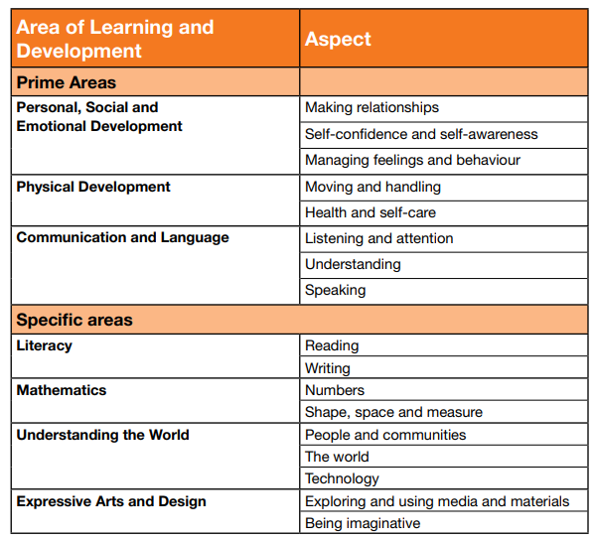
Do it now task | Success criteria | The bigger picture | New information | Application | Demonstrate success | Plenary
CA4 Revision
Notes:
https://www.youtube.com/watch?v=5gumm5mhL5M

Slide 9
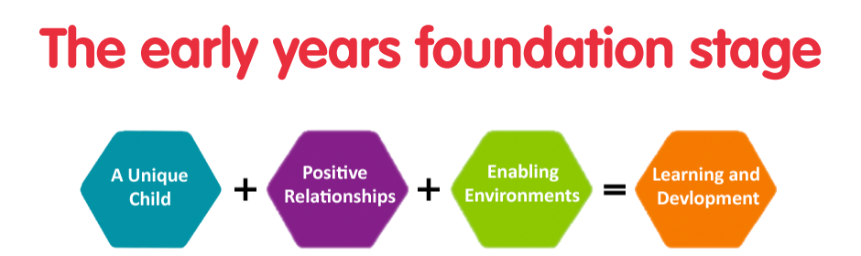
Do it now task | Success criteria | The bigger picture | New information | Application | Demonstrate success | Plenary
CA4 Revision
All early years provisions need to promote learning to meet the early years learning goals within the statutory framework; The Early Years Foundation Scheme
Notes:
https://www.youtube.com/watch?v=5gumm5mhL5M

Slide 10
Do it now task | Success criteria | The bigger picture | New information | Application | Demonstrate success | Plenary
CA4 Revision
 | Description | What an EYP can do
Unique child | Every child is a unique child, who is constantly learning and can be resilient, capable, confident and self-assured | understand and observe each child’s development and learning, assess progress, plan for next steps support babies and children to develop a positive sense of their own identity and culture identify any need for additional support keep children safe value and respect all children and families equally
Positive relationships | Children learn to be strong and independent through positive relationships. | Help foster a sense of belonging Be sensitive and responsive to the child’s needs, feelings and interests Be supportive of the child’s own efforts and independence Be consistent in setting clear boundaries Create a stimulating learning environment Build on key person relationships in early years settings
Notes:
https://www.youtube.com/watch?v=5gumm5mhL5M

Slide 11
Do it now task | Success criteria | The bigger picture | New information | Application | Demonstrate success | Plenary
CA4 Revision
 | Description | What an EYP can do
Enabling Environment | Children learn and develop well in enabling environments, in which their experiences respond to their individual needs and there is a strong partnership between practitioners and parents and carers. | Enabling Environments are created by the provision if they: value all people value learning
Learning & Development | Children develop and learn in different ways. The framework covers the education and care of all children in early years provision, including children with special educational needs and disabilities. | Practitioners teach children by ensuring challenging, playful opportunities across the prime and specific areas of learning and development. They foster the characteristics of effective early learning: Playing and exploring Active learning Creating and thinking critically
Notes:
https://www.youtube.com/watch?v=5gumm5mhL5M

Slide 12
Do it now task | Success criteria | The bigger picture | New information | Application | Demonstrate success | Plenary
CA4 Revision
Although all early years settings must follow the EYFS statutory guidance, there are still variations between settings
Variation – change or slight difference
Notes:
https://www.youtube.com/watch?v=5gumm5mhL5M

Slide 13
Do it now task | Success criteria | The bigger picture | New information | Application | Demonstrate success | Plenary
CA4 Revision
Location
Number of children
Eligibility/admissions criteria
Opening times
Ratio of staff to children
Accessibility
Capacity
Cost
Variation in early years provision
Indoor environment
To learning activities
Approach
Facilities
Outdoor environment
Policies
Resources
Procedures
Notes:
https://www.youtube.com/watch?v=5gumm5mhL5M

Slide 14
Do it now task | Success criteria | The bigger picture | New information | Application | Demonstrate success | Plenary
CA4 Revision
Resources and activities available
Location
What factors could influence parental choice?
Cost
Staff
Ofsted reports
Recommendations from other parents
Notes:
https://www.youtube.com/watch?v=5gumm5mhL5M

Slide 15
Do it now task | Success criteria | The bigger picture | New information | Application | Demonstrate success | Plenary
CA4 Revision
Have a go at these PPQs
State what is meant by statutory provision [1 mark]
List four types of early years settings. [4 mark]
Explain how can opening times of an early years setting influence parental choice? [2 mark]
As a qualified early years worker Sarah could work in a nursery school. Name three (3) other early years settings that Sarah could work in as a qualified early years worker. [3 marks]
List two ways a setting can vary which may influence parental options for childcare. [2 mark]
Choose one variation from 4a. Explain how or why this may affect parental decision. [2 marks]
Notes:
https://www.youtube.com/watch?v=5gumm5mhL5M

Slide 16
Do it now task | Success criteria | The bigger picture | New information | Application | Demonstrate success | Plenary
CA4 Revision
1. State what is meant by statutory provision? [1 mark]
2. List four types of early years settings. [4 mark]
Services that have to be available by law.
Services provided in statute and funded by the government.
Crèche
Childminder
Nursery
Pre-school
Nursery class
Primary school
Notes:
https://www.youtube.com/watch?v=5gumm5mhL5M

Slide 17
Do it now task | Success criteria | The bigger picture | New information | Application | Demonstrate success | Plenary
CA4 Revision
3. Explain how can opening times of an early years setting influence parental choice? [2 mark]
They might not open until after the parent needs to be at work, and might close before they can get to pick them up, so the service can’t take them when they need them to.
Notes:
https://www.youtube.com/watch?v=5gumm5mhL5M

Slide 18
Do it now task | Success criteria | The bigger picture | New information | Application | Demonstrate success | Plenary
CA4 Revision
Award one mark for each relevant setting named, up to a maximum of three marks.
For example:
• pre-school (1)
• day nursery (1)
• childminders (1)
• primary school (1)
• before and after school club (1)
• holiday club (1)
• crèche (1)
• children’s centre (1).
Do not credit nursery school as this is in the question. Accept any other suitable response.
4. As a qualified early years worker Sarah could work in a nursery school.
Name three (3) other early years settings that Sarah could work in as a qualified early years worker.
[3 marks]
Notes:
https://www.youtube.com/watch?v=5gumm5mhL5M

Slide 19
Do it now task | Success criteria | The bigger picture | New information | Application | Demonstrate success | Plenary
CA4 Revision
Accessibility:
cost
eligibility and admissions criteria
Location
opening times
Capacity:
number of children
ratio of staff to children
Facilities:
indoor environment
outdoor environment
resources
Approach:
to learning activities
Policies
procedures
5 (a) List two ways a setting can vary which may influence parental options for childcare. [2 mark]
5 (b) Choose one variation from 4b. Explain how or why this may affect parental decision
[2 marks]
Notes:
https://www.youtube.com/watch?v=5gumm5mhL5M

