Slide 1

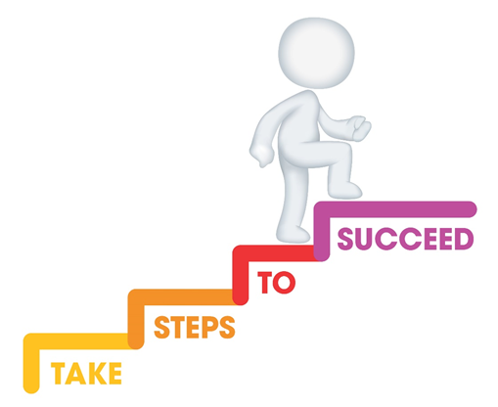




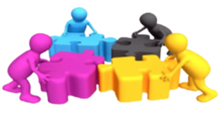

Do it now task | Success criteria | The bigger picture | New information | Application | Demonstrate success | Plenary
CA3 Revision
Todays date:
12/05/25
Last lesson Define the term transition | Last lesson Give one example of a transition
Last week What is the difference between nature and nurture? | Last topic Define holistic development
Notes:
https://www.youtube.com/watch?v=5gumm5mhL5M

Slide 2
Do it now task | Success criteria | The bigger picture | New information | Application | Demonstrate success | Plenary
CA3 Revision
Last lesson Define the term transition A change of place, family circumstance and/or carer | Last lesson Give one example of a transition Going to school Arrival of a new sibling Moving house Family breakdown Death/illness of a family member
Last week What is the difference between nature and nurture? Nature – biological influence Nurture – environmental influence | Last topic Define holistic development Overall development including physical, cognitive, communication and language, emotional and social
Todays date:
12/05/25
Notes:
https://www.youtube.com/watch?v=5gumm5mhL5M

Slide 3
Do it now task | Success criteria | The bigger picture | New information | Application | Demonstrate success | Plenary
CA3 Revision
Success Criteria
By the end of the lesson you should be able to…
Apply knowledge to exam style questions
Recall and state key definitions from Content Area 3
Notes:
https://www.youtube.com/watch?v=5gumm5mhL5M

Slide 4
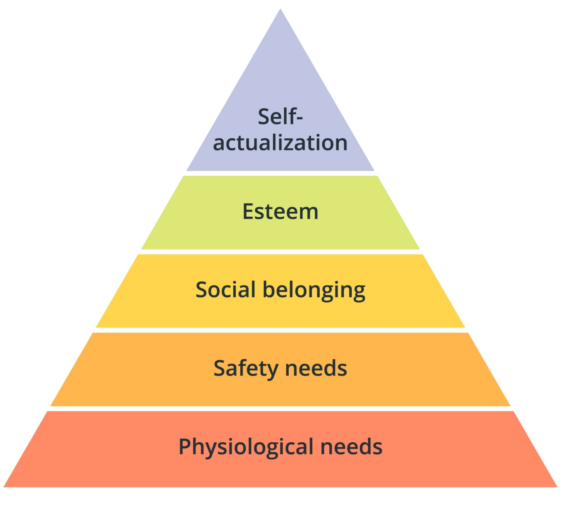
Do it now task | Success criteria | The bigger picture | New information | Application | Demonstrate success | Plenary
CA3 Revision
Maslow’s Hierarchy of Needs
Definition:
A motivational theory where individuals are motivated by their needs. When individual’s basic needs are not met they may not be able to progress to meet their more complex needs.
Notes:
https://www.youtube.com/watch?v=5gumm5mhL5M

Slide 5
Do it now task | Success criteria | The bigger picture | New information | Application | Demonstrate success | Plenary
CA3 Revision
Maslow’s Hierarchy of Needs
Physiological needs are basic needs that keep us alive and functioning.
Safety needs help to keep us safe and secure.
Love and belonging give us a sense of belonging.
Esteem needs give us a sense of self purpose and help us achieve positive self-concept.
Self-actualisation is when we have achieved all our goals and have reached our full potential.
Notes:
https://www.youtube.com/watch?v=5gumm5mhL5M

Slide 6

Do it now task | Success criteria | The bigger picture | New information | Application | Demonstrate success | Plenary
CA3 Revision
Psychological needs are more psychological needs that relate to our emotions and fulfil an intrinsic desire.
Basic needs are required to keep us alive and free from harm.
Basic needs:
Food and drink
Fresh air
Rest and sleep
Exercise
Physical safety
Emotional safety
Shelter
Psychological needs:
Sense of belonging
Affection
Sense of achievement
Feeling valued
Establishing emotional boundaries
Notes:
https://www.youtube.com/watch?v=5gumm5mhL5M

Slide 7
Do it now task | Success criteria | The bigger picture | New information | Application | Demonstrate success | Plenary
CA3 Revision
Food and drink | Provide healthy daily meals and snacks. Give access to drinking water.
Fresh air | Plan regular opportunities for outdoor play. Provide trips outside the setting.
Rest and sleep | Make quiet activities available. Schedule nap times.
Exercise | Provide access to climbing equipment. Offer times for physical movement such as dancing.
Physical safety | Check equipment for faults. Make sure doors and gates are locked. Do not use physical punishment.
Emotional safety | Provide a consistent key person. Arrange small group play. Be a caring practitioner. Ensure bullying is not tolerated.
Shelter | Provide a warm and welcoming environment, Provide areas shaded from the sun.
How can an early years practitioner support basic needs?
Notes:
https://www.youtube.com/watch?v=5gumm5mhL5M

Slide 8
Do it now task | Success criteria | The bigger picture | New information | Application | Demonstrate success | Plenary
CA3 Revision
Sense of belonging | Respond to the child’s interests. Encourage the child to join in. Provide opportunities to interact with others.
Affection | Comfort a child when distressed. Show empathy.
Sense of achievement | Praise the child’s efforts not just the end result. Recognise positive behaviour.
Feeling valued | Display the child’s artwork. Show an interest in the child’s culture. Listen attentively to the child. Recognise their needs.
Establishing emotional boundaries | Provide consistency with rules.
How can an early years practitioner support psychological needs?
Notes:
https://www.youtube.com/watch?v=5gumm5mhL5M

Slide 9
Do it now task | Success criteria | The bigger picture | New information | Application | Demonstrate success | Plenary
CA3 Revision
Support their levels of concentration so they can learn new things.
Help them to grow physically and mentally strong and healthy.
How will meeting children’s needs support their holistic development?
Increase their positive self-concept.
Enable them to interact with more people and develop their communication skills and their social skills.
Make them more resilient and willing to try again if something is difficult.
Notes:
https://www.youtube.com/watch?v=5gumm5mhL5M

Slide 10
Do it now task | Success criteria | The bigger picture | New information | Application | Demonstrate success | Plenary
CA3 Revision
How can these routines promote the independence, health, safety, and wellbeing of a child?
Getting dressed | Mealtimes | Toileting/washing | Bedtime
Decision making Choice Self-esteem Fine motor skills | Decision making Self-reliance Problem solving Healthy diet | Self-care Self-reliance Protection from infection | Healthy wellbeing Choice Decision making Self-care
Notes:
https://www.youtube.com/watch?v=5gumm5mhL5M

Slide 11
Do it now task | Success criteria | The bigger picture | New information | Application | Demonstrate success | Plenary
CA3 Revision
Working in partnership with the parents/carers. This means that routines can be the same at home and nursery for consistency.
Make it fun.
How can an EYP support the child to establish routines?
Provide resources to show the child the routine. For example, pictures to show how to brush teeth.
Ensure the routine is age and stage appropriate for the child.
Be consistent so the child becomes familiar with the routine.
Notes:
https://www.youtube.com/watch?v=5gumm5mhL5M

Slide 12
Do it now task | Success criteria | The bigger picture | New information | Application | Demonstrate success | Plenary
CA3 Revision
Child-initiated play is any play activity that has been started by the child and has little or no adult involvement. It stems from the child’s interest and experiences.
Adult-led play is any play activity that has been planned by an adult and has adult involvement within the activity.
Notes:
https://www.youtube.com/watch?v=5gumm5mhL5M

Slide 13
Do it now task | Success criteria | The bigger picture | New information | Application | Demonstrate success | Plenary
CA3 Revision
 | Child-initiated play | Adult-led play
Strengths | Follows the child’s interests. Provides independence as the child is in control. Develops children’s creativity and imagination. Supports natural development. Increases concentration as the activity is chosen by the child. | Provides structure to the activity. Can focus on specific areas of development. Can support children to use new resources safely. Often encourages participation from all children. Provides guidance for the children
Weaknesses | Can limit learning opportunities without adult input. A child may choose to do the same activity every day and avoid others | Can limit learning opportunities. The child may not engage for long if they are not interested. Can stifle a child’s creativity and imagination.
Notes:
https://www.youtube.com/watch?v=5gumm5mhL5M

Slide 14
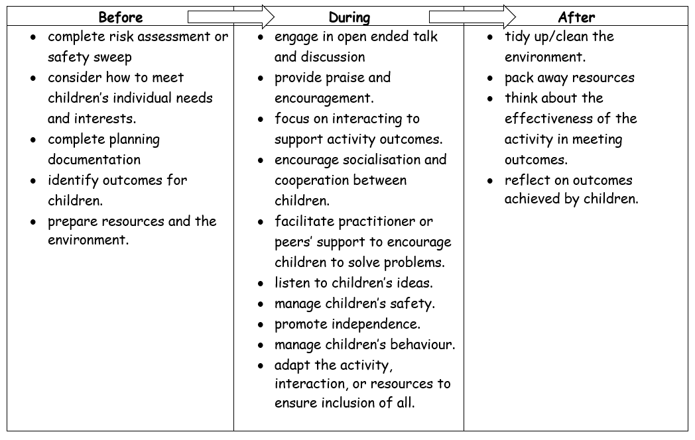
Do it now task | Success criteria | The bigger picture | New information | Application | Demonstrate success | Plenary
CA3 Revision
Role of the early year practitioner during play activities (before, during and after)
Notes:
https://www.youtube.com/watch?v=5gumm5mhL5M

Slide 15
Do it now task | Success criteria | The bigger picture | New information | Application | Demonstrate success | Plenary
CA3 Revision
Stages of play
0-3 months | Unoccupied Play | This is when babies are exploring their surroundings by moving their arms and legs.
0-2 years | Solitary Play | This is when children play by themselves and seem to ignore others.
2 years | Onlooker Play | This is when children play by themselves but watch others playing.
Notes:
https://www.youtube.com/watch?v=5gumm5mhL5M

Slide 16
Do it now task | Success criteria | The bigger picture | New information | Application | Demonstrate success | Plenary
CA3 Revision
Stages of play
2-3 years | Parallel Play | This is when children play alongside each other but do not interact very much.
3-4 years | Associate Play | This is when children start to interact with each other but there is no organisation to the play.
4-5 years | Co-operative Play | Children play with each other in an organised manner where they all have roles and responsibilities in the activity.
Notes:
https://www.youtube.com/watch?v=5gumm5mhL5M

Slide 17
Do it now task | Success criteria | The bigger picture | New information | Application | Demonstrate success | Plenary
CA3 Revision
Types of Play
Physical play involves the use of the child’s fine or gross motor skills.
Creative play allows the child to explore and experiment using different media.
Imaginative play uses imagination to create different scenarios.
Sensory play involves using the senses to explore and experiment.
Notes:
https://www.youtube.com/watch?v=5gumm5mhL5M

Slide 18
Do it now task | Success criteria | The bigger picture | New information | Application | Demonstrate success | Plenary
CA3 Revision
Physical Play
Description | Benefits
Physical play involves the use of the child’s fine or gross motor skills. | Develop balance and co-ordination. Learn control of fine movements – hand-eye co-ordination. Learn new concepts – testing out their ideas. Increase their confidence. Explore a healthy wellbeing – physically and mentally.
Notes:
https://www.youtube.com/watch?v=5gumm5mhL5M

Slide 19
Do it now task | Success criteria | The bigger picture | New information | Application | Demonstrate success | Plenary
CA3 Revision
Creative Play
Description | Benefits
Creative play allows children to explore and experiment using different media | Encourages creativity and freedom of thought. Increases logical thinking. Allows children to explore their emotions Develops confidence. Allows children to express themselves without complex vocabulary. Develops new vocabulary.
Notes:
https://www.youtube.com/watch?v=5gumm5mhL5M

Slide 20
Do it now task | Success criteria | The bigger picture | New information | Application | Demonstrate success | Plenary
CA3 Revision
Imaginative Play
Description | Benefits
Imaginative play resources enable children to use their ideas to create a world of unlimited possibilities. | fosters creativity by providing a safe space for children to act out scenarios of their choosing promotes physical development in a fun way practice and develop their language and social skills boosts the development of problem-solving and self-regulation skills
Notes:
https://www.youtube.com/watch?v=5gumm5mhL5M

Slide 21
Do it now task | Success criteria | The bigger picture | New information | Application | Demonstrate success | Plenary
CA3 Revision
Sensory Play
Description | Benefits
Sensory resources can be anything that enable children to use their senses to explore. | Explore different textures, tastes and smells. Allows children to express their emotions. Develop their confidence. Explore new concepts. Support fine motor skills through small muscle movement. Extend vocabulary and communication skills.
Notes:
https://www.youtube.com/watch?v=5gumm5mhL5M

Slide 22
Do it now task | Success criteria | The bigger picture | New information | Application | Demonstrate success | Plenary
CA3 Revision
Have a go at these past paper questions
What is a basic care need and give an example? (2 marks)
Identify 4 basic care routines (4 marks)
What is Maslow’s hierarchy of needs? (3 marks
Discuss the role of the EYP before, during and after play activities (6 marks)
Identify and describe the different play types (8 marks)
Notes:
https://www.youtube.com/watch?v=5gumm5mhL5M

Slide 23
Do it now task | Success criteria | The bigger picture | New information | Application | Demonstrate success | Plenary
CA3 Revision
What is a basic care need and give an example? (2 marks)
A need which is necessary to be met in order for a child to survive, for example food and drink
Example: Food and drink, Fresh air, rest and sleep, exercise, physical safety, emotional safety, shelter
Notes:
https://www.youtube.com/watch?v=5gumm5mhL5M

Slide 24
Do it now task | Success criteria | The bigger picture | New information | Application | Demonstrate success | Plenary
CA3 Revision
Identify 4 basic care routines (4 marks)
Getting dressed
Mealtimes
Toileting/ washing routines
Rest and sleep
Notes:
https://www.youtube.com/watch?v=5gumm5mhL5M

Slide 25
Do it now task | Success criteria | The bigger picture | New information | Application | Demonstrate success | Plenary
CA3 Revision
What is Maslow’s hierarchy of needs? (3 marks
A motivational theory where individuals are motivated by their needs as human beings. When individuals basic needs are unmet they may not be able to progress to meet their more complex needs.
Notes:
https://www.youtube.com/watch?v=5gumm5mhL5M

Slide 26
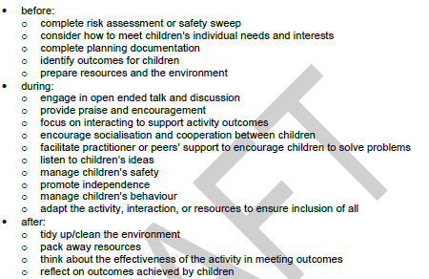
Do it now task | Success criteria | The bigger picture | New information | Application | Demonstrate success | Plenary
CA3 Revision
Discuss the role of the EYP before, during and after play activities (6 marks)
Notes:
https://www.youtube.com/watch?v=5gumm5mhL5M

Slide 27
Do it now task | Success criteria | The bigger picture | New information | Application | Demonstrate success | Plenary
CA3 Revision
Identify and describe the different play types (8 marks)
Physical play – activities involving the use of fine and gross motor skills to develop children’s balance, coordination, confidence and healthy wellbeing. Children could use balls, construction toys, rattles or climbing apparatus.
Creative play – Play which allows children to explore, experiment and use different media to develop new concepts, new language, confidence and problem solving. Children could use paint, clay, chalk, natural resources or musical instruments to take part in creative play.
Imaginative play – the use of the child’s imagination to create different scenarios to develop the expression of children’s feelings, the control of fine motor skills, their relationships and communication skills.
Sensory play – Play which stimulates the child’s senses to develop the expression of their feelings, hand eye coordination, concentration and new concepts. Sensory play might compromise the use of dough, scented dough, corn flour, slime, sand, water, shaving foam, paint and instruments.
Notes:
https://www.youtube.com/watch?v=5gumm5mhL5M

