Slide 1

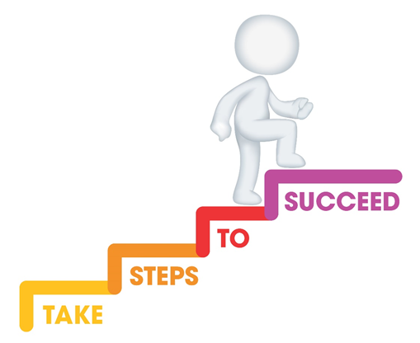




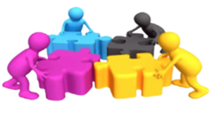

Do it now task | Success criteria | The bigger picture | New information | Application | Demonstrate success | Plenary
CA2 Revision Booklet
Todays date:
28/04/25
Last lesson Define holistic development | Last lesson Give one key milestone for physical development
Last week Give one key milestone for cognitive development | Last topic
Notes:
https://www.youtube.com/watch?v=5gumm5mhL5M

Slide 2
Do it now task | Success criteria | The bigger picture | New information | Application | Demonstrate success | Plenary
CA2 Revision Booklet
Success Criteria
By the end of the lesson you should be able to…
Apply knowledge to exam style questions
Identify examples of transitions and explain the impact on children’s holistic development
Recall and state key definitions from Content Area 2
Notes:
https://www.youtube.com/watch?v=5gumm5mhL5M

Slide 3
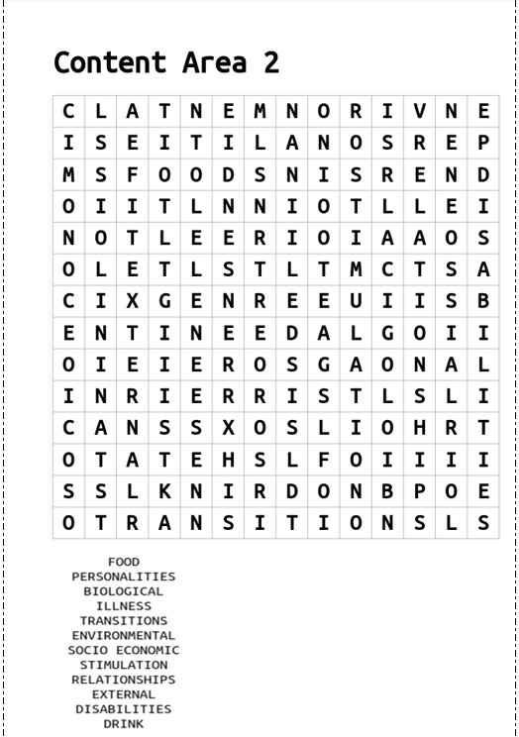
Do it now task | Success criteria | The bigger picture | New information | Application | Demonstrate success | Plenary
CA2 Revision Booklet
Task
Complete the word search to find the key terms from CA2
S&C – can you define any of these key terms?
Notes:
https://www.youtube.com/watch?v=5gumm5mhL5M

Slide 4
Do it now task | Success criteria | The bigger picture | New information | Application | Demonstrate success | Plenary
CA2 Revision Booklet
Nurture
- Environmental factors
Nature
- Genetics
Biological factors
- Genetic factors, brain functions, neurotransmitters, the endocrine system (glands/organs), and our physical health.
Transitions
A change of place, family circumstances and/or carer.
Key terms
Socio-economic factors
- Income, education, employment, community safety and social support.
Environmental factors
Social environment (school and community)
Emotional environment (relationships at home)
Economic environment
Family Lifestyle factors
- Dynamic of relationships, roles, and responsibilities within a family unit
Notes:
https://www.youtube.com/watch?v=5gumm5mhL5M

Slide 5
Do it now task | Success criteria | The bigger picture | New information | Application | Demonstrate success | Plenary
CA2 Revision Booklet
Nature - Biological
Biological factors | Example
Physical traits – some are linked to genetic inheritance. | Height, physical strength, face shape, eye colour.
Medical conditions - most are linked to genetic inheritance. | Diabetes, asthma, sickle cell anaemia.
Learning difficulties – are most likely as a result of genetic inheritance. | Autistic spectrum conditions, dyslexia.
Disabilities – some are linked to genetic inheritance, whilst others may occur during pregnancy and birth | Deafness, sight problems, cerebral palsy, spina bifida.
Personality & temperament | Shyness, curiosity, outgoing
Pregnancy & birth – how healthy a mother is during pregnancy can affect a child’s development | German measles, foetal alcohol syndrome, spina bifida, developmental difficulties.
Notes:
https://www.youtube.com/watch?v=5gumm5mhL5M

Slide 6
Do it now task | Success criteria | The bigger picture | New information | Application | Demonstrate success | Plenary
CA2 Revision Booklet
Nurture - Environmental
Environmental factors | Example
Love & interaction – children thrive if they feel loved & have plenty of positive attention from the adults who care for them. | Cuddles, time to talk, being spoken to positively, being listened to.
Stimulation & play –opportunities to play, talk and do different things. | Going to different places, doing different things, playing with adults and other children, sharing books.
Physical conditions/ socio-economic –shelter, warmth and room to move and explore. | Warm home, opportunities to go outdoors, space to play indoors.
Food & drink – children need food & drink that is nutritious and healthy – provides energy to explore, move and learn. | Developing good food habits including enjoying vegetables and foods high in nutrients.
Family Lifestyle | Abuse, neglect, drug/alcohol abuse, healthy diet, poor diet.
Personal factors are about inherited traits and also what happened before and immediately after you were born. External factors are about where and how you grew up. They also include the events and experiences that you have had.
Notes:
https://www.youtube.com/watch?v=5gumm5mhL5M

Slide 7
Do it now task | Success criteria | The bigger picture | New information | Application | Demonstrate success | Plenary
CA2 Revision Booklet
Transitions
Definition – a change of place, family circumstance and/or carer
- Going to a pre-school, nursery or childminder
- Death or illness of a family member
- Starting school
- Being cared for by a family member
Examples of transitions
- Family breakdown e.g. divorce
- Going to a club or class
- Changing group or class within a nursery, pre-school or school.
- Moving home
- Arrival of a new baby
Notes:
https://www.youtube.com/watch?v=5gumm5mhL5M

Slide 8
Do it now task | Success criteria | The bigger picture | New information | Application | Demonstrate success | Plenary
CA2 Revision Booklet
Impacts of transitions on a child’s development
Area of development | Impact from transition
Language development | Child not wanting to talk, finding it hard to listen and withdrawing.
Cognitive development | Concentration, memory may be limited, children need to be interested in what they are learning.
Social and emotional development | Anxiety, behavioural changes
Physical development | Loss of appetite. Sleep patterns can be impacted. Regression
Notes:
https://www.youtube.com/watch?v=5gumm5mhL5M

Slide 9
Do it now task | Success criteria | The bigger picture | New information | Application | Demonstrate success | Plenary
CA2 Revision Booklet
Adopt a child-centred approach:
Have realistic expectations of the child’s needs and interests
Find out about the child’s interests
Maintain consistency in care
Build positive relationships with the child and family:
Share information
Use effective communication
Establish care routines
Set clear boundaries
Be sensitive to needs
Show respect
Support strategies
Provide experiences for expression:
Imaginative play
Sensory experiences
Sharing books with the child
Notes:
https://www.youtube.com/watch?v=5gumm5mhL5M

Slide 10

Do it now task | Success criteria | The bigger picture | New information | Application | Demonstrate success | Plenary
CA2 Revision Booklet
What factors in Liam's life could be influencing his development? Consider both environmental and socioeconomic factors.
How might Sarah’s long work hours and financial stress impact Liam’s emotional development? (Hint: sense of security, attachment, and emotional well-being)
Based on the information in the case, suggest two strategies Sarah or Liam’s teacher could use to support his emotional and cognitive development.
Task
Read the case study about Liam and answer the questions
Notes:
https://www.youtube.com/watch?v=5gumm5mhL5M

Slide 11
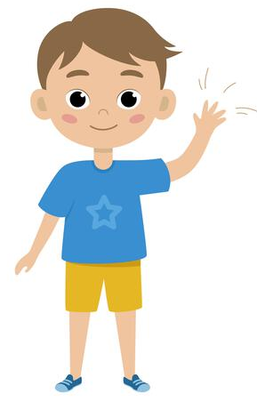
Do it now task | Success criteria | The bigger picture | New information | Application | Demonstrate success | Plenary
CA2 Revision Booklet
Describe the transition
Explain how holistic development can be affected by the transition
Explain how parent/carer can support the child with this transition
Explain how an Early Years Practitioner can support the child with this transition.
Task
Read the case study about Charlie and answer the questions
Notes:
https://www.youtube.com/watch?v=5gumm5mhL5M

Slide 12
Do it now task | Success criteria | The bigger picture | New information | Application | Demonstrate success | Plenary
CA2 Revision Booklet
Notes:
https://www.youtube.com/watch?v=5gumm5mhL5M

