Slide 1

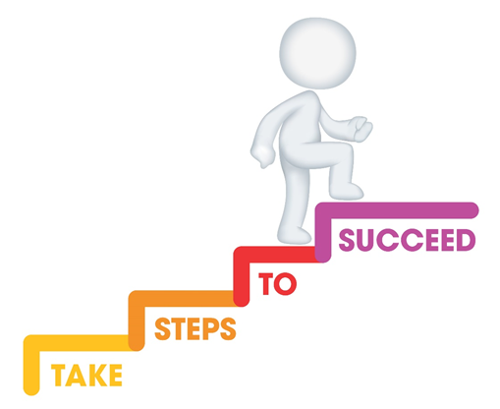







Do it now task | Success criteria | The bigger picture | New information | Application | Demonstrate success | Plenary
CA1 Revision Booklet
Todays date:
14/04/25
Do it now questions – Define holistic development What are the four areas of development? What is one transition a child may experience during childhood?
Stretch and challenge:
Define the term attachment
Notes:
https://www.youtube.com/watch?v=5gumm5mhL5M

Slide 2
Do it now task | Success criteria | The bigger picture | New information | Application | Demonstrate success | Plenary
CA1 Revision Booklet
Success Criteria
By the end of the lesson you should be able to…
Apply knowledge to exam style questions
Explain key milestones from birth to 0-5 years in reference to areas of development.
Recall and state key definitions from Content Area 1.
Notes:
https://www.youtube.com/watch?v=5gumm5mhL5M

Slide 3
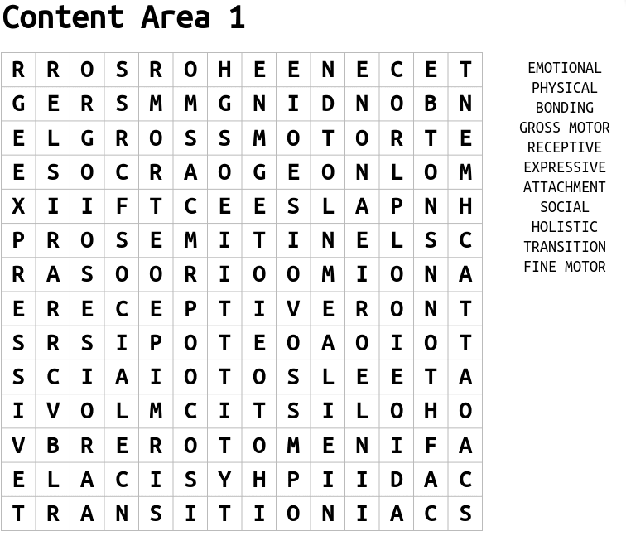
Do it now task | Success criteria | The bigger picture | New information | Application | Demonstrate success | Plenary
CA1 Revision Booklet
Task
Complete the wordsearch and find all the key terms from CA1
S&C – once completed, can you define any of the key terms?
Notes:
https://www.youtube.com/watch?v=5gumm5mhL5M

Slide 4
Do it now task | Success criteria | The bigger picture | New information | Application | Demonstrate success | Plenary
CA1 Revision Booklet
Physical development
Holistic development
Key Terms
Communication and language development
Transition
Task
Can you define all these key terms?
Social and emotional development
Cognitive development
Notes:
https://www.youtube.com/watch?v=5gumm5mhL5M

Slide 5
Do it now task | Success criteria | The bigger picture | New information | Application | Demonstrate success | Plenary
CA1 Revision Booklet
Holistic development -Overall development of a child
Physical development - movements, balance and co-ordination.
Communication and language development –
Talking, listening & understanding. Reading & writing for older children
Key Terms
Transition –
a change of place, family circumstances and/or carer.
Social and emotional development –
Relationships with others, managing feelings, confidence & self-control
Cognitive development –
Thinking, memory & understanding concepts such as time, colour & number
Notes:
https://www.youtube.com/watch?v=5gumm5mhL5M

Slide 6
Do it now task | Success criteria | The bigger picture | New information | Application | Demonstrate success | Plenary
CA1 Revision Booklet
Key terms for each area of development
Physical Development | Communication and Language development | Social & emotional development | Cognitive development
Fine motor – small movements often made using hands, such as picking up a spoon or using a pencil | Receptive language – what children can understand | Attachment – a close bond between the child & their parents | Object permanence – the ability to understand that objects when placed out of sight are still in existence
Gross motor – large movements such as running balancing & throwing. | Expressive language – what children can say | Bonding – the process by which children & parents develop a strong loving relationship | Trial by error – seeing what happens after an action has been made & learning from it.
Notes:
https://www.youtube.com/watch?v=5gumm5mhL5M

Slide 7
Do it now task | Success criteria | The bigger picture | New information | Application | Demonstrate success | Plenary
CA1 Revision Booklet
 | Birth | 1 year | 2 years | 3 years | 4 years | 5 years
Physical development (fine motor skills) | hands are firmly closed Often fold their thumb under fingers | Clasps hands together Points using index finger | Draws lines, dots and circles Separates interlocking toys | Fastens large zip Begins to show preference for dominant hand | Begins to fasten buttons Uses spoon and fork well to eat | Can use a knife and fork Can thread small beads
Notes:
https://www.youtube.com/watch?v=5gumm5mhL5M

Slide 8
Do it now task | Success criteria | The bigger picture | New information | Application | Demonstrate success | Plenary
CA1 Revision Booklet
 | Birth | 1 year | 2 years | 3 years | 4 years | 5 years
Physical development (gross motor skills) | Lies with head to one side Head lags when pulled to sitting position | Sits down from standing Is more mobile | Runs with control Throws and kicks a ball | Can walk backwards and sideways Jumps with both feet | Ride a tricycle Climb playground equipment with confidence | Can run with better speed and coordination May begin to ride a two-wheeled bicycle
Notes:
https://www.youtube.com/watch?v=5gumm5mhL5M

Slide 9
Do it now task | Success criteria | The bigger picture | New information | Application | Demonstrate success | Plenary
CA1 Revision Booklet
 | Birth | 1 year | 2 years | 3 years | 4 years | 5 years
Communication and language development | Cries to indicate needs Recognises main caregiver’s voice | Understands simple frequent words Babbles leading to spoken words | Uses 50 words or more Refers to self by name | Uses 200 words or more Joins in simple rhymes | Enjoys telling and sharing stories Can be understood easily by others | Shows signs of reading Concentrates and maintains attention
Notes:
https://www.youtube.com/watch?v=5gumm5mhL5M

Slide 10
Do it now task | Success criteria | The bigger picture | New information | Application | Demonstrate success | Plenary
CA1 Revision Booklet
 | Birth | 1 year | 2 years | 3 years | 4 years | 5 years
Social and emotional development | Expresses pleasure when being fed Often imitates facial expressions | Enjoys simple games Dependant on others | Frustrated when unable to express feelings May be clingy | Expresses emotions Enjoys playing with others | More confident in new situations Can be sensitive to others | Enjoys group play Has likes and dislikes
Notes:
https://www.youtube.com/watch?v=5gumm5mhL5M

Slide 11
Do it now task | Success criteria | The bigger picture | New information | Application | Demonstrate success | Plenary
CA1 Revision Booklet
 | Birth | 1 year | 2 years | 3 years | 4 years | 5 years
Cognitive development | Turns head towards bright light Startled by sudden noises | Understand simple instructions Responds to gestures | Understands consequences for actions Names pictures and objects in book | Recognises objects that are heavy and light Sorts objects by shape and size | Counts to 10 Names some colours | Can count to 20 Understand basic rules
Notes:
https://www.youtube.com/watch?v=5gumm5mhL5M

Slide 12
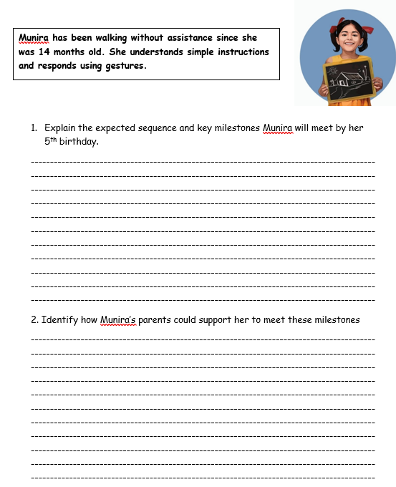
Do it now task | Success criteria | The bigger picture | New information | Application | Demonstrate success | Plenary
CA1 Revision Booklet
Task
Read the case study and answer the exam style questions
Notes:
https://www.youtube.com/watch?v=5gumm5mhL5M

Slide 13
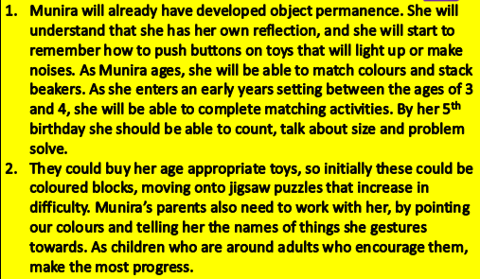
Do it now task | Success criteria | The bigger picture | New information | Application | Demonstrate success | Plenary
CA1 Revision Booklet
Notes:
https://www.youtube.com/watch?v=5gumm5mhL5M

Slide 14
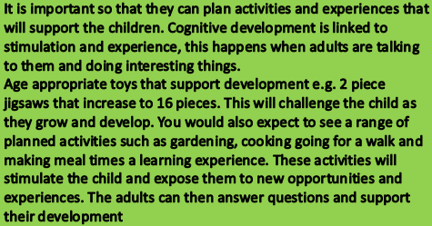
Do it now task | Success criteria | The bigger picture | New information | Application | Demonstrate success | Plenary
CA1 Revision Booklet
Notes:
https://www.youtube.com/watch?v=5gumm5mhL5M

